Slide 1
The ADS: sustainable digital archiving and value added
Julian Richards, Director
Archaeology Data Service
APA Conference, ESA, Frascati, 6-7 November 2012

Slide 2
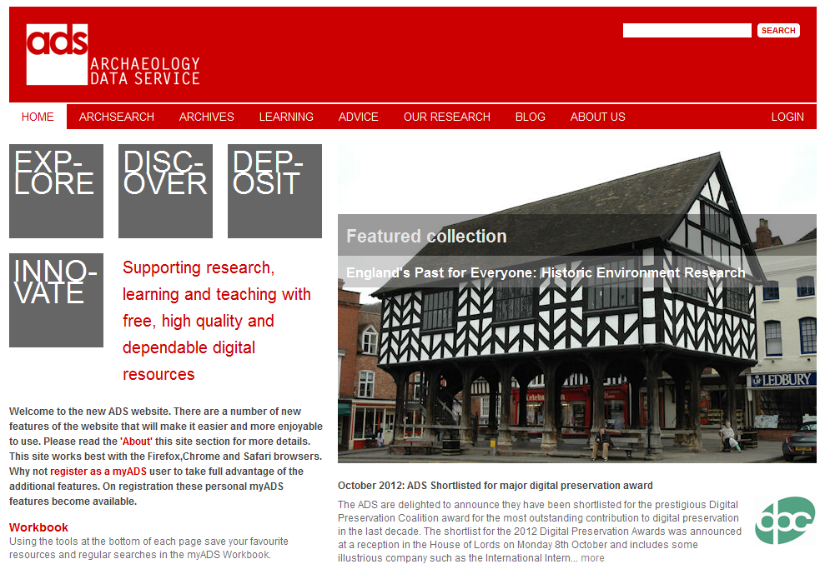

Slide 3
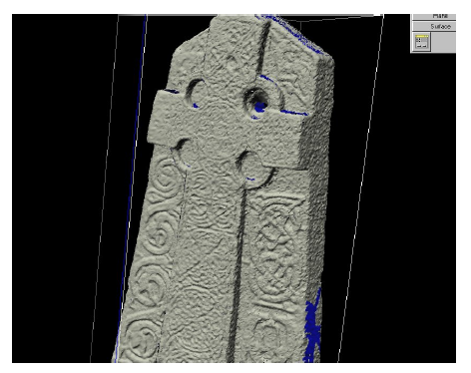
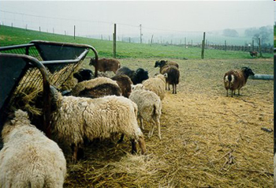
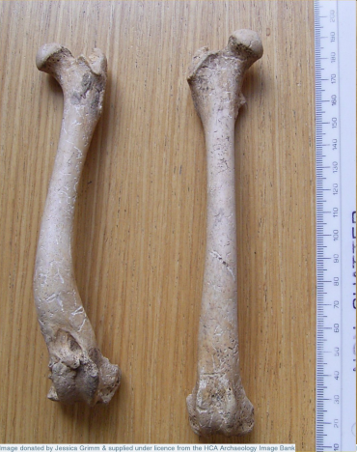
Supporting research, learning and teaching with free, high quality and dependable digital resources
Digital preservation
Free access to data via the Internet
Guidance and support for data creators

Slide 4
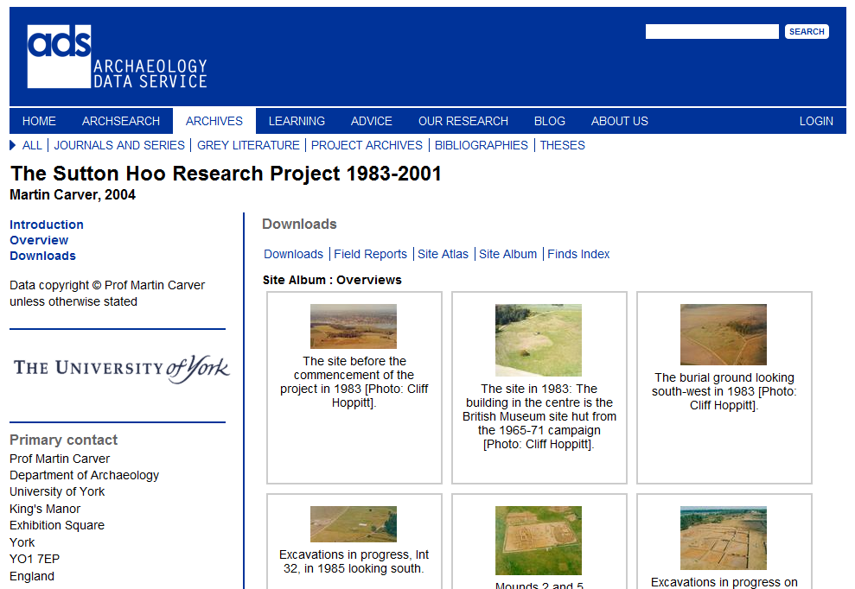

Slide 5
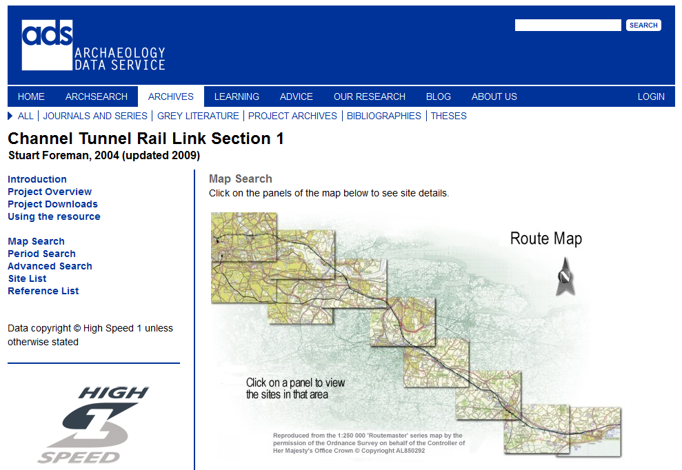

Slide 6
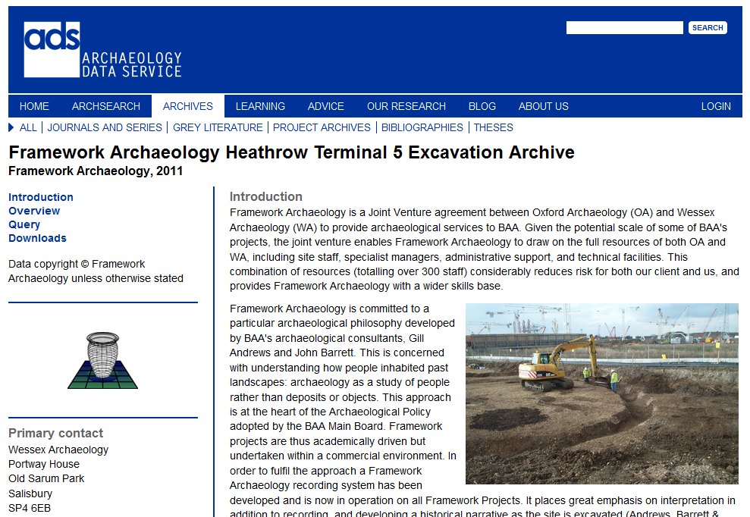

Slide 7
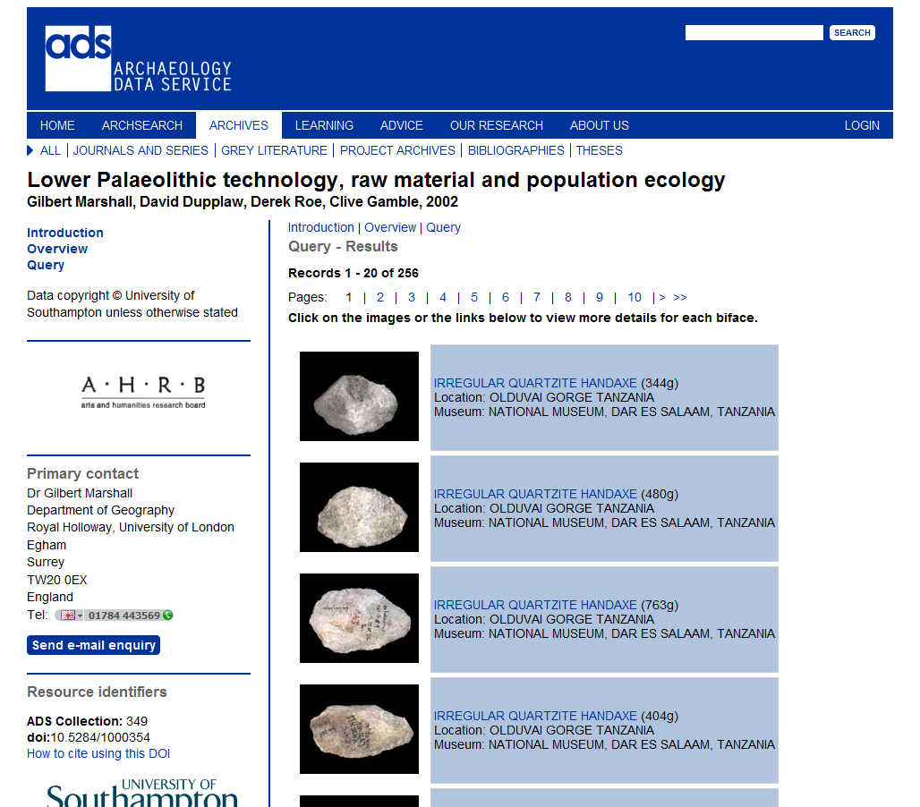

Slide 8
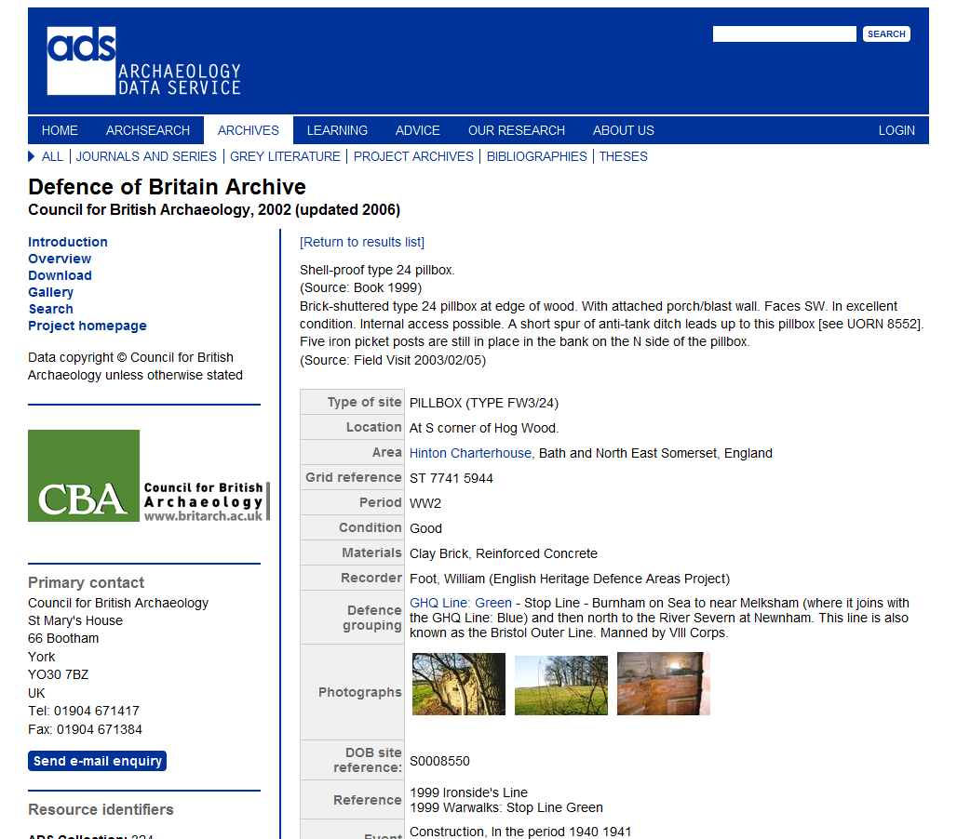

Slide 9
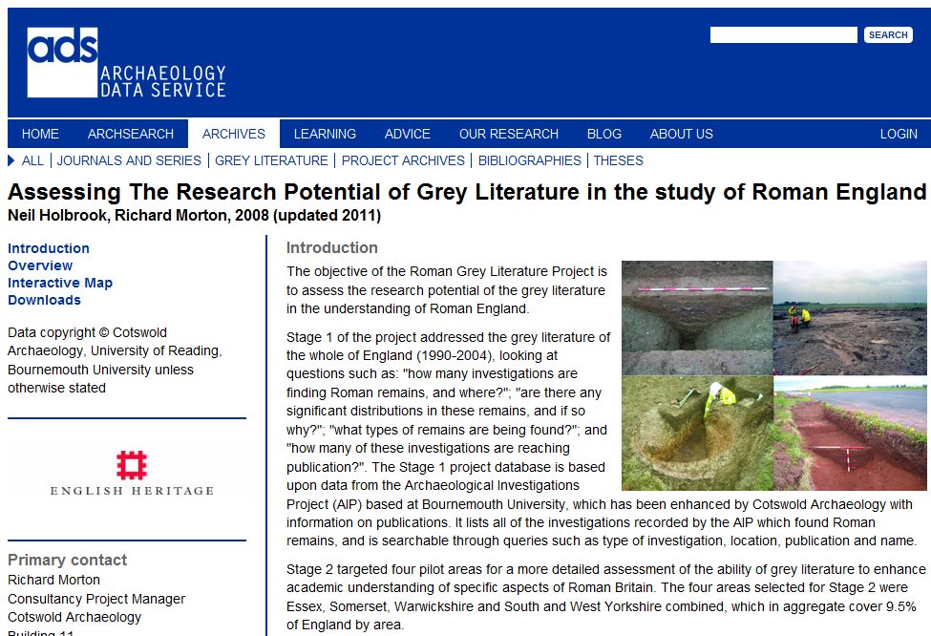

Slide 10

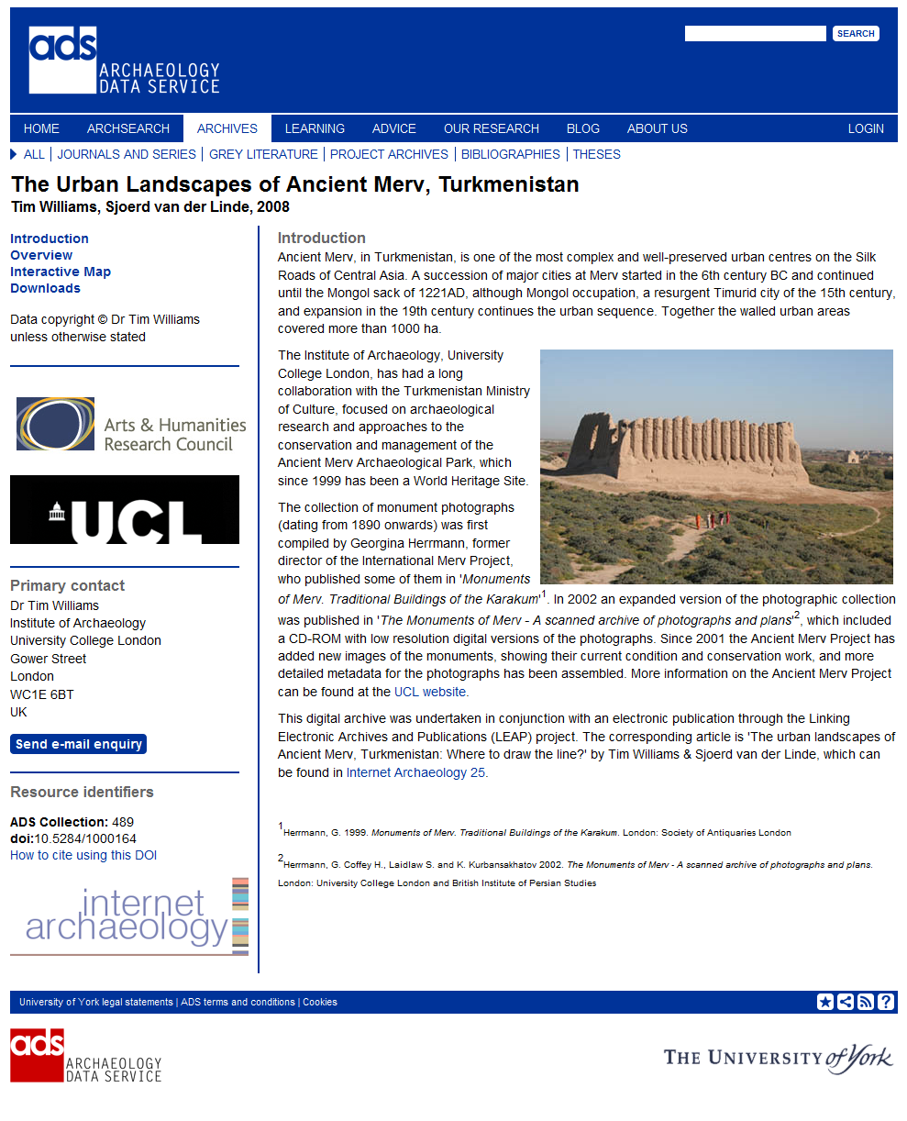
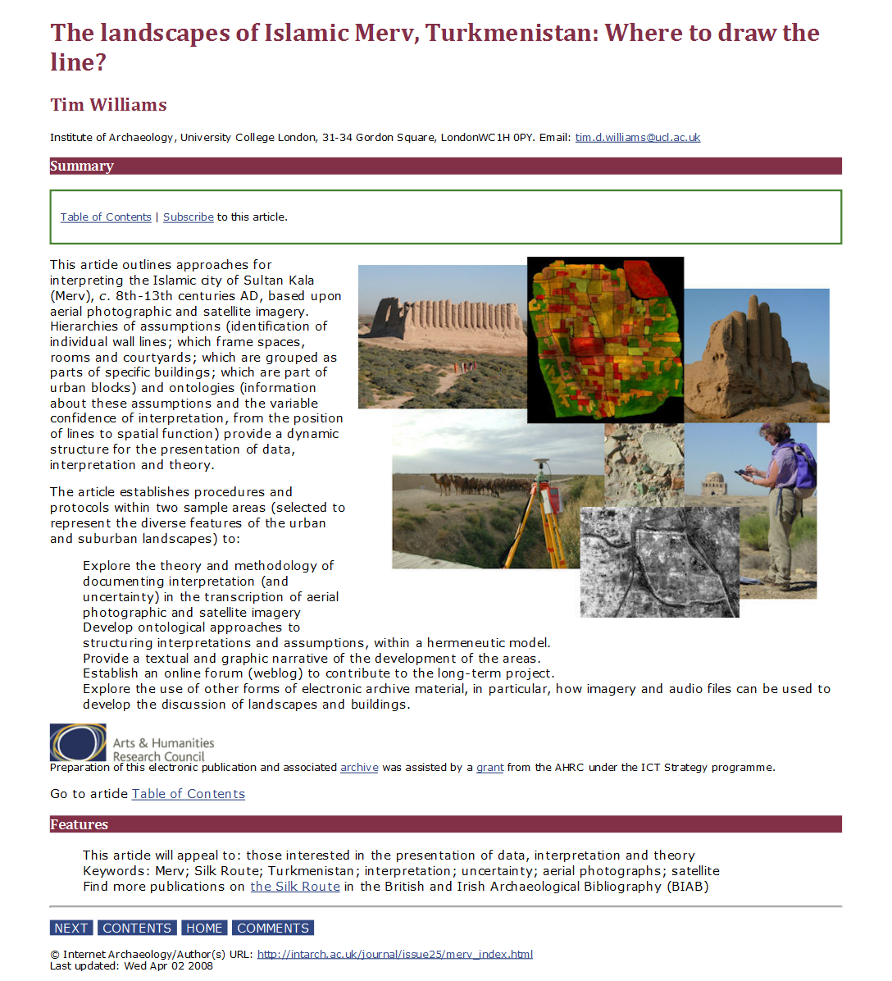
British Archaeological Awards 2008 Best Archaeological Innovation

Slide 11
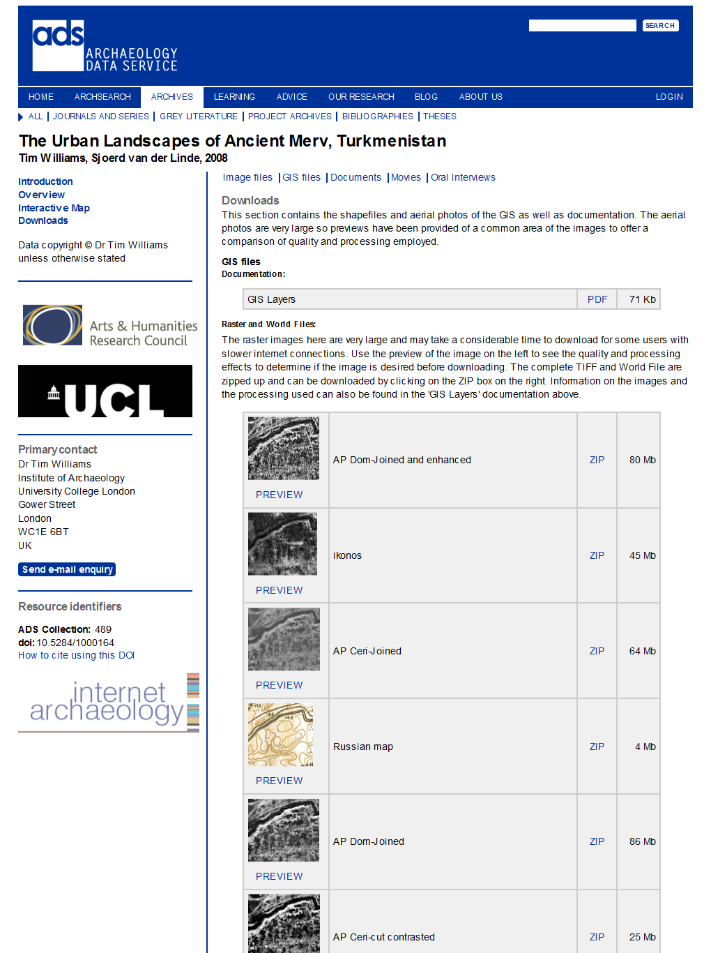
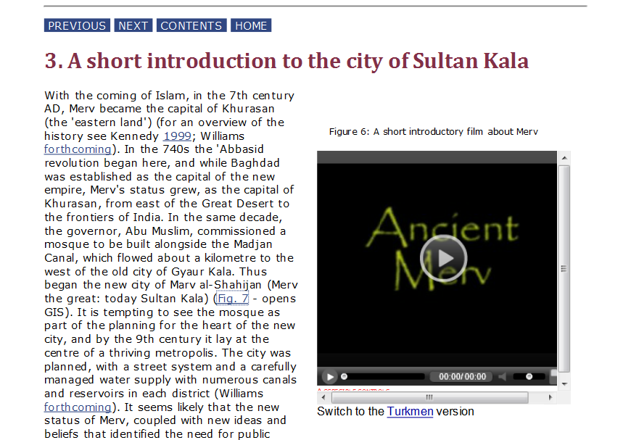
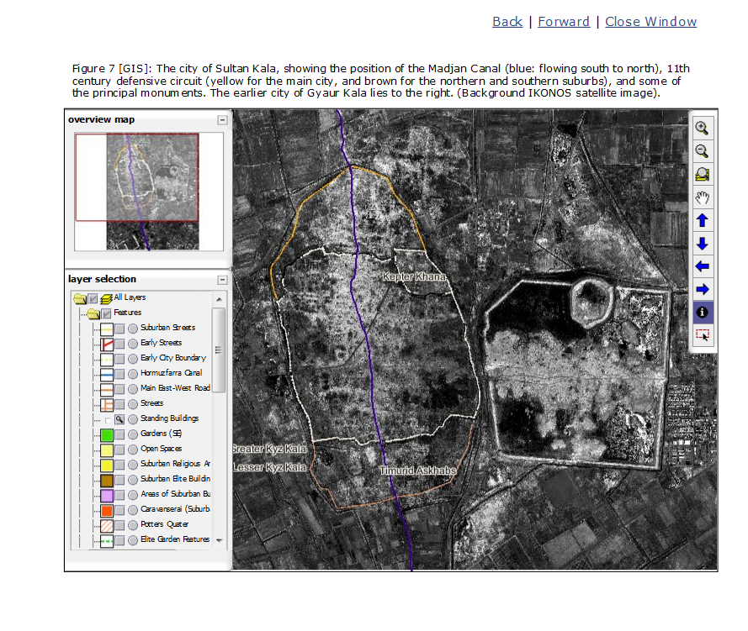

Slide 12
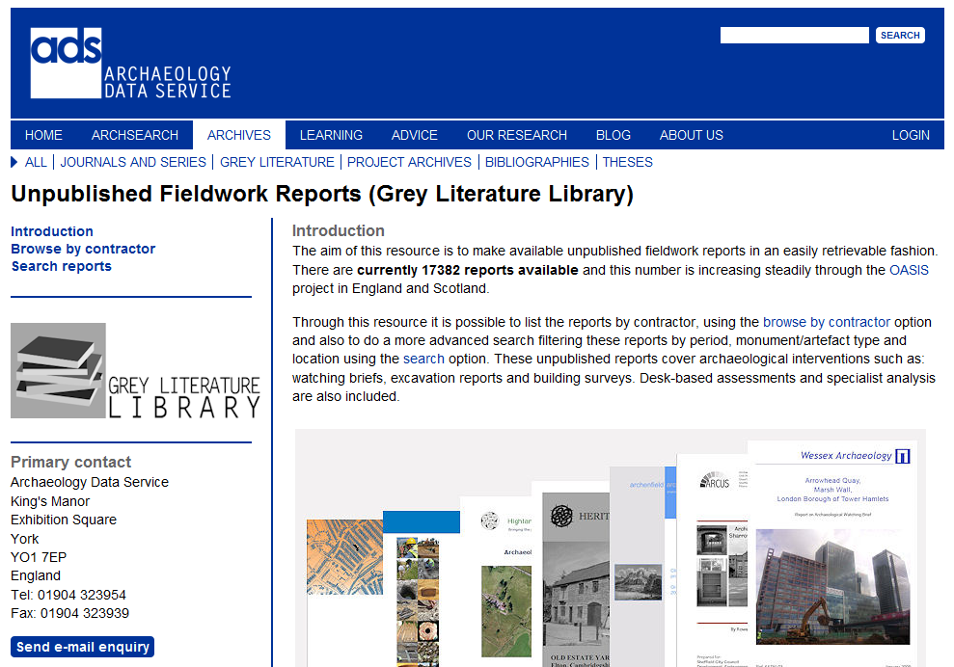


Slide 13
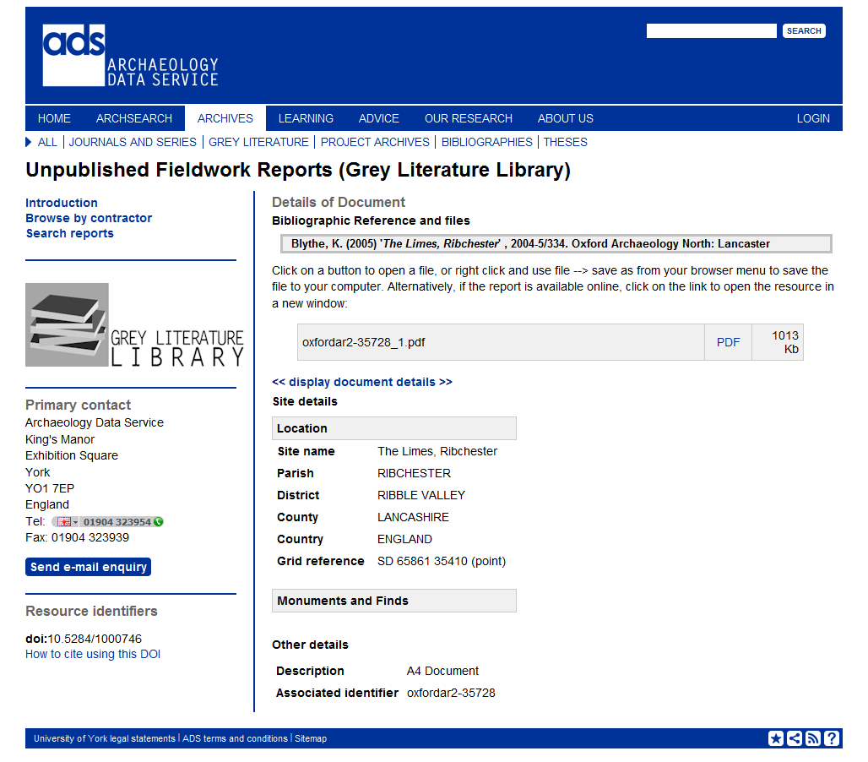

Slide 14
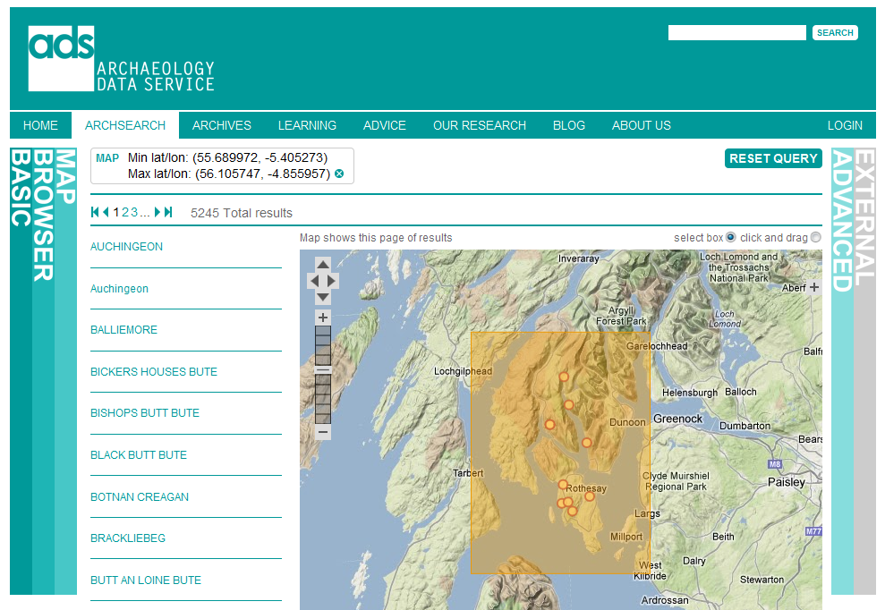

Slide 15
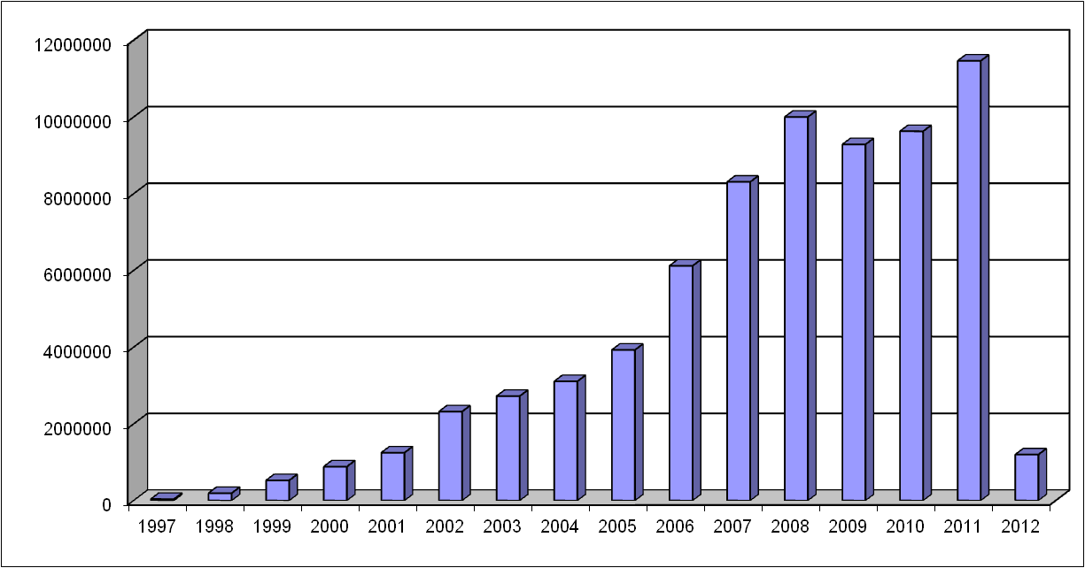
Year on year usage 1997-2012

Slide 16
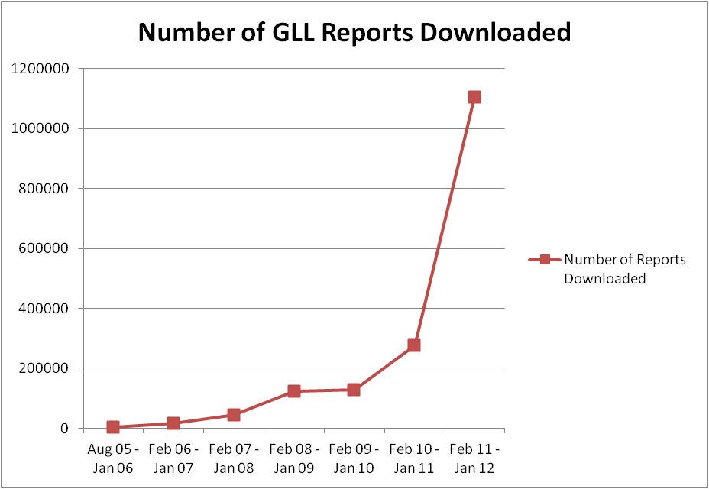
Grey Literature Library

Slide 17
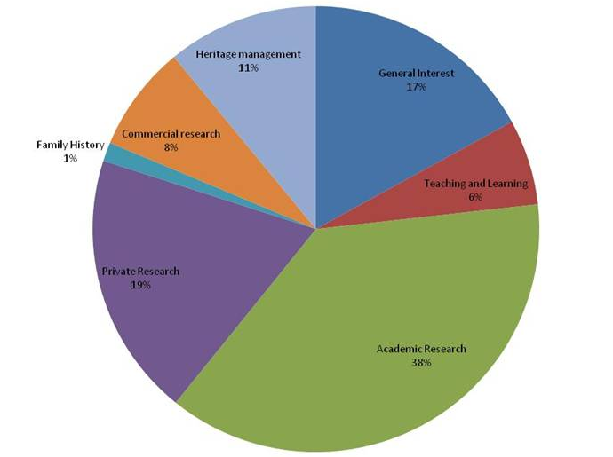
Primary re-use of data

Slide 18




How did it all start ?
Commercial archaeological
contractors

Slide 19
The Archaeology Data Service: Staffing
Set up in 1996 – 2 members of staff
Currently c.15 members of staff
  Director
  Deputy Director (Collections)
  Deputy Director (Access)
  Administrator
  Systems Manager
  3 Applications Developers
  6 Digital Archivists
  1 IfA/HLF trainee
Based within the University of York

Slide 20
ADS Charging Policy
ADS one-off deposit charge levied at point of deposit:
Included in project costing – to research council, public body, or commercial contractor
Starts at c. £250; can be up to c.£50,000
Generally < 3% of project costs
Costing based on:
  Number of files
  Complexity
  Size

Slide 21
Refreshment costs
C = A + I + D + R
C (Cost of preservation) =
A (Management and Administration) +
I (Ingest costs) +
D (Dissemination costs) +
R (Refreshment costs)

Slide 22
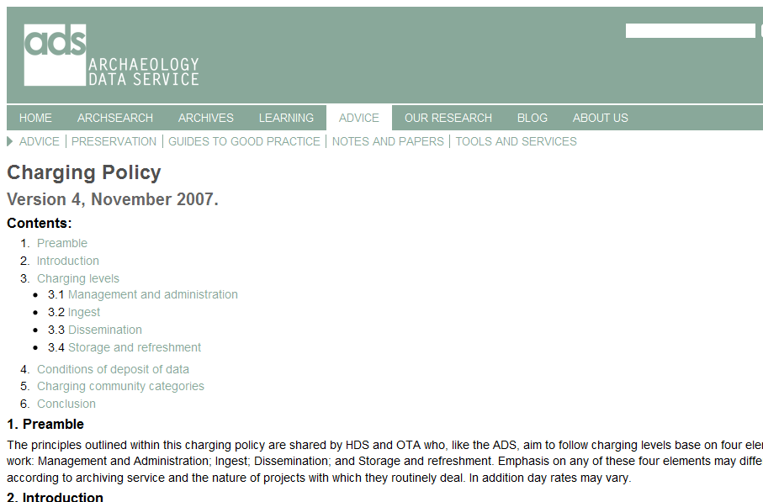
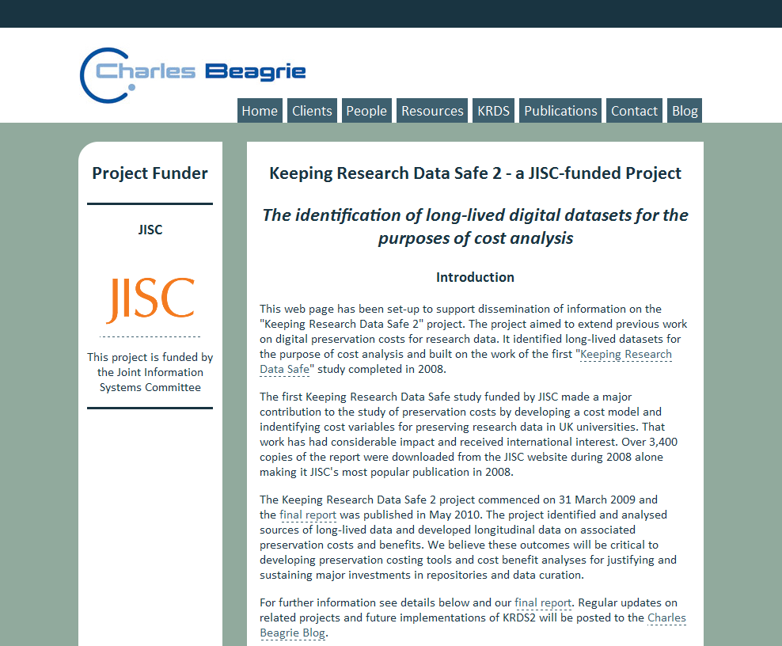
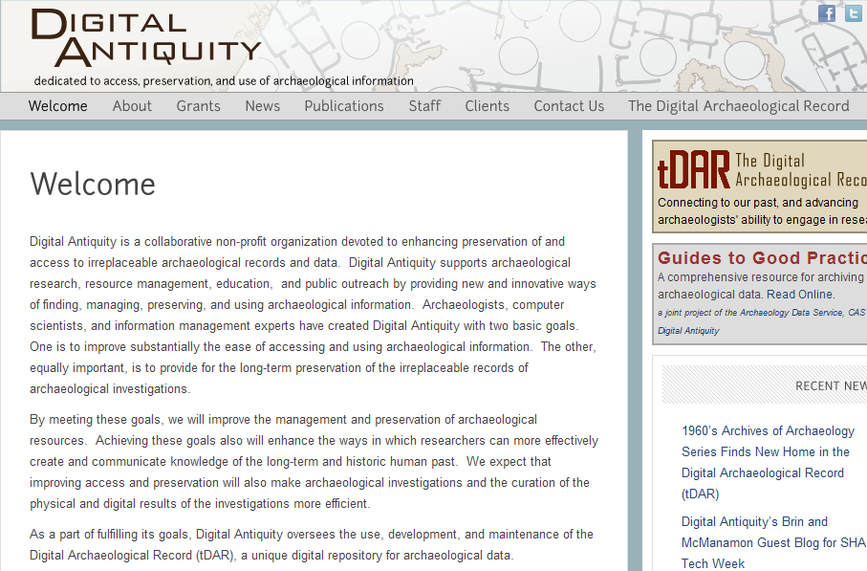
ADS charging policy: widely emulated

Slide 23



The Impact of the ADS Project:
a study and methods of enhancing sustainability
(1) Develop and refine a range of methods to measure the costs, benefits, economic impacts and value of the ADS
(2) Integrate these quantitative methods and findings with the more qualitative aspects of value

Slide 24
Methodology
Desk-based analysis of existing evaluation literature & existing data from KRDS and other studies of the costs and benefits of research data infrastructure and services;
Existing management and internal data collected by ADS, such as user registration and access statistics, deposit records, internal operational and financial reports, and
Original data collection in the form of an online survey of ADS users and depositors, and semi-structured interviews.

Slide 25
Measures of value
Investment value: annual ADS operational funding, & the costs that depositors face in preparing data for deposit and in making that deposit: £1.2-£1.7m ( 1.5-2.1m euros)
Use value: average ADS user access costs x no. of users: £2.5m-£5m (3.1-6.2m euros)
Contingent value: the amount users are "willing to pay“ or “willing to accept” in return for giving up access: £7m-£15m (8.7-18.7m euros)
Efficiency gain: user estimates of time saved by using ADS resources: £14m-£64m (17.4-79.7m euros)
Return on investment: 2.5-fold to 8-fold return, increasing with time

Slide 26
The Impact of the ADS Project:
a study and methods of enhancing sustainability

Slide 27
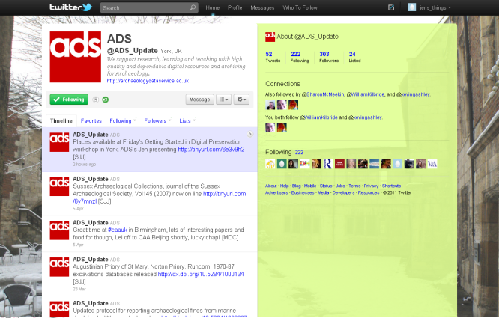

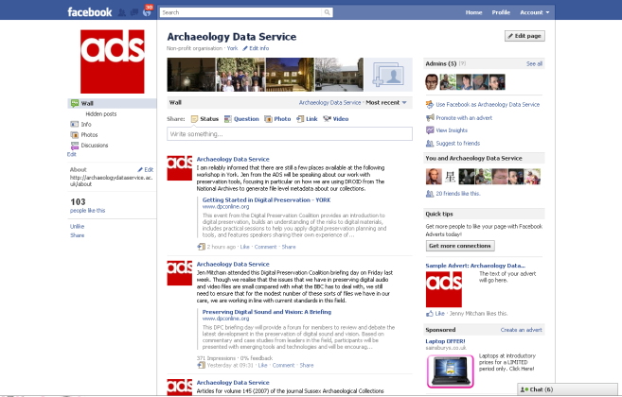

Further information
Thank-you for listening
Follow us on Twitter:
@ADS_Update
Follow us on Facebook:
http://www.facebook.com/archaeology.data.service
E-mail: julian.richards@york.ac.uk
Website: http://archaeologydataservice.ac.uk/

