Slide 1

Costs and benefits of preserving digital research data
Peter Doorn
Director, DANS
APA Conference
Frascati, 6th November 2012
Value from data now and into the future

Slide 2
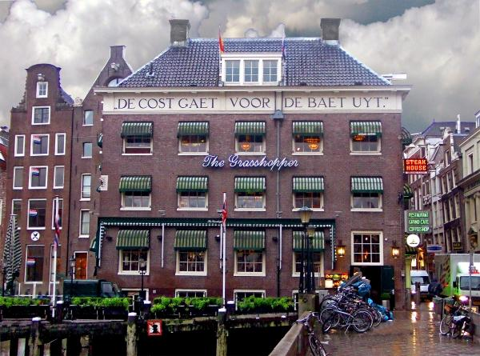
Outlay must precede returns
or
Costs come before profit
or
No pain, no gain
18th Century “Bureau for Trade Information” next to Stock Exchange, Amsterdam (now a coffee shop)

Slide 3
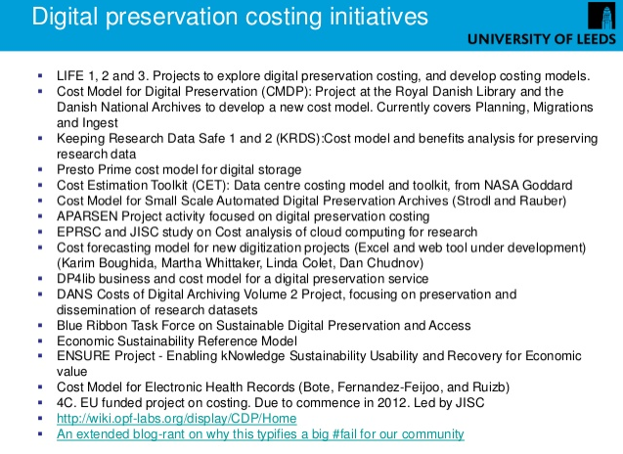

Paul Wheatley

Slide 4
So many cost models and approaches…
Most preservation activities (for research data) are publicly funded: non-profit organizations working for subsidized clients
Open data <?> Valorization
Preservation does not come alone: providing access, projects, …
Which activities (personnel costs) to include in cost calculations?
Costs and funding of hardware (storage and servers) and software (development of archiving systems) vary a lot

Slide 5
The value of data
Hard to quantify: investment, depreciation, added value…
Not for profit, but for scientific progress
Valorization: value of data increases by re-use
Limits to growth: sustain the success of the operation: increasing data volumes lead to increasing costs of storage and making data accessible
Archiving services
  charge re-use of data: <-> open access
  charge deposit of data: ± gold open access
Treat commercial customers differently?

Slide 6
What is DANS?
First predecessor dates back to 1964 (Steinmetz Foundation), Historical Data Archive 1989
Institute of Dutch Academy and Research Funding Organisation (KNAW & NWO) since 2005
Mission: promote and provide permanent access to digital research information

Slide 7
Our main activities and services
Encourage researchers to self-archive and reuse data by means of our Electronic Archiving SYstem EASY
Our largest digital collections are in archaeology, social sciences and history (moving into other domains)
Provide access, through Narcis.nl, to thousands of scientific datasets, e-publications and other research information in the Netherlands
Data projects in collaboration with research communities and partner organisations
  Advice, training and support (Data Seal of Approval, Persistent Identifier Infrastructure)
R&D into archiving of and access to digital information

Slide 8
NARCIS.nl: Access to Research Information, e-Publications, Data Sets and more

Slide 9
Datasets in DANS EASY (Sept. 2012)
1,8% of datasets > 2 GB
2,8% of datasets > 1 GB
23,560 datasets 1,693,413 files

Slide 10
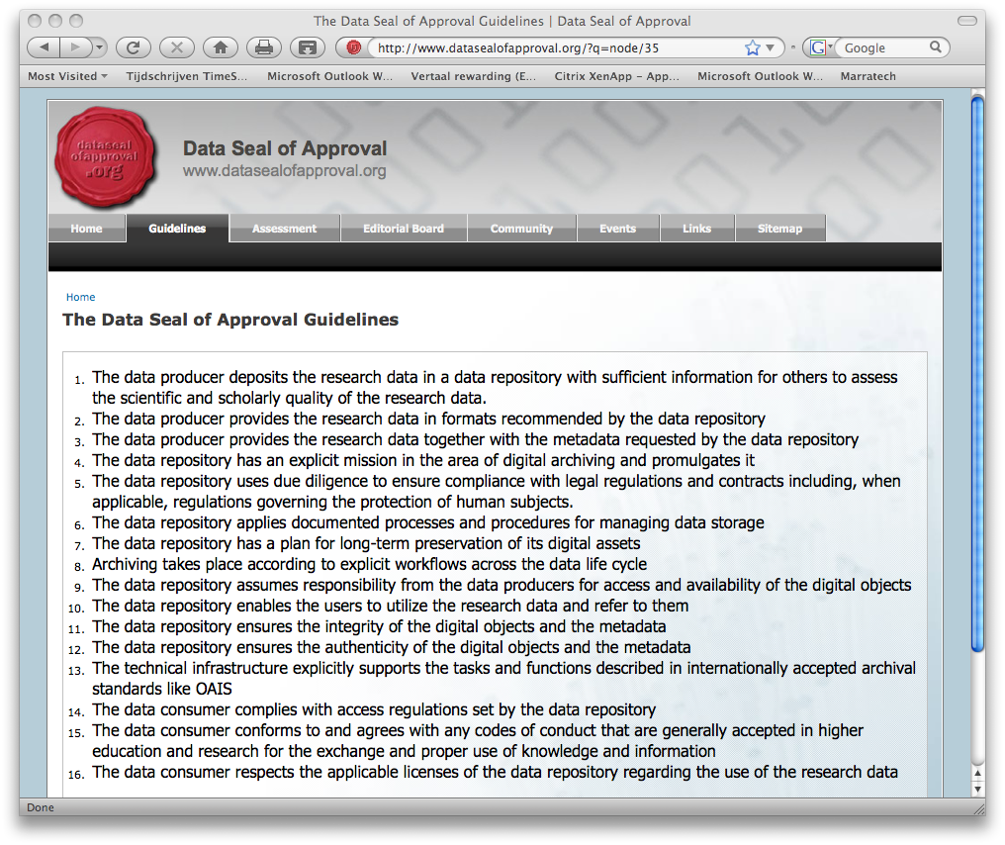
5 Criteria
16 Guidelines
Data Seal of Approval
The research data:
can be found on the Internet
are accessible (clear rights and licenses)
are in a usable format
are reliable
can be referred to (persistent identifier)
Partnership with ISO and DIN standards of Trustworthy Archives
www.datasealofapproval.org

Slide 11
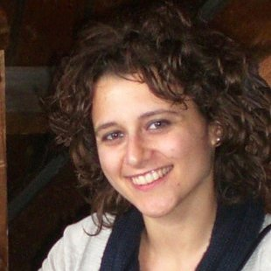
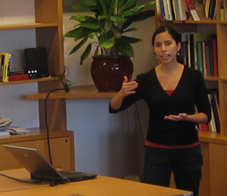
Cost projects at DANS
Anna Palaiologk (2008/9)
Activity Based Costing Model (ABC)
Improving tactical and strategic decision-making
Understand the use of scarce organizational resources in various business activities
Balanced Scorecard (BSC)
Translates an organization’s mission and existing business strategy into a limited number of specific strategic objectives that can be linked and measured operationally
Zuleica Arias (2011)

Slide 12
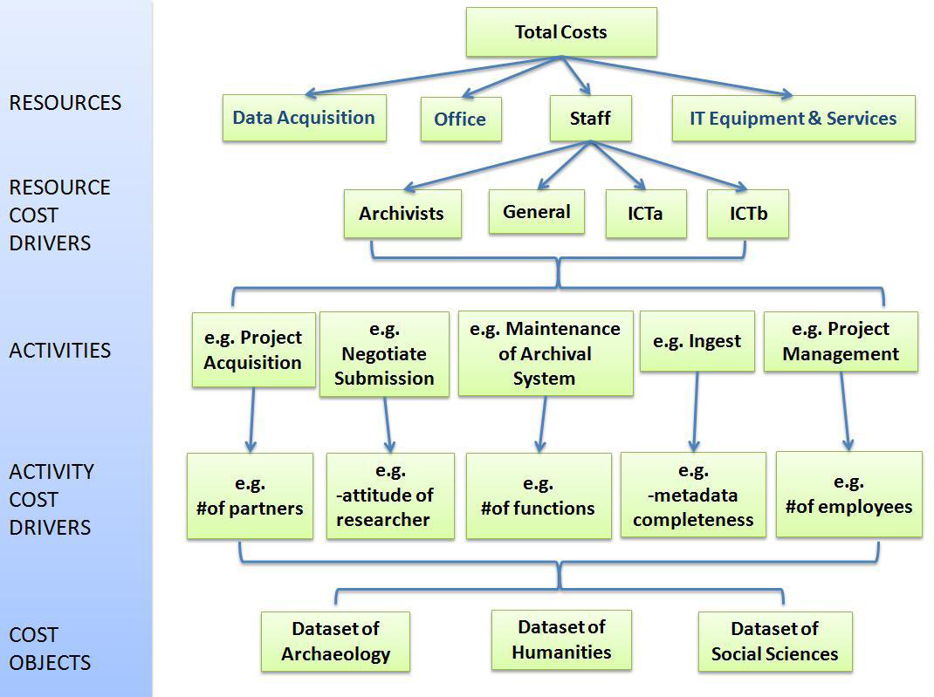
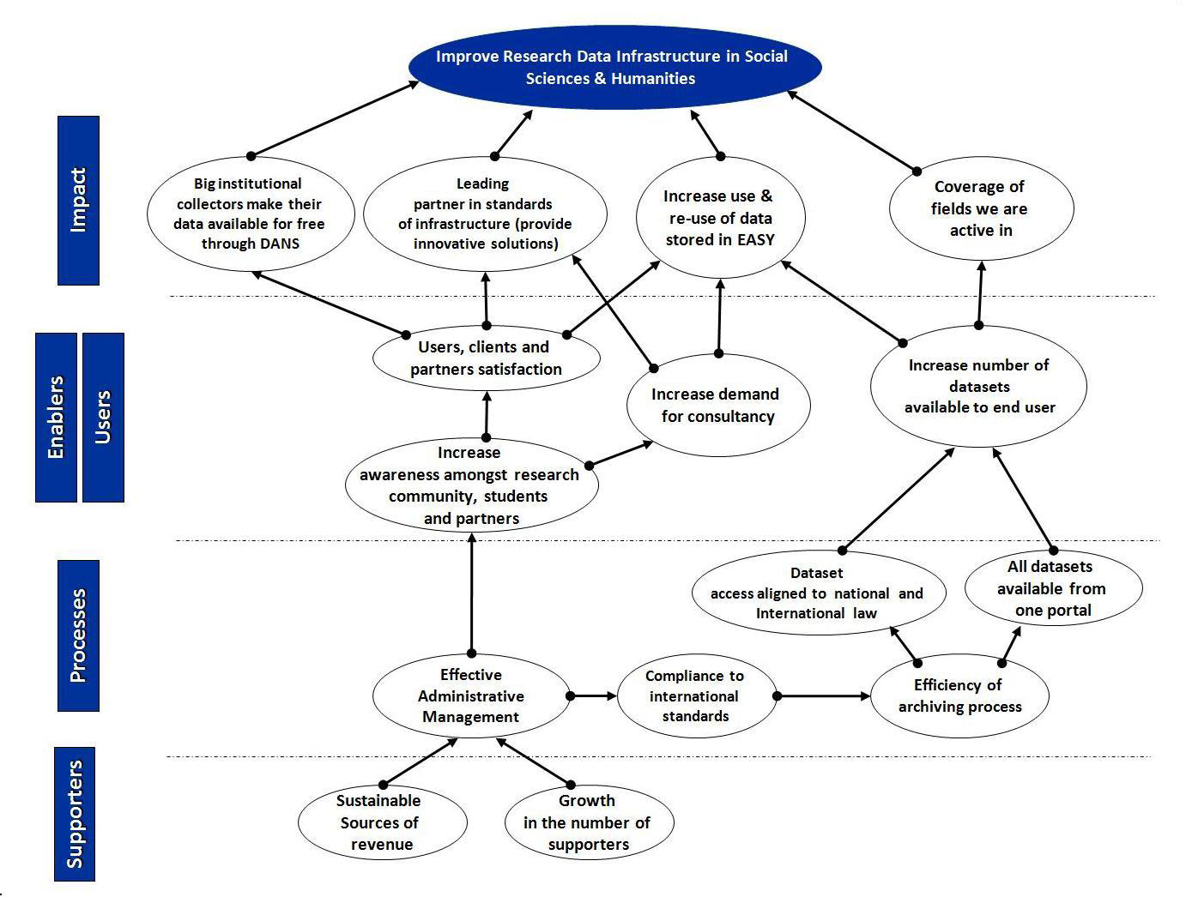
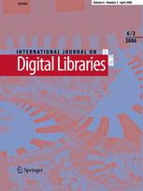
Activity Based Costing Model (ABC)
Balanced Scorecard (BSC)
Based on Cooper and Kaplan (1988)
Based on Kaplan and Norton (1997)
For more information see: Anna S. Palaiologk, Anastasios A. Economides, Heiko D. Tjalsma, Laurents B. Sesink (2012), ‘An activity-based costing model for long-term preservation and dissemination of digital research data: the case of DANS’, in: International Journal on Digital Libraries, Sept. 2012, 12:4, p. 195-214.
http://link.springer.com/article/10.1007%2Fs00799-012-0092-1

Slide 13
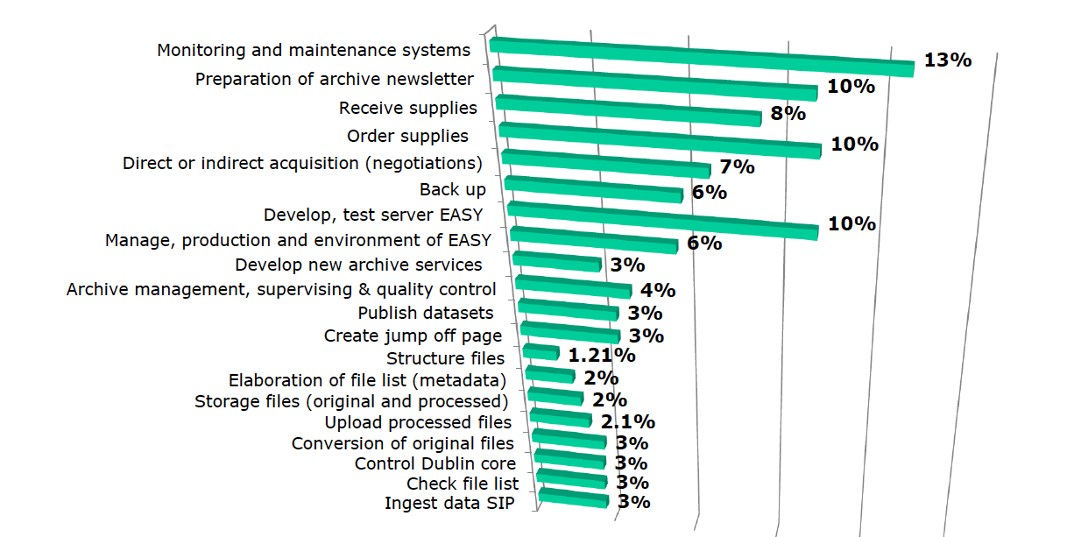
Indirect cost (%) per principal activities

Slide 14
Earlier approaches to earning money from archived data
DANS Predecessors (1990s – 2005):
“Data marketing” project of Historical Data Archive to promote re-use
Subscription system by Steinmetz Archive (for social sciences)
Research Funding Agency contract with Statistics Netherlands (CBS) and other govt. organisations:
  yearly payment of K€ 450
  subscription by faculties at reduced rate or “pay per dataset”
  DANS made access free in 2005 and re-negotiated CBS-contract in 2010

Slide 15
To conclude: our current policy
Scenarios are not only economic, but also political:
Do not charge re-use (depositors are free to negotiate access)
Earn back additional storage and handling costs
Charge organizations who want to use the archive as a backup (data always has to have a scientific relevance)
Charge only deposits of > 2 Gb (cf. Dropbox)
Charge where the deposit is obligatory
Pay for 5 years at once and the rest is free (“pension fund model”)
Urge funders to make it possible that researchers include storage costs for 5 years in project budgets when they store their data in a trusted archive
Reduce storage costs: promote a publicly funded shared storage facility (for science or for the NL Coalition for Digital Preservation – NCDD)

Slide 16
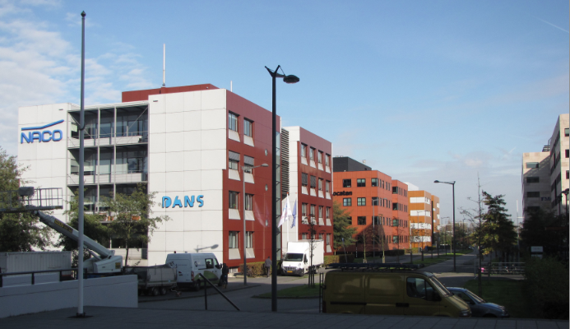
Thank you for your attention and visit us at:
www.dans.knaw.nl
www.narcis.nl
peter.doorn@dans.knaw.nl

