Slide 1
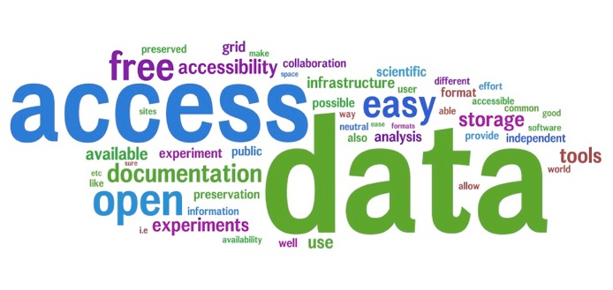
Data across time and organizations APA Conference 2012
Monica Marinucci
Director of Research, Global Education & Research Industry Unit
Notes:
1
1

Slide 2
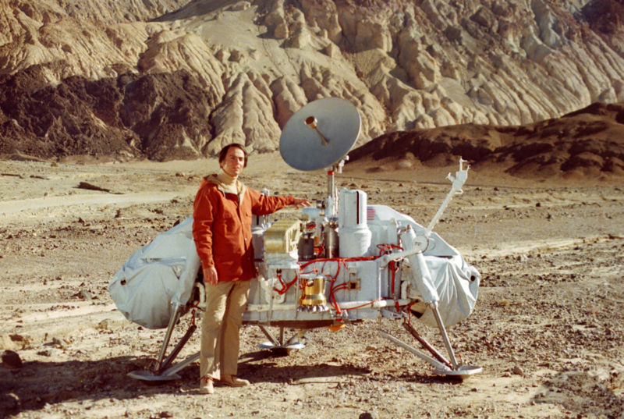
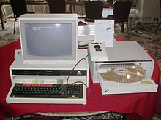
Archiving nowadays
1976: Viking Mission on Mars
1986:BBC Domesday Project
To maintain access
To meet legal and corporate regulations
To fulfil a mission
Compliant image archive
Availability
Royal Botanical Gardens Kew

Slide 3
Business Reasons
Save Money
Reduce Risk
Increase User Productivity
Reduce capital and operational costs to maximize IT investments
Ensure continued access to critical data and functions
Improve service levels resulting in higher productivity

Slide 4
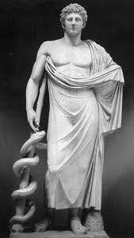
Business Value
HealthCare
Government
Manufacturing
Banking
Justice

Slide 5
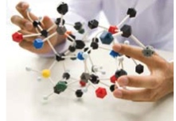
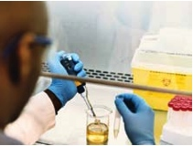
Research Strategies
Unlock potential of your Research content
Broadening Research community using data
Reduce Time-to-Discovery
Shortening Research Lifecycle
Institutional Leadership
Optimizing resources and IT assets
Attracting future Researchers
Global collaboration opportunities
Security and re-use of Intellectual Property
Access new types of user communities
Maximize the value of research data

Slide 6
Research Data Management Flow
Experiment and Research Creation
Sharing an d Collaboration
Permanent Access
Data Acquisition
Data Analysis and Validation
Scholarly Publications
Community Involvement
Archiving and Long-term Access
Science Daily (February 24, 2010),
“…it’s about doing good science, and ensuring the science is reproducible, but it’s also about finding ways to bring data together from different sources and using them in new ways…to replicate a study or re-use data you have to know where a data set came from and how it’s been processed. Tracking all the context and transformations is part of the curation process.”

Slide 7
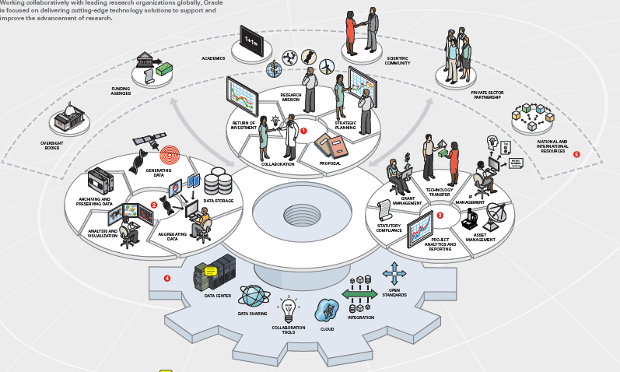
Oracle Differentiators
Research Ecosystem
Addresses the whole Research Content Lifecycle
Optimized storage and access strategy
Collaboration and Re-use of content in a unified coherent repository
Security & Identity Management
Research Mission
Research Data Management
Research Administration
Research Infrastructure
The Research Enterprise

Slide 8
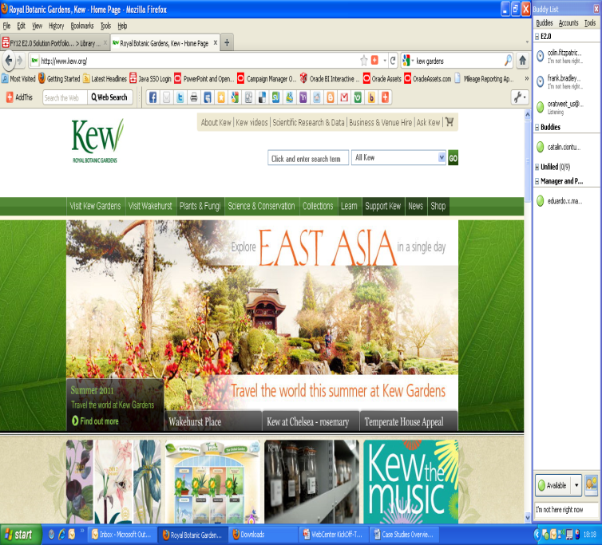
Royal Botanic Gardens Kew
ORGANISATION OVERVIEW
The RBG Kew is first and foremost a scientific institution, as well as a key contributor to education establishments
CHALLENGES/OPPORTUNITIES
Large numbers of disparate systems for content
Huge amount of content from years of research, with large numbers of specimens and digital assets in excess of 1 billion
They need to revamp their web presence, their Digital Asset Management and their internal IT systems.
SOLUTION
Kew used Oracle’s Content Management system to consolidate their digital assets in multiple formats and launch a modern user experience for their 250th anniversary
RESULTS
Leaner, less people intensive content creation, authorization and publishing of content
Increased numbers of people online
Reduced costs of content system maintenance
UCM

Slide 9
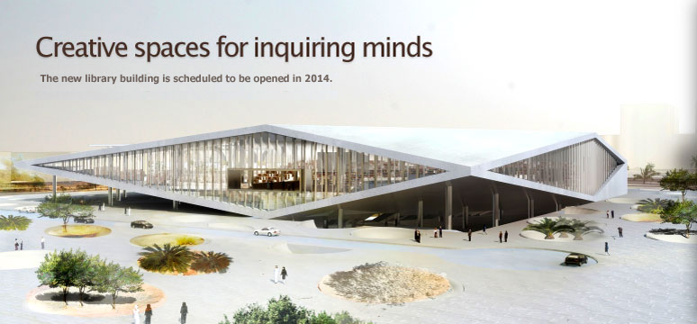
Qatar National Library
COMPANY OVERVIEW
Part of the Qatar Foundation, Qatar National Library was the first public library in the Gulf region, founded in 1962.
It serves everybody from world-class researchers looking for highly-specialized scientific articles, to the general public who enjoy listening to music or watching videos.
CHALLENGES/OPPORTUNITIES
Increasing data volumes
Quality of Service by ensuring Stability, Reliability and Sustainability
Benefit of a full integrated solution and linear performance increase with the future upgrade
SOLUTION
Qatar Foundation National Library used Sparc Systems, Solaris Virtualisation, Oracle Storage Solutions and Oracle’s Axiom Storage to a fully integrated environment
RESULTS
Sustainable and Long-term Infrastructure to support customer’s growth and ambition.
Fully integrated solution where monitoring and administration are optimised

Slide 10
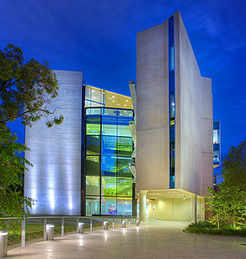
Queensland Brain Institute
COMPANY OVERVIEW
One of the world’s largest neuroscience research organizations
Employees: 380
CHALLENGES/OPPORTUNITIES
Reduce file retrieval times to ensure researchers can access data such as magnetic resonance imaging files and high-resolution scans in a timely manner
Shorten backup times to minimize the impact of this process on the ability of staff to access files
Ensure support is readily available to assist with issues such as failed parts or outages
SOLUTION
Oracle Sun infrastructure and Oracle Premier Support to ensure that critical research data and systems are secure, always available, and easy to access
RESULTS
Ensured scientists can access the research data and image files they need much faster than before
Cut backup times from seven hours to between five and ten minutes, enabling more frequent backups that ensure data security

Slide 11
Thank You!

Slide 12
12
Notes:
12

