Slide 1
Value of Earth Observation Data
APA Conference 2012
ESA/ESRIN Frascati, 6-7 November 2012
M. Albani
Earth Observation Ground Segment Department
European Space Agency (ESRIN, Frascati)
Notes:
1

Slide 2
ESA and Earth Observation missions
Earthnet: Access for European users to non-ESA missions: Landsat, SPOT, CZCS, J-ERS, ALOS...
Since
1977
1990 2000 2010
Meteo
METEOSAT M-1, 2, 3, 4, 5, 6, 7
METEOSAT Second Generation MSG-1, -2, -3
MTG
in cooperation
with EUMETSAT
METOP-A, -B, -C
(Gravity and Ocean
Circulation Explorer)
GOCE
Science
(Gravity and Ocean Circulation Explorer)
(Soil Moisture and
Ocean Salinity)
to better understand the Earth
System
SMOS
(Polar Ice
Monitoring)
Earth
Explorers
CryoSat2
(Atmospheric Dynamics Mission)
ADM/Aeolus
SWARM
(Magnetic Mission)
EarthCARE
(Clouds, Aerosols & Radiation Mission)
ERS-1, -2
ENVISAT
EE 7
Sentinel 1
Applications
Services
Sentinel 2
Sentinel 3
to initiate long term monitoring systems and services
Earth Watch
Sentinel 5P
GMES in cooperation with EC
Sentinel 4/5
Notes:
2

Slide 3
Earth Observation Missions Selection
Experimental Missions: defined and implemented starting from the requirements of the scientific community (several itarations).
Operational Missions (e.g. meteorological missions): supporting applications and operational services (e.g. weather forecasting, oil spill monitoring, etc).
Earth Observation data archived and disseminated by ESA:
From ESA Missions;
From Third Party Missions selected according to a procedure involving European Scientific Community.

Slide 4
How to quantify the value of EO data (1)?
Several studies in the past have addressed the value of Earth Observation systems Data and Information as for example in the GMES programme definition context (ESA and EC).
Value of Information (VOI) was described by Macauley (2005) as “being an outcome of choice, whereby individuals may be willing to pay for information depending on their degree of uncertainty and the opportunities they face”.
Under this framework VOI is related to:
The degree of uncertainty faced by decision makers;
What is at stake in terms of the outcome of their decisions;
The cost of using the information to make decisions; and
The cost/price of the next-best information substitute.
Notes:
The larger the degree of uncertainty and what is at stake, then it follows that information can also have a large value.
On the other hand we do not have to confuse the value of the data with the one of the policy initiatives related to it. EO data does not directly provide costs and benefits of an environmental nature, rather it provides the basis to create information, upon the basis of which people and decision makers may choose to expend resources to deliver an outcome which affects the environment. When new policy initiatives are being founded upon particular information sources, it is easy to mistake the value of the policy initiative for the value of the information source.
If the EO data and the information generated starting from it can not be substituted by other means then the value of the EO data is larger. If a secondary or alternative data source can be used, then the value of EO data is related to the incremental precision provided by EO data wrt the other source.
Earth Observation global data can not generally be substituted by other means and have therefore large value.

Slide 5
How to quantify the value of EO data (2) ?
Some studies for example show that improved weather forecasting systems can provide benefits in the order of around 3-5% of output.
Other studies also show that under certain conditions, perfect information about climate change sensitivities can have very large impacts overall.
A simplified approach to estimating a benefits across a number of activity areas that are connected to a particular EO system adopted in recent studies:
Preferred when information regarding users’ willingness to pay for better information is not known.
Under this approach, the benefits of better information are recognized as being incremental, and valued as 1% of output in each activity area affected by the EO system.

Slide 6
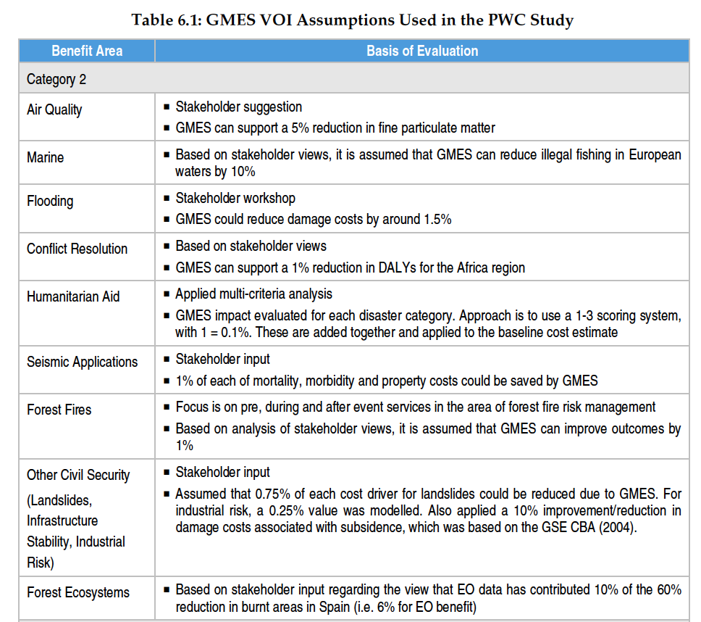
Examples from GMES Studies (1)

Slide 7
Examples from GMES Studies (2)

Slide 8
Example of Earth Science data use: Arctic sea ice melting
Notes:
This time series is used to show the progressive reduction of the sea ice in the Arctic area. Sea Ice melting is one of the Essential Climate Variables.
Ice melting at the north pole would significantly impact on our global environment (which we need to model and forecast). Moreover it would have an incredible impact on sea routes traffic (90% of the goods are transported on the sea) and therefore on the global economy.
It is essential that our scientist have the full access to all information related to this (and other) phenomena.
Unfortunately satellites (and/or experiments) are not forever. The video you see was realized unifying over 4 missions (i.e. 4 different satellites and sensor).
This poses problems of file conversion, metadata harmonization. Which must be planned and have a cost.

Slide 9
Greece fires
Envisat MERIS
24 August 2007

Slide 10
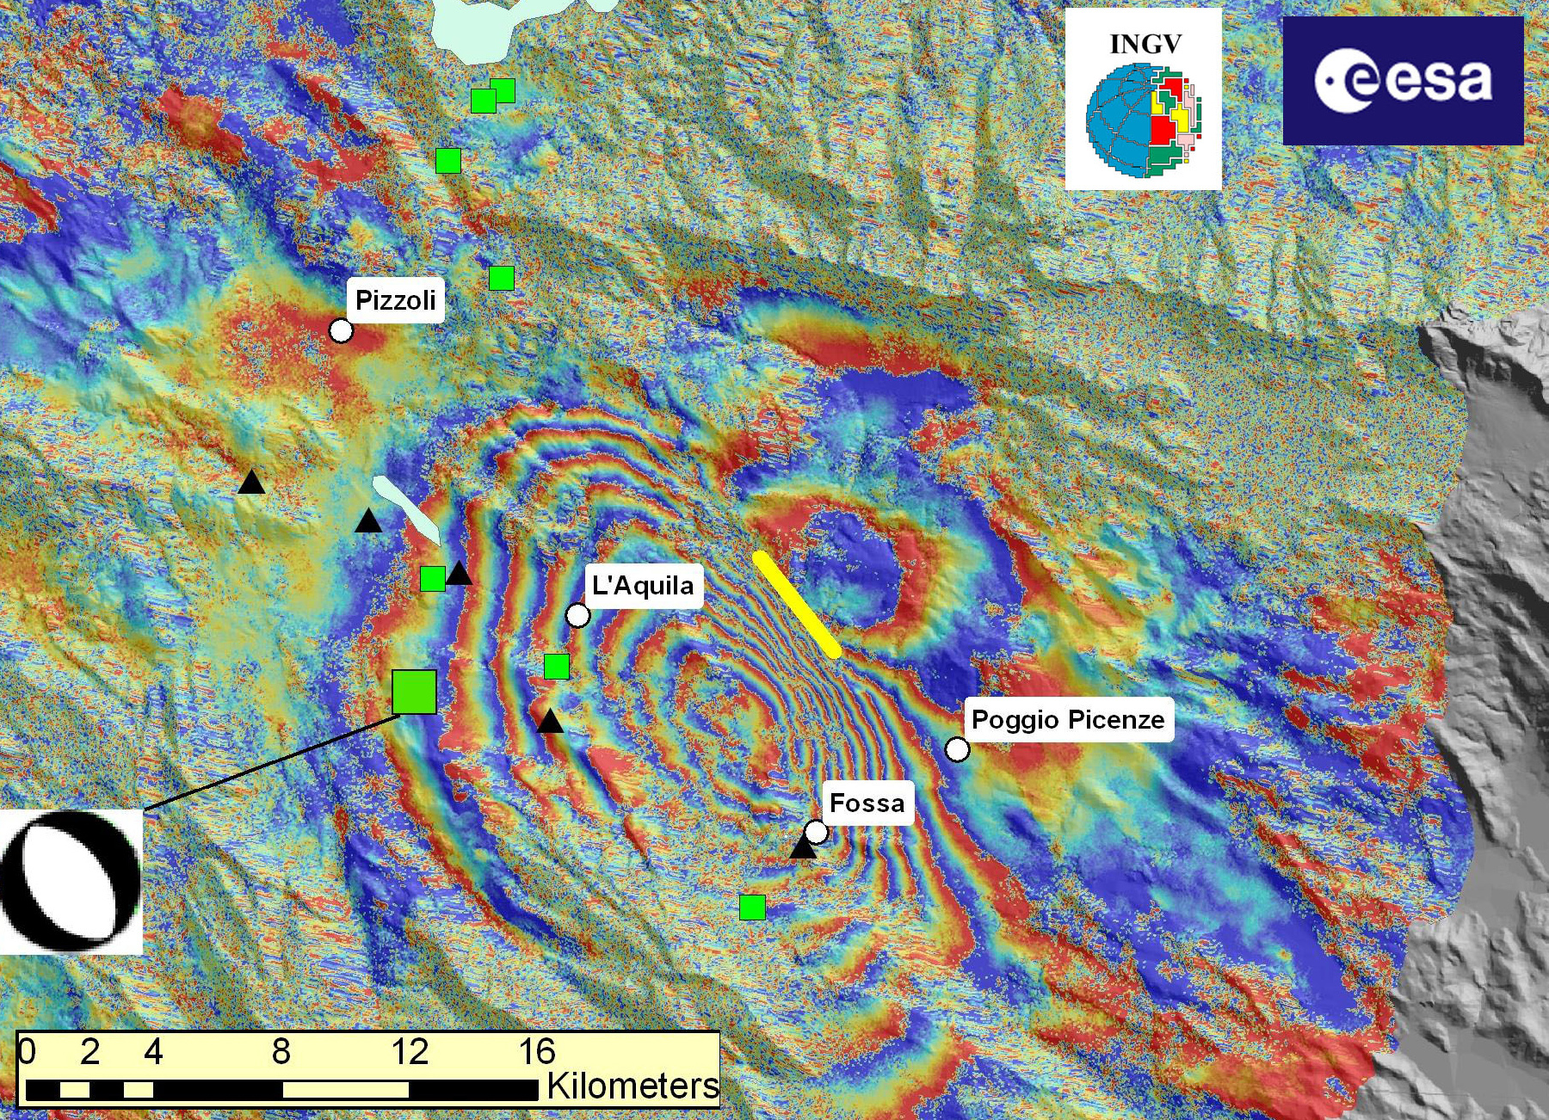
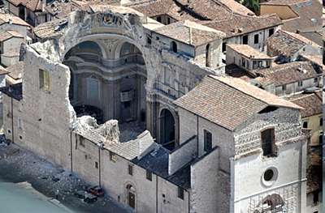
L’Aquila earthquake
(April 2009)
Envisat ASAR data
Each fringe (a colour cycle) of the interferogram is equivalent to a surface displacement of 2.8 cm along the satellite direction.

Slide 11
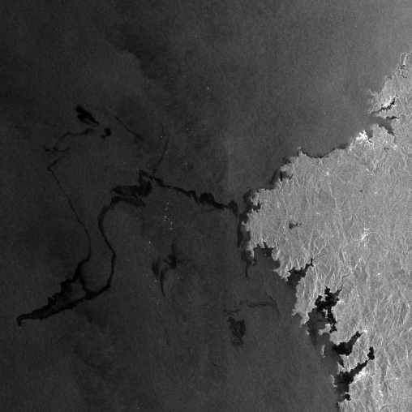
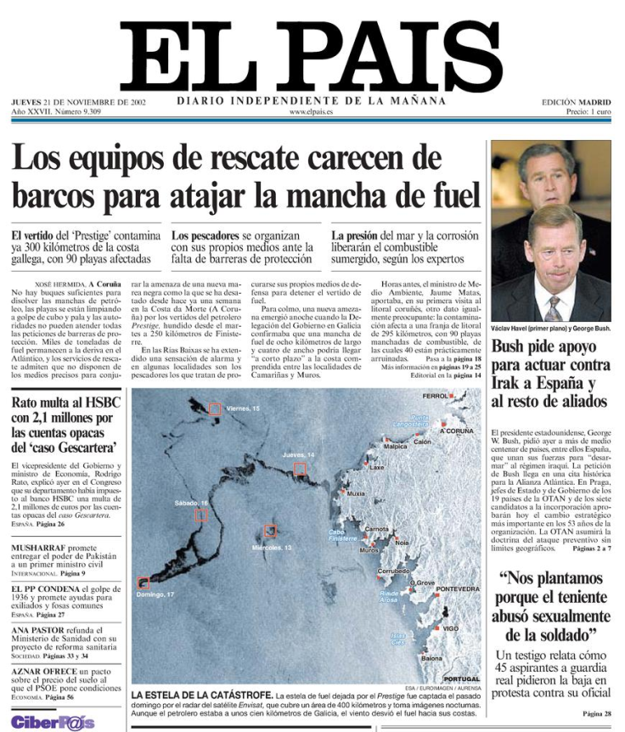
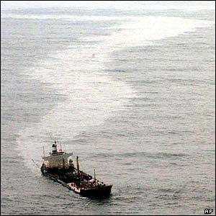
ASAR
Oil spill detection and monitoring
Oil spill
“Prestige” tanker
“Prestige” tanker
Galicia (Spain)
17 November 2002
50 km

Slide 12
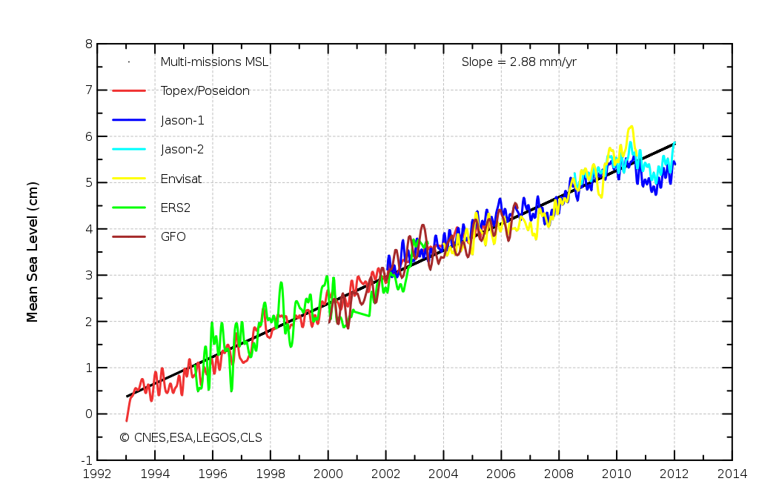
Altimetry
Sea level rise
Global mean sea level rise
Data quality is essential for a mission success
→ achieved through cal/val, processing algorithms upgrade and data reprocessing

Slide 13
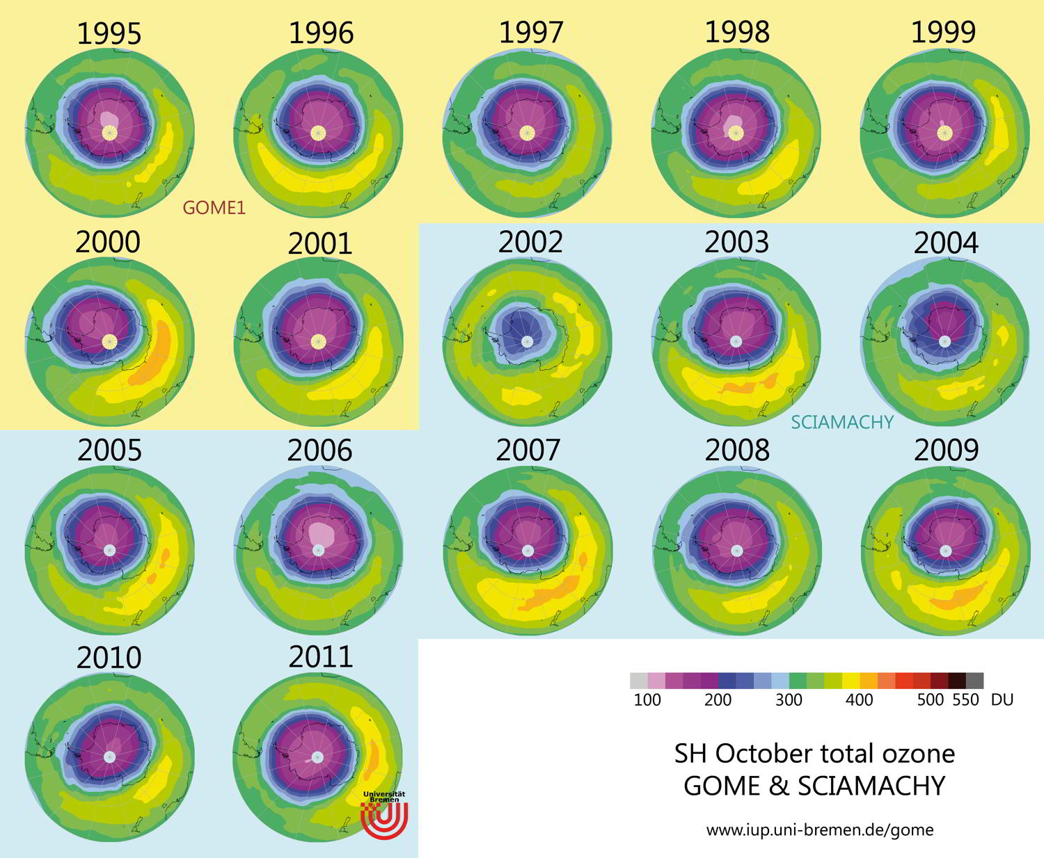
SCIAMACHY
South Hemisphere
Ozone hole
Data continuity is fundamental for observing and understanding most of the geophysical parameters
Source: IUP-UB M. Weber

Slide 14
Carbon Dioxide (CO2)
SCIAMACHY
Source: M. Buchwitz, University of Bremen

Slide 15
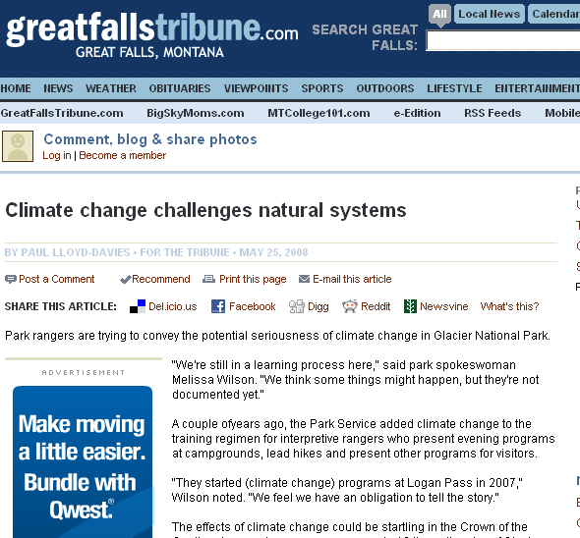
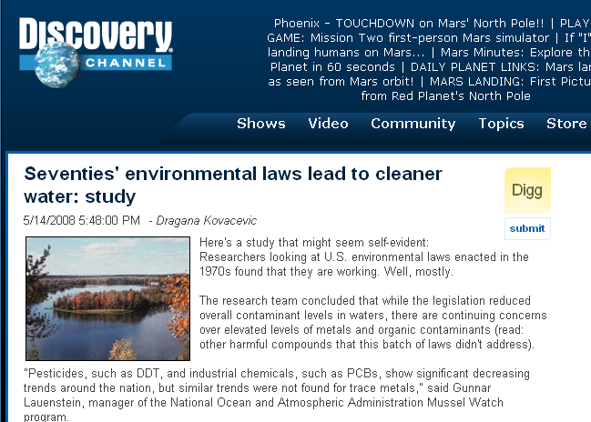
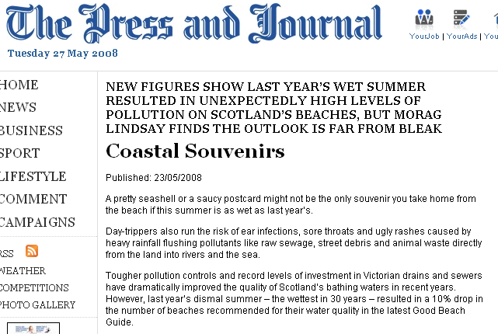
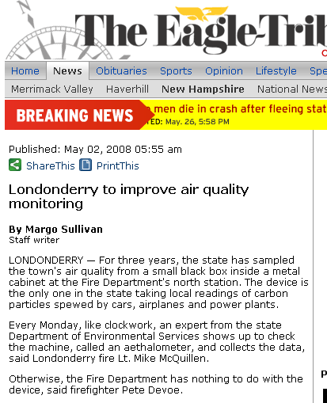

Slide 16
Conclusion: Earth Observation Data Value
Very difficult to associate a value to EO data.
EO Data:
Are UNIQUE and not repeatable.
Constitute a humankind asset.
Are Fundamental for monitoring Global Change and our planet and to define policies and actions directly affecting Human lives and world economy.
Are supporting several commercial but mostly scientific research activities and applications.
Have incremental value as they are combined together and with data from other sources and disciplines.
EO Data need to be preserved together with all associated “knowledge” necessary to use and understand them, need to be curated and valorized, and made accessible to users.
Notes:
Data Appraisal Procedure available at EROS USGS Centre to appraise value of data in case of purging so others can take over. Based on……

Slide 17
Thank you !

