Slide 1
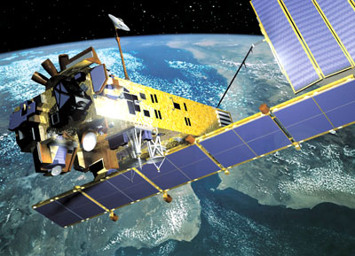
APA Conference – Nov 6th - 7^{th,} 2012,
European Space Agency, ESRIN, Frascati, Italy
Value From Data Now and Into the Future
Neil Grindley
JISC
Programme Manager – Digital Preservation & Curation
Questions ...
Why is digitally encoded information valued by your organisation?
How can that value be increased?
How can digital preservation (and the APA) help?
What are the ultimate goals?

Slide 2
Why is digitally encoded information valued by your organisation?
Physical/analogue formats of information are still needed ...
e.g. travel (passport, boarding pass)
... but this is just a small printed by-product of a large digitally driven ecosystem of processes involving discovery systems, databases, metadata standards, authority files, imaging software, scanners, image recognition software, barcode software, QR codes, etc. etc. ...
Why does JISC value digital information?
Because digital is:
Accessible
Flexible
Smart
Mashable
...
BECAUSE
DIGITAL
ENABLES
INNOVATION

Slide 3
JISC remains an organisation that is committed to INNOVATION
JISC is going through a substantial transition process which will create a new organisation that is easier for our communities to engage with and be better at supporting them. It will be able to respond more quickly and effectively to their priorities and needs
These changes will help JISC to be more efficient whilst consolidating its business and reducing its costs
As part of the transition process, we are re-inventing our innovation work. We are part of the way through this process - we’ll be developing and testing new approaches during the coming year (2013). We will engage with, and actively seek feedback from, our communities as we develop these new approaches.
Even as these changes take place we will still be investing in innovation work; £12.6m from our revenue budget and over £2m from capital funds in the period up to July 2013.
The new strategic vision will not contain many surprises - we will carry on doing what JISC is known for. But the wheels will run smoother and the work will be co-invented and co-designed with stakeholders working more closely with JISC.

Slide 4
People refer to JISC as a ‘funder’ ... JISC doesn’t define itself that way.
We want people to understand that JISC addresses a number of critical functions:
We plan, manage and provide infrastructure
(e.g. JANET, National Data Centres, data-driven infrastructure)
We drive, participate in, and support the formation and implementation of policy
(e.g. open access, research data retention policy)
We support the intersection between policy and service provision, at international, national and local levels
(e.g. standardisation, interoperability, rationalisation)
We shape strategy and commit to collaborative coordination efforts where it is clear that the outcomes will be of benefit to UK universities & colleges
(APA, OPF, DCC, DPC, RDA, OpenAIRE, EuroCRIS ... etc. etc.)
And as a result of the above ... we design programmes and we fund projects.

Slide 5
How can the value of digital information be increased?
Not a straightforward question, the term itself is slippery ... Value, benefit, impact, cost
Financial value – return on investment
Research Value – can lead to new discoveries
Aggregate value - the entity can be usefully combined with other resources
Bequest value – future generations are likely to appreciate the preserved goods
Altruistic value – credit and reputation is enhanced through unselfish behaviour
Existence value – sentiment, impression, perception or a perceived (rather than an actual) need for the resource bestows credit on the custodian
Public value – contributes to the reputation of society more broadly (e.g “UK plc”)
Contingent value – the value that people say they will pay to keep or be compensated for the loss of the resource
Shadow Pricing – revealed and stated preferences

Slide 6
Enhancing the Sustainability of Digital Collections – 8 projects investigating and measuring how effectively action can be taken to increase the prospects of sustainability for specified digital resources.
Analytical Access to Domain Dark Archive (AADDA) - Institute of Historical Research (University of London)
Enhancing ways that researchers can engage with web archive collections
Big Data (Big Data) - Oxford Internet Institute
Improving analysis and visualisation tools in web archives
Impact of the Archaeology Data Service (ADS Impact) - University of York
Understanding the cost/benefit equation of the ADS and communicating its value proposition
Developing a Sustainability Index Using British History Online (ISURV) - Institute of Historical Research
Comparing the functional performance of different sections of related websites
Enhancing the Sustainability of the Linnean Online Collections (Linnean Project) - University of London
Developing improvement metrics for a specified resource and then acting on the results
Sustainability Development for a Crowd-Sourced Learning Framework - a Geospatial Case Study (SDCLF) -
Gaining a better understanding of the dynamics of crowd-sourcing contributions to an open geo-spatial repository
Sustaining the EEBO-TCP Corpus in Transition (SECT) - Bodleian Library University of Oxford
Undertaking a benchmarking impact study and analysis with the TIDSR toolkit
Semantic Technologies Enhancing the Lifecyle of Learning Resources (STELLAR) - Open University
Surveying stakeholder opinion and transforming content with linked data methods to test concepts of value
http://www.jisc.ac.uk/preservation
February 2012 – July 2013

Slide 7
How can digital preservation (and the APA) help?
Modern communications paradigms are going through a period of massive upheaval
New business models are yet to emerge
New scholarly processes are being argued
The role of libraries and archives are being redefined
Research methods are changing and evolving

Slide 8
How digital preservation (and the APA) can help?
To counteract all of this uncertainty, it will help enormously if people believe that the data that they need - or might need in the future - will remain:
Accessible
Trustworthy
And unlikely to disappear any time soon

Slide 9
How digital preservation (and the APA) can help?
Preservation Planning
Who: Identify the key players involved with long-term preservation of the targeted content.
What: Describe or characterize the collection and content.
Where: Document the locations of all the copies of the content and metadata.
When: Document the targeted preservation timeframe and impact of loss.
How: Document how the key content management and preservation tasks will occur.

Slide 10
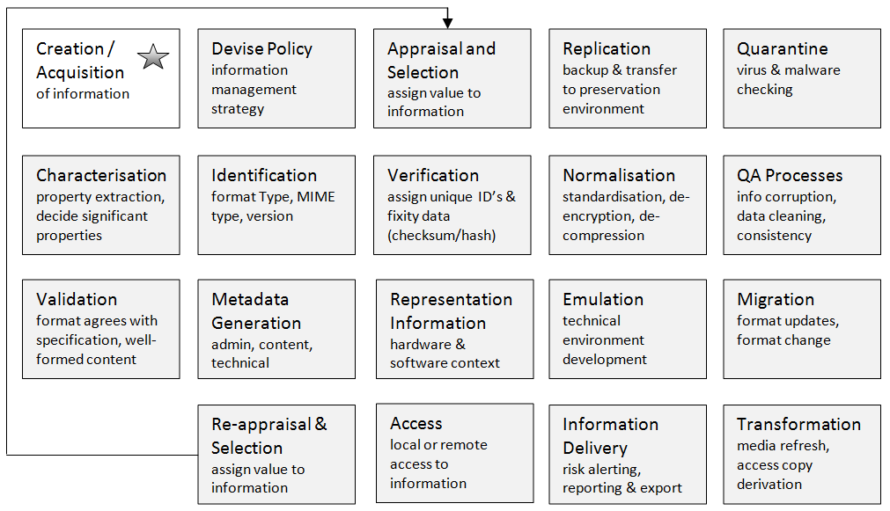
What might organisations need in terms of preservation services?
?

Slide 11
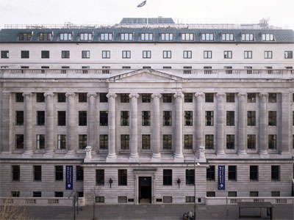
What are the ultimate goals?
Clarity
Capacity
Capability
Coherence
Control
Credibility

Slide 12
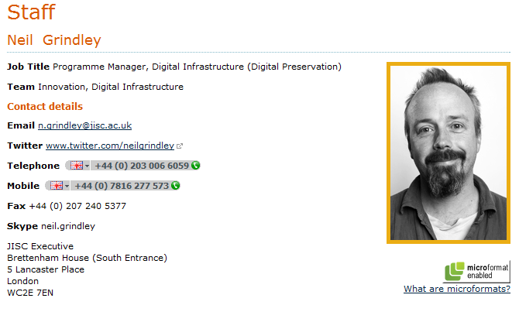
http://www.jisc.ac.uk/contactus/staff/neilgrindley.aspx

