Slide 1
Open Data from Reliable Records
Anne Thurston

Slide 2
The Open Data movement, a key aspect of Open Government, is now a top development interest across the world.
There is great hope that data will provide the key to transparency, accountability, anti-corruption and citizens’ rights in countries worldwide.

Slide 3
Government data is largely drawn from records. Achieving global goals for increased transparency through Open Government and Open Data depends in large measure on the strength of the framework for managing public sector records.

Slide 4
There is a lack of clarity about records and data. Most development specialists still overlook the significance of records for reliable data. The Open Data Community sometimes refers to ‘data records’ or to ‘paperless data’.
There is a belief that records are paper documents and data are electronic documents.

Slide 5
Questions need to be asked about the veracity of the data available and its relationship to records as sources of evidence. Can the records from which the data are derived be trusted?

Slide 6
To remain authentic, reliable, complete and accessible for as long as needed, records and data must be managed within a trusted environment that protects their integrity. This involves a combination of laws and policies, standards and practices, and skills.

Slide 7
The Open Data approach has evolved from principles developed by the dataset community. The approach draws on subject-based cataloguing rules. There has been little involvement by records professionals, whose focus is on context.
If datasets are separated from the records from which they are derived, the context is lost.

Slide 8
The integrity of digital records depends upon a quickly changing array of hardware and software. If they are not carefully managed and protected, their availability, authenticity and usability cannot be guaranteed, with the result that data will be incomplete and untraceable.

Slide 9
Digital records and data must be captured and held in a safe, neutral and professionally managed repository and supported by complete metadata if they are to survive.
Trusted digital repositories are the internationally accepted, technology-neutral means of providing long term access to digital records and datasets and protecting their integrity, completeness and traceability.

Slide 10
As the high expectations for Open Data are translated into developing country contexts, questions need to be asked about the veracity of the data available and its relationship to records as sources of evidence.

Slide 11
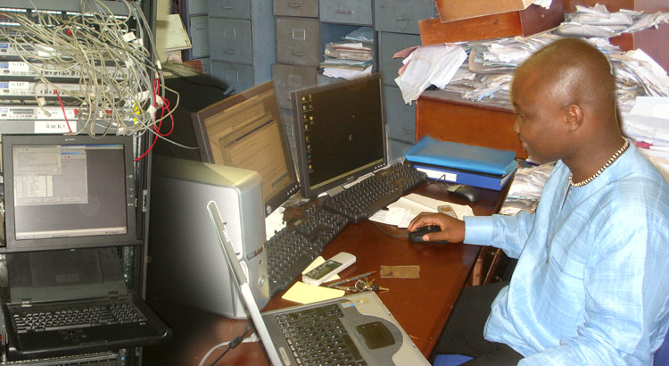

Slide 12
For the most part, development planners and government stakeholders are unaware of preservation and access issues, of the cost of the failure to address these issues or of what needs to be done.
They still tend to believe that technology will resolve the problems.

Slide 13
There are major gaps in the institutional and regulatory framework needed to ensure that digital records and data remain accessible and trustworthy.
National archives are severely underfunded, legislation is out of date, international standards have not been introduced.

Slide 14
Relatively few information professionals worldwide have had in-depth training and experience in managing and preserving digital information.

Slide 15
The Open Government Partnership offers a significant opportunity for linking the records and Open Data communities. At present, records barely feature on the Open Government agenda, but for many of the 57 countries that have signed up to the Partnership, Open Data projects, are a key element of commitments.

Slide 16
A number of significant issues are surfacing that have the potential to undermine Open Data initiatives. The problems encountered have a direct relationship to the lack of standards, policies and practices for managing records and data.

Slide 17
The lack of an evidence trail back to a verifiable source can be hugely damaging if it later transpires that they are not trustworthy.
At best, organisations can waste time and resources; at worst, citizens and stakeholders can be actively misled, erroneous decisions can be made and resources wasted.

Slide 18
The failure to effectively consolidate, present and provide access can also result in wasted resources and misinformation, and can require considerable work before it can be used.

Slide 19
Data is can be released that offers little value to potential users due to type, comprehensiveness or timeliness. The risk is that incomplete, out-of date or incomplete data will be little practical use.

Slide 20
Data may not survive because it is not captured in secure, professionally managed facilities.

Slide 21
If trust in the data is undermined, trust in Open Data and Open Government initiatives will be undermined. However, if the Open Data and the records management communities can find common ground in the Open Government environment, there is a significant opportunity to enhance openness internationally and to strengthen the evidence base worldwide.

