Slide 1
Researchers and Funders: Tales of Challenges and Change
APA Conference, Frascati, 2012-11-06
Hans Pfeiffenberger Alfred Wegener Institut, Helmholtz Association

Slide 2
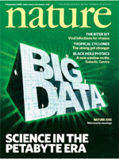
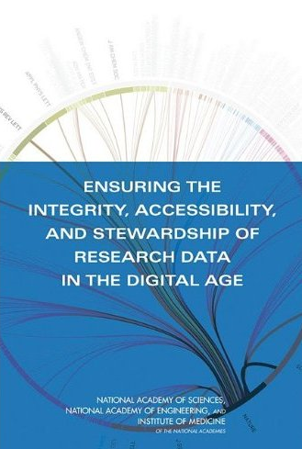
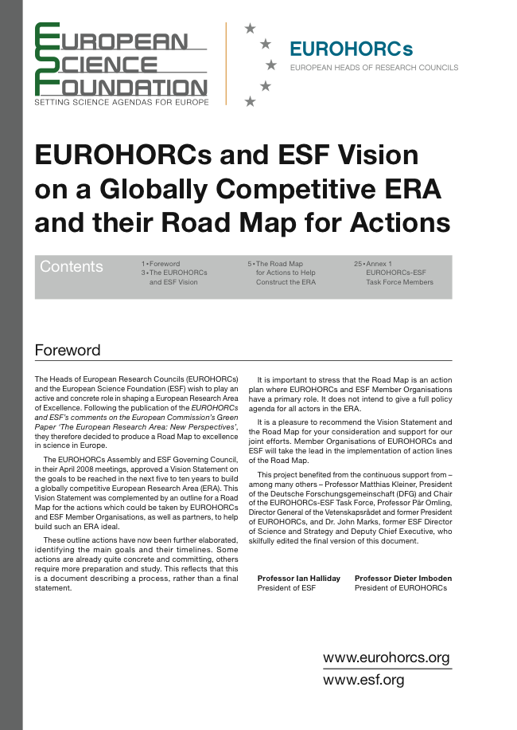
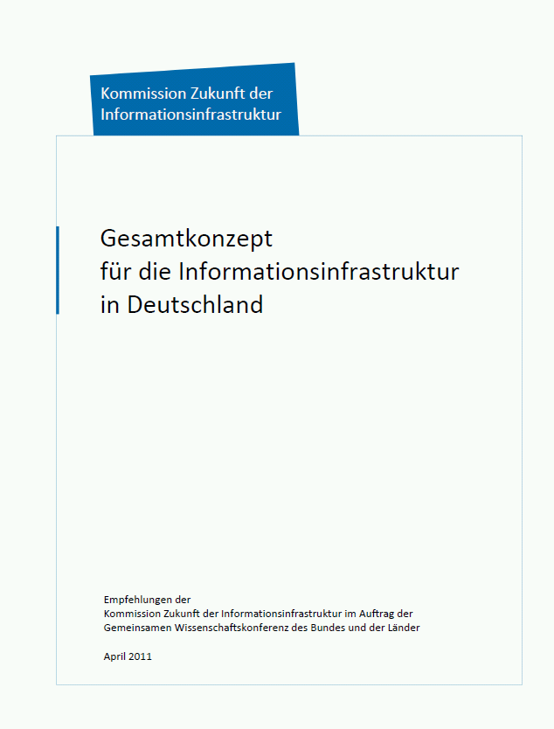
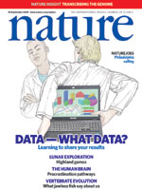
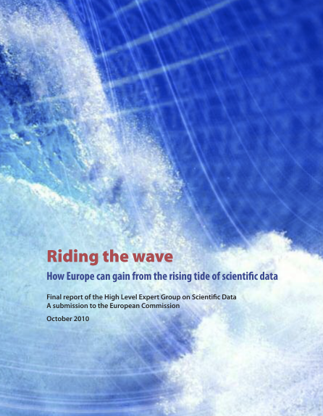
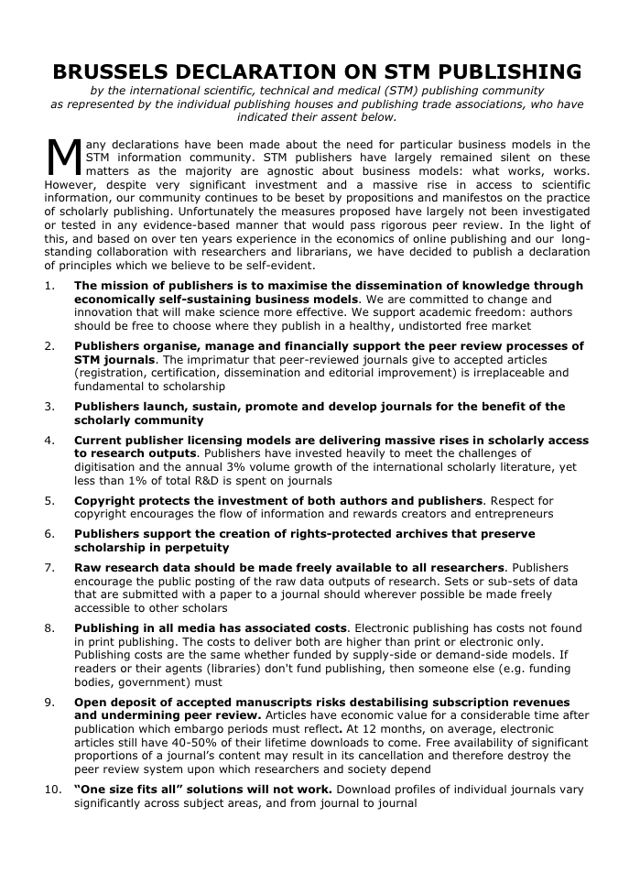
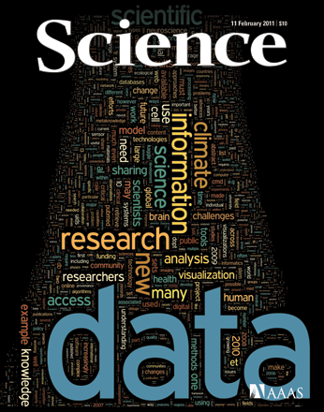
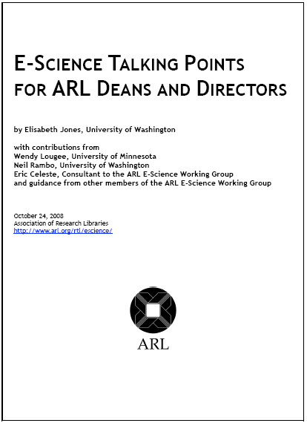
BACKGROUND
et al
Notes:
2

Slide 3
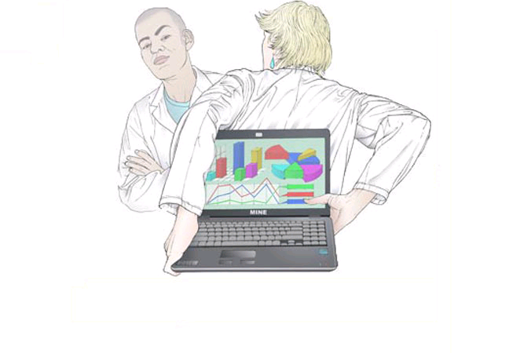
BACKGROUND
Illustration: http://www.nature.com/news/specials/datasharing/index.htm
Notes:
3

Slide 4
ODE‘s Task
Take a fresh look at and identify barriers and drivers to data sharing
by interviewing distinguished representatives of all stakeholder groups
by collecting "success stories”, “near misses” and “honourable failures” in data sharing, re-use and preservation.
Notes:
4

Slide 5
Barriers and Drivers
accreditation & certification
education
culture & attitude
legislation
quality
funding
cooperation
data sharing
policies
publishing & visibility
data flow improvements
Infrastructure
disciplines
career
efficiency
Notes:
5

Slide 6
To Unravel Complexity
Extract meaningful, to the point information and actionable advice
Short paper per group of stakeholders
Why should you care?
What are our credentials?
What has ODE learned from others (about you)
What you can do
Advisable actions with highest impact only
For more: read full reports
Notes:
6

Slide 7
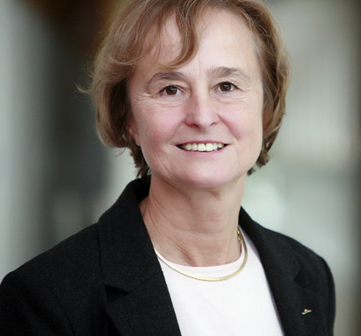
One of ODE‘s TALES
Built a data base for deep sea biological and geochemical data from a variety of sources.
1775 published and unpublished data sets were collected in two years
Learned that one may need to to pay research groups to prepare their (existing) data for incorporation in the ADEPD database
Karin Lochte
Vice-President Helmholtz Assoc., member German Science Council, EC-expert group on Research Infrastructures, …
Notes:
7

Slide 8
Researchers: Why Care?
Successful examples, such as sharing data through the Worldwide Protein Data Bank, Pangaea and GenBank, ...
reminds also of major differences between disciplines
… sharing in your discipline may be worth the effort as well.
there are (many) more examples too difficult to be presented in half a paragraph:
GalaxyZoo (too advanced / foreign concept for most?)
World Met. Org.: (too abstract/government-like?)
…
Notes:
8

Slide 9
Others‘ Views for Researchers
… publishers make it clear that their own infrastructure might not be sufficient to preserve data ...
researchers will not be aware of publishers’ problems - just perhaps if they are (chief-)editors
Data centres and libraries are willing to work with you on an incentive system ...
they might not expect libraries and data centers being active players in the area of incentives (evaluation)
…they will offer advice and training on finding, preparing and managing data.
where this is not already established, a role of libraries in data management is also not intuitive
Notes:
9

Slide 10
What Researchers Can Do (1)
… (everybody) depend(s) on your learned societies’ or editorial boards’ views … formulate rules for appropriate data management plans and best practice for sharing.
regarding matters of “culture”, societies and editorial boards are the most authoritative entities for researchers
more so than their institutions!
(If policies run counter to culture, researchers will dodge)
… which data can be shared, or where ethical or other concerns will prevent data sharing.
there are just too many good reasons for restrictions to ignore, even in the first approximation
Notes:
10

Slide 11
What Researchers Can Do (2)
… identify the best providers of data stewardship and work with them ... If capable providers do not exist …you should communicate this to your research funders.
researchers are the most credible source of guidance for data managing institutions as well as for funding agencies
they must not expect to get good infrastructure without their own activity
“Credit where credit is due!”
On credit for providing open access, we met – even in one person – much ambiguity by data producers.
Even more so, data consumers need convincing that data should be regarded “cite-worthy” items.
Notes:
11

Slide 12
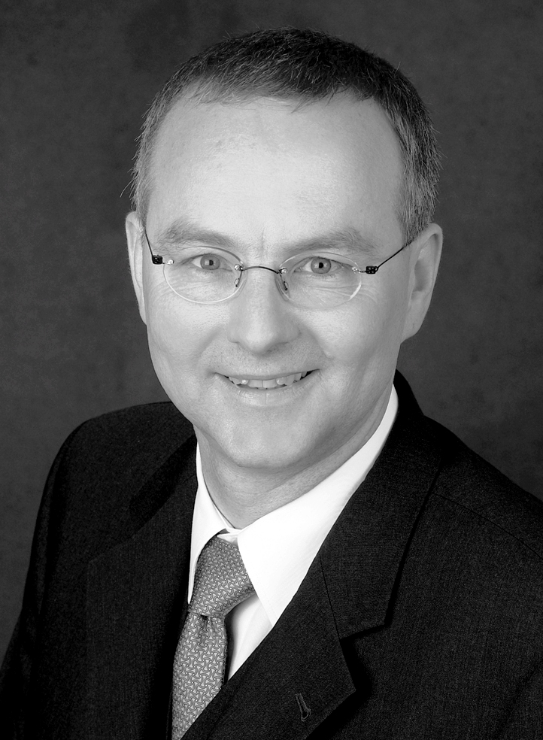
One of ODE‘s HYPOTHESES
“Without the infrastructure that helps scientists manage their data in a convenient and efficient way, no culture of data sharing will evolve.”
Stefan Winkler-Nees
Deutsche Forschungs-Gemeinschaft (DFG)
Notes:
12

Slide 13
Funders: Why Care?
… leading examples such as the Worldwide Protein Data Bank, Pangaea and GenBank show ...
hints also (obliquely) at huge differences between (disciplinary) funders’ activities, priorities and policies
… increase the benefits and outcomes of research funding ...
above all, funders will always need justification for their policies, funding rules and decisions
Notes:
13

Slide 14
Others‘ Views for Funders
Researchers have to balance priorities of data … sharing with pressures such as publication of papers.
hint: It is you who hold researchers back form sharing by “data-blind” evaluation and funding criteria
… reduces long-term costs … data regeneration is more expensive ...
good preservation requirements are also good economic/financial practise!
… sustainable solution lies in the distributed data infrastructure ...
Don’t even try to enforce simple solutions
Notes:
14

Slide 15
What Funders Can Do (1)
… promote explicit funding for data management in research grants ...
this is the most effective, plausible way to establish funding for data stewardship (perhaps not clear to every funder)
… co-ordinate policies with other funders and across disciplines … data as a measure of academic prestige, …taking data into account as well as publications when planning research evaluations.
Don’t even try to re-invent the wheel
co-ordinating policies across disciplines may re-enforce simplicity - see scientific publishing paradigm
Notes:
15

Slide 16
What Funders Can Do (2)
… ensure funding for co-ordinated development and maintenance of basic institutional or discipline-based infrastructures...
There are (still?) major differences in emphasis of approaches even between sophisticated funders, e.g. regarding the importance of institutional vs. disciplinary infrastructures
… data skills training in postgraduate courses.
we encountered the skills/training question ever so often. Postgraduate education is the most obvious first step
Notes:
16

Slide 17
Conclusion
From a rich and complex source of information on data sharing
We extracted and prioritized challenges to researchers and funders (why care and what you can do)
We transferred evidence and enablers of change between disciplines and stakeholder domains
Notes:
17

