Slide 1
ODE final meeting Data centres and data sharing Frascati, 7 November 2012
Simon Lambert Scientific Computing Department STFC, UK

Slide 2
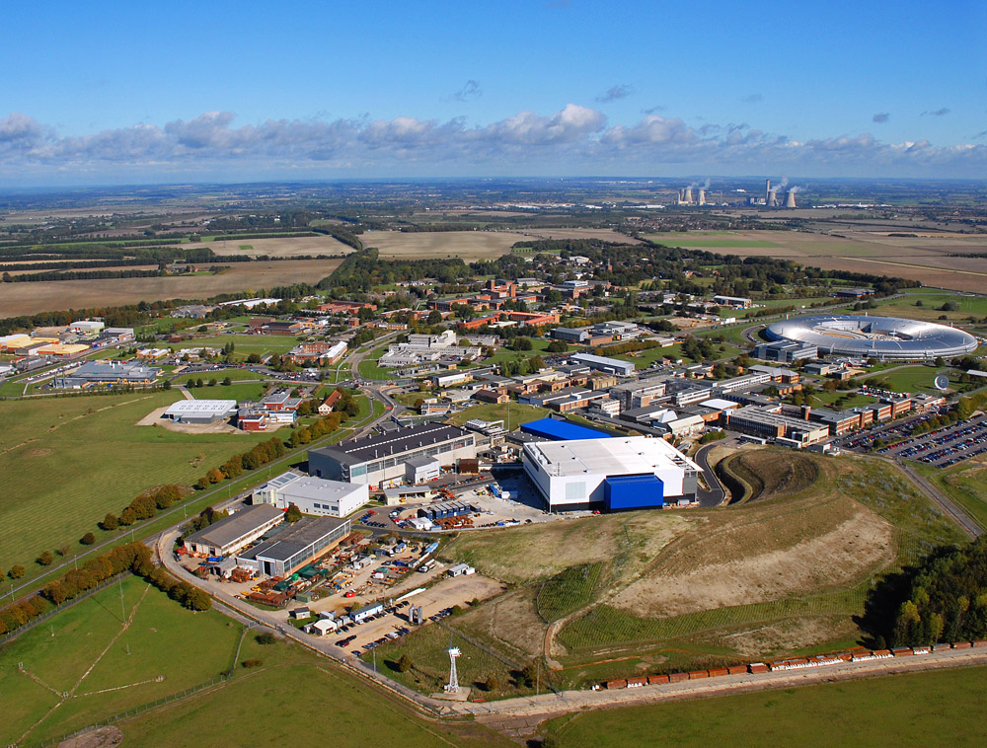
STFC and science data
Science and Technology Facilities Council
Operates large-scale scientific facilities
Funds research in particle physics and astronomy
Large and complex data holdings
STFC Rutherford Appleton Laboratory

Slide 3
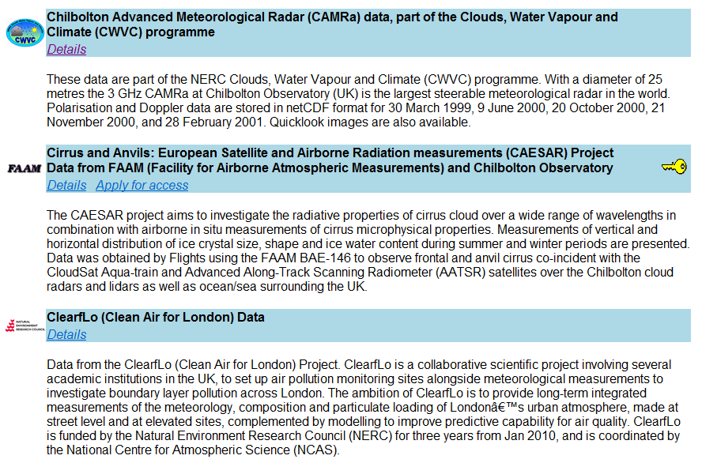
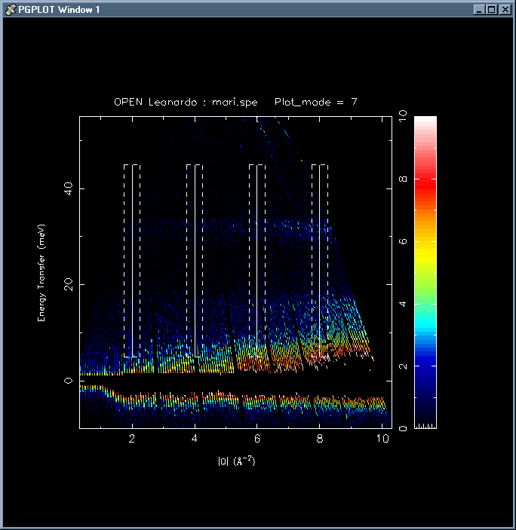
STFC and science data
British Atmospheric Data Centre
Petabyte store tape robot
ISIS data analysis

Slide 4
Diversity of data centres … and of practices
Where do researchers put their data?
PARSE.Insight survey
20% of respondents stored their research data in a digital archive, of whom …
14% using an organisation archive
6% a discipline archive
Why?
That’s the way the science works ~ Imposed obligation ~ ‘Culture’ etc.

Slide 5
Responsibilities of data centres
Preprocessing (perhaps)
Quality control (perhaps)
Persistent identification
Long-term preservation
Standards
…

Slide 6
What makes for successful data sharing?
Know the communities
Maintain highest standards of data management
Trustworthiness
Sustainable funding and management
… and …

Slide 7
What makes for successful data sharing?
“Actively seek to work within the global research network by forging links with other data centres, with research institutions, with publishers, and with complementary service providers.”

Slide 8
Data centres as part of a whole
Making data sharing happen
Researchers
Libraries
Data centres
Publishers
Funders and policy makers

Slide 9
The forces at work in data sharing
Encourage
Obstruct
DRIVERS
BARRIERS
Overcome
ENABLERS

Slide 10
Barriers to data sharing
Part of the problem or part of the solution?
Risk that data holders cease to operate, and archive is lost
Lack of data reviewers in infrastructure to assure data quality
Introducing specific job profiles with career paths for data preparation and quality assurance staff – such staff may be embedded in research groups or hosted in data centres
Impossibility of data centre staff having detailed technical knowledge of all data
Data centres meeting minimum standards of data curation must be available to scientists in all disciplines, so that they have confidence their data will be correctly attributed, its integrity will be maintained, and any restrictions such as embargos and protection of commercial confidence will be properly applied

Slide 11
Working together
Relationships (between data centres and other parties)
Efficiency
Where is the job best done?
Trust (short and long term)
Data centre as a Trustworthy Digital Repository?

Slide 12
Working together
Data centres and researchers
The “designated community”
Benefits for researchers
Integration with workflows
Data lifecycle and data management in science

Slide 13
Working together
STM declaration
“Raw research data should be made freely available to all researchers. Publishers encourage the public posting of the raw data outputs of research. Sets or sub-sets of data that are submitted with a paper to a journal should wherever possible be made freely accessible to other scholars”
Data citation
Reciprocal linking with publishers

Slide 14
Conclusions
“Data centres should …”
Institutional repositories
Designated community
Sustainability
Links with publishers
Trust and authority
Citation and metadata standards
Data lifecycle
Institutions of research and teaching
Training and professional development

