Slide 1
Project Overview
APA Conference 2012
ESA/ESRIN (Frascati), 6-7 November 2012
M. Albani (European Space Agency)

Slide 2
Presentation Outline
Project Overview
Combined User Requirements and Use Cases
Services and Toolkits

Slide 3
Introduction & Participants
Project: SCIence Data Infrastructure for Preservation – Earth Science (SCIDIP-ES)
INFRA-2011-1.2.2 Data infrastructures for e-Science
Project ID: 283401
Project Type: CP-CSA
Start Date: 01.09.2011
Duration: 36 Months
Website: www.scidip-es.eu
Total Budget: 7,721,082 €
EC Funding: 6,599,992 €
Total funded effort in person/months: 605
Coordinator: European Space Agency
Contact Person: Mirko Albani (ESA)
Project Consortium (17 partners):
Earth Science
Industrial
Researchers
Notes:
The consortium consists of partners dealing with Data Preservation from different perspectives:
Earth Science Data Managers: applying data preservation to own data holdings and making those available to end users.
Researchers in Digital Data Preservation, standards and modelling.
Industrial Partners: performing R&D activities and software development.
Earth Science repositories - Operative context - Provide precise use cases, needs, constraints.
Industrial partners guarantee a professional approach to software modelling, coding and assessment
Research and development - OAIS - bringing experience coming from prjs such as CASPAR and SCHAMAAN into SCIDIP
Big industry is not inside the consortium: we do not want to relay on proprietary solutions
Users are involved indirectly through our surveys and workshops
3

Slide 4
International Context
“A fundamental characteristic of our age is the raising tide of data – global, diverse, valuable and complex. In the realm of science, this is both an opportunity and a challenge.”
Report of the High-Level Group on Scientific Data, October 2010, “Riding the Wave: how Europe can gain from the raising tide of scientific data”
Data Intensive Science (4th Paradigm): data at the centre of the scientific process.
EC Recommendation 2012/417/EU, July 2012: “Access to and preservation of scientific information”.
Data is the new gold. “We have a huge goldmine ….. Let’s start mining it.”
Neelie Kroes, Vice-President of the European Commission responsible for the Digital Agenda

Slide 5
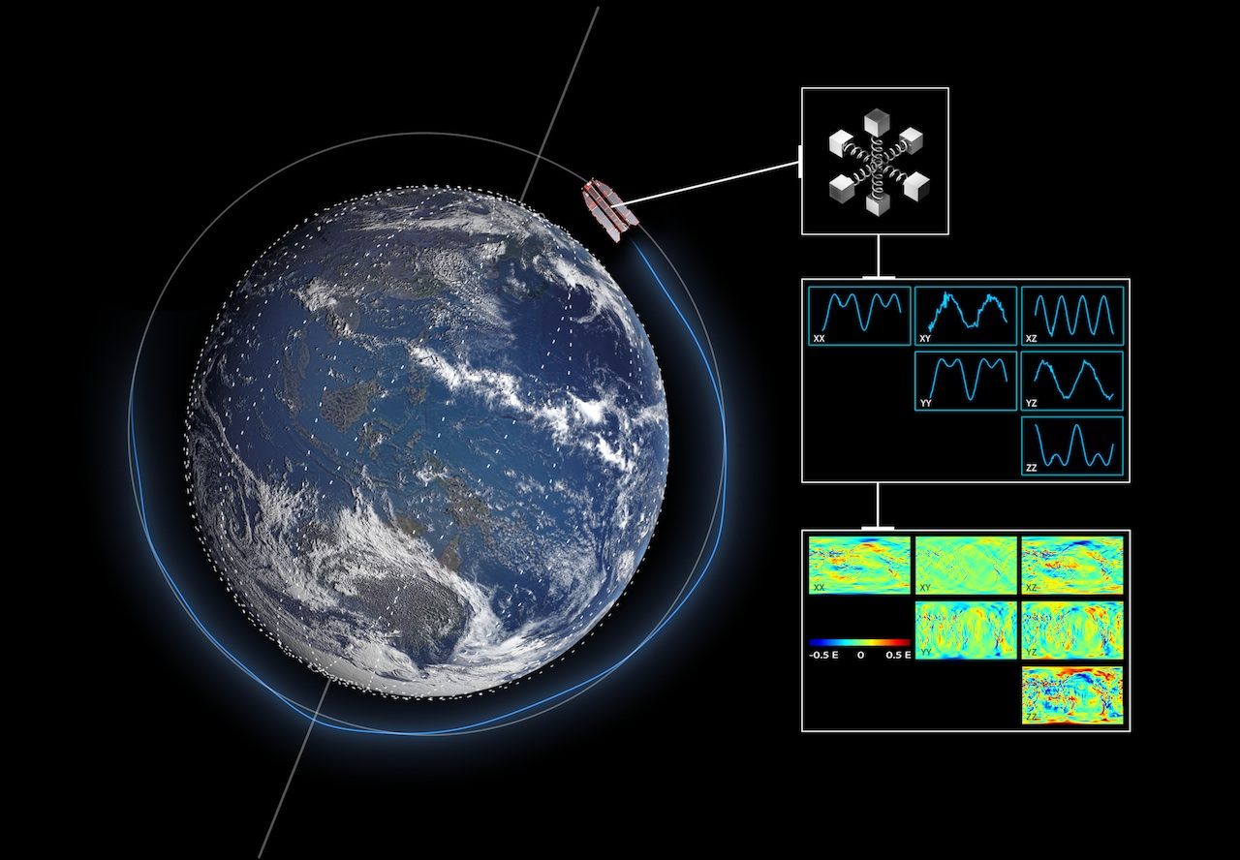
An example of data lifecycle: sensed data need to be acquired…
Level 0
001 | 4100
002 | 4102
003 | 4102
004 | 6144
005 | 6150
006 | 7168
007 | 6146

Slide 6
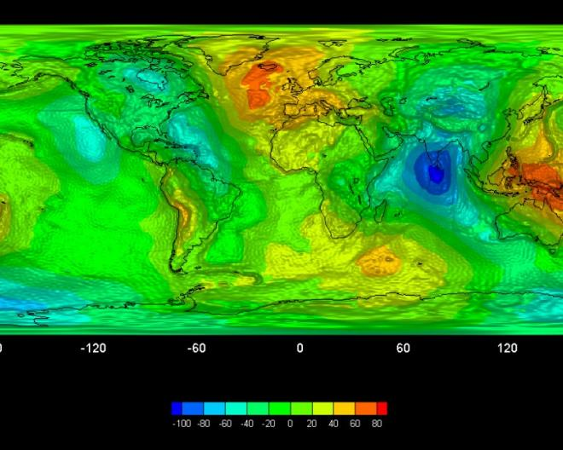
...to be combined and processed to get this
Processing/combining
Processing
Level 0
Level 1
Level 2

Slide 7
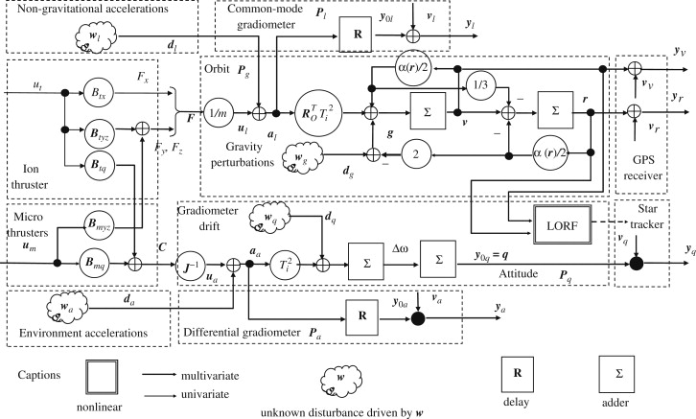
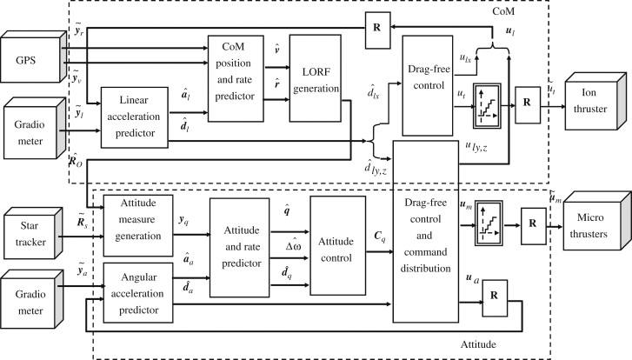
...through complex processing schemes
Algorithm
Manual

Slide 9
Data & Knowledge Preservation
Level 0
Level 1
File specs.
Desc. Info
Processor
Algorithm
User Manual
Publications
The preservation of data (the “bytes”) is useless without the preservation of the knowledge associated with the data (e.g. the “quality”, the process to generate them).
We must:
Ensure and secure the preservation of archived data and associated knowledge ideally for an unlimited time span.
Ensure, enhance and facilitate archived data accessibility.
Allowing to combine data from different sources and to perform more complex analyses (data unfamiliar become familiar)
Ensure coherency of approaches among different Earth Science providers.

Slide 10
Genesis of the SCIDIP-ES project
Two aspects are considered:
Technical – based on the advancements in research for digital data preservation.
Domain Specific – based on Earth Science needs.
Notes:
The 2 parents need to work together to raise the child

Slide 11
SCIDIP-ES Objectives
To develop and deploy generic and sustainable digital data preservation services and toolkits.
Validate and use them in the Earth Science domain as a start.
To harmonise data preservation policies and approaches, metadata and ontologies in the Earth Science domain:
Paving the way for the set-up of an harmonized and common approach for the Long Term Preservation of Earth Science Data.

Slide 12
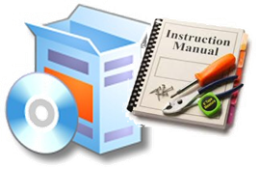
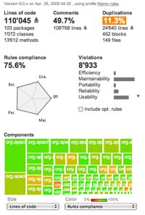
SCIDIP-ES Journey
Earth Science Survey,
Requirements
& Use Cases
SEP 2011
JUN 2012
Interactive Platform &
Initial Prototype
S&T Release
Earth Science
Harmonization
Halftime S&T Release
MAY 2013
FEB 2013
FEB 2014
Final S&T
Release
AUG 2014
Earth Science
LTDP Architecture
Services Final Testing
& Assessment
Notes:
The first year of the project focused on preparation of documentation for requirements, data models, surveys, specifications, research results for putting in place a key achievement: the 1st Interactive Platform
That achievement poses the basis for providing/presenting the results to a ES Community which we are building.
Interactive Platform and ES Community will characterise our second year of activities, allowing the SCIDIP-ES to organise dedicated workshops for growing the consensus and awareness around the innovative results for supporting LTDP tasks.
Moreover, workshops will be arranged in cooperation with other LTDP initiatives for addressing efficiently the issues (especially from the research perspectives)
The Final release (iterative and incremental development process) of Interactive Platform will allow to move forward by performing:
«User Testing»
««Services Assessment & Evolution»
Based on those important reports, the ES-community could take the right decision for adoption or evolution. Moreover, a liason activity could be considered for identifying «priorities and interests» within the SCIDIP-ES services/toolkits.

Slide 13
SCIDIP-ES Cooperation
Non-Earth Science Community
Earth Science Community
MoUs with
FP7 Projects
ESA
MoUs with FP7 Projects
e-Infrastructure
ESA, APA,
GIM, STFC
ESA, DLR, CNES
Earth Observation Space Community

Slide 14
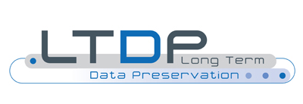
The Complete Picture
Needs and Communities
Technology and
Infrastructure Heritage
System and standards
SCIDIP
European preservation agenda
High Level Expert Group
European
E-Infrastucture
Other Communities
From generic to specific
From specific to generic
Earth Science Case
Earth Science
Notes:
The need to preserve data is expressed by different communities in different domains. Earth Science is a key example of broad and worldwide distributed community with this need and is very active in the Data preservation field.
Several projects in the past have addressed digital data preservation and produced visions, tools, approaches, prototype services, etc.
Infrastructure and standards related to digital data and archiving models (e.g. OAIS) are in place.
SCIDIP-ES is putting together in the same project key user and provider communities in the Earth Science and in other domains, is including the key technology partners from the key FP projects who addressed in the past the preservation of digital data, and has unique links to standardization bodies and broader communities in particular in the Earth Science domain.
BACK-UP TEXT
This was produced recently by the EU’s High Level Expert Group on Scientific data – presented to Commissioner Redding last year.
Create a robust, reliable, flexible, green, evolvable data framework with appropriate governance and long-term funding schemes to key services such as Persistent Identification and registries of metadata.
Propose a directive demanding that data descriptions and provenance are associated with public (and other) data.
Create a directive to set up a unified authentication and authorisation system.
Set Grand Challenges to aggregate domains.
Provide “forums” to define strategies at disciplinary and cross-disciplinary levels for metadata definition.
IMPACT IF ACHIEVED
Dramatic progress in the efficiency of the scientific process, and rapid advances in our understanding of our complex world, enabling the best brains to thrive wherever they are.

Slide 15
Earth Science Data Preservation status and needs
Earth-Science data managers have individually dealt for decades with preservation and access to heterogeneous and complex scientific data.
BUT need to:
Improve effectiveness of data preservation through the application of standard approaches and tools and exploitation of latest Digital Preservation developments and achievements (i.e. SCIDIP-ES services and toolkits). Reduce preservation threats.
Ensure preservation of data but also of all context/provenance/quality information: Data Records, Processing Software, Documentation.
Harmonize preservation approaches and policies and coordinate efforts to better support pressing needs from very sensitive applications.
Enhance interoperability and facilitate data usability and access by the scientific user community.

Slide 16
What will SCIDIP-ES do for Earth Science?
Provide state of the art data preservation services and toolkits.
Raise awareness on data preservation issue and enhance dialogue in this context between ES data repositories:
Paving the way for the set-up of an Earth Science LTDP Framework
Define common preservation policies and approaches.
Propose path for harmonizing metadata, semantics, ontologies, and data access policies:
Facilitating data discovery and use.
Define an Earth Science LTDP framework governance model and architecture.

Slide 17
Starting from…..
Achievements in the domain of Earth Observation from space: Ground Segment Coordination Body LTDP Working Group.
Reviewing the Earth Observation results in light of OAIS and latest digital preservation techniques and standards and extending them to the Earth Science domain.

Slide 18
Earth Science Activities Workflow
Year 1 Surveys
Year 2 WP33 Harmonization
Year 3 WP33 LTDP Architecture
MAIN BLOCKS of ACTIVITIES

Slide 19
Survey Rationale
Survey of earth science users to assess understanding of issues and level of expertise with respect to long-term data preservation
Identify current existing and utilised:
Data preservation policies and guidelines
Metadata, semantic and ontology models
Technologies for data discovery, access, management and visualisation

Slide 20
Survey Methodology
Independent search activity
T15.2 Survey of policies and technologies
T15.3 Survey of metadata, semantics and ontologies
On-line user survey
D15.1 Report on survey of technologies, policies, metadata, semantics and ontologies
On-line user survey
In-depth user consultation
In-depth user consultation
Notes:
The results of all elements of the survey have been synthesised into D15.1 Report on survey of technologies, policies. Metadata, semantics and ontologies

Slide 21
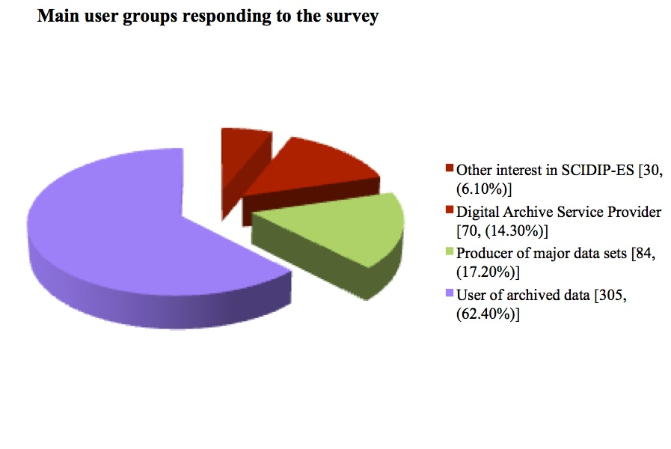
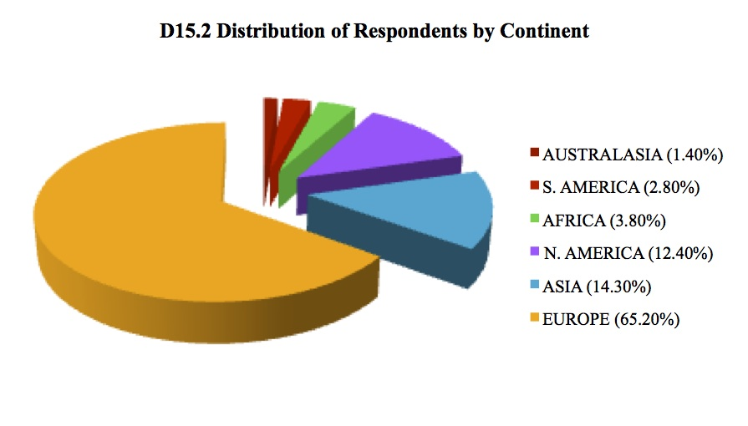
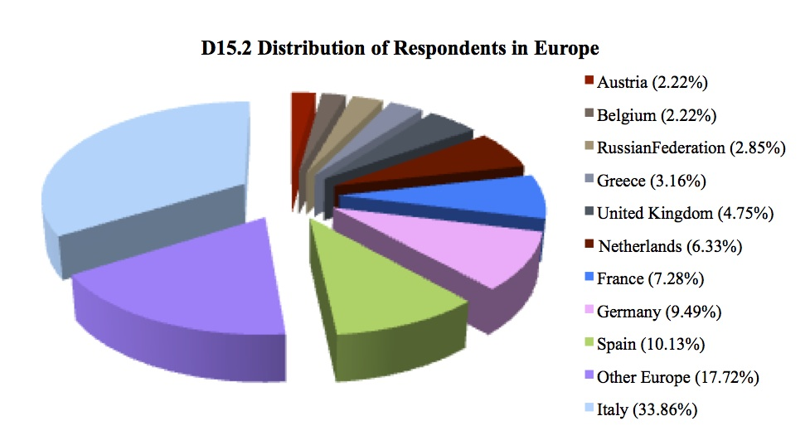
Survey Results: 551 responses
Notes:
The total number of responses to the surveys were 551 and reflect feedback from a range of user groups
Originating largely from Europe but there were also responses from other regions as well.
The survey therefore included input from a wide range of respondents with the level of detail in the responses also being quite varied.

Slide 22
Survey Results: analysis
System infrastructure and architecture
Data discovery
Data access
Processing, knowledge, extraction and management
Data preservation, technologies, policies and guidelines
Metadata, semantics and ontologies
Notes:
The remaining outcomes of the survey provided additional insight to the current state of the art wrt to data preservation within the earth science domain and are categorised under a series of headings
The structure of the deliverable itself was also developed to reflect these headings with the objective of the deliverable being more focussed on specific topic headings which would then form direct input into the WP33 activities

Slide 23
Survey conclusions
System infrastructure and architecture
Archive systems:
EO community: proprietary systems/ Others: open source e.g PostGres
Often based on tape archives / disk storage for rapid access to frequently used datasets
Users generally have a better understanding of the discovery and retrieval system used to access the data than the underlying archive services
Data discovery
Metadata standards ISO19115/19119 widely used in the ES domain
Metadata harvesting methods include OpenSearch 1.1 and Open Archives Protocol for Metadata Harvesting (OAI-PMH)
Earth Observation data also uses the Earth Observation Metadata profile of observations and measurements

Slide 24
Survey conclusions
Data access
Web services are most commonly used for accessing an archive
Web based forms + FTP download or off-line ordering also used for very large data sets
Wide variety of portals currently in use for accessing different data types
Large cyber infrastructure projects also providing data access services e.g GEOSS, EarthCube
Processing, knowledge extraction and management
Data analysis software separate from data discovery and access services
Data processing using a range of tools that are not domain specific
Limited number of file formats
Trend towards researchers using data beyond their own disciplines and from other geographic regions
Notes:
Data analysis software is generally separate from the data discovery and access software. Basic tools are sometimes provided e.g. plotting tools
More complex visualisation tools are sometimes provided but these tend to be less common
A wide range of data processing tools are used. Many of these are not used solely in the ES domain but are also used elsewhere e.g MATLAB, ArcGIS etc.
A limited number of file formats are in use in the ES domain. Specifically image files are important as are database formats. In addition NetCDF is relativley widely used in the ES domian..

Slide 25
Survey conclusions
Data preservation, technologies, policies and guidelines
Archive service providers expect to retain data for up to 10 years
Data producers tend towards 5 to 10 years for retention of data
Stakeholders would like to retain data indefinitely but in reality this is between 10 and 20 years
Data preservation policies most common in EO domain and follow OAIS model and LTDP guidelines
Metadata, semantics and ontologies
Main use is for querying and exchanging data
Many of the models are XML based
Majority are dealing with geoinformatics
Findings and recommendations from WP15 and WP33 on data discovery and access will be made available to ES Community for further implementation.
Collaboration with other projects (e.g. GENESI-DEC, ENVRI).
Notes:
Data preservation
archive service providers expect to retain data for at least10 years BUT should be noted that a significant number of the archive service providers only expected to retain the data for 5 to 10 years
Data preservation policies
Significant number of high profile earth science organisations do not have a formally documented preservation policy. However, they do have clear data preservation objectives . The survey clearly shows that earth science organisations are well aware of the issue of data preservation

Slide 26
Survey Methodology
Independent search activity
T15.2 Survey of policies and technologies
T15.3 Survey of metadata, semantics and ontologies
WP33 Definition of earth science common policies, semantics, ontologies, metadata, architecture and governance model
D15.1 Report on survey of technologies, policies, metadata, semantics and ontologies
On-line user survey
On-line user survey
In-depth user consultation
In-depth user consultation
Notes:
Results of the surveys conducted in WP15 will be used as input to the definition of the common earth science data preservation policies, harmonised semantics, ontologies and metadata being undertaken in WP33.

Slide 27
Earth Science Harmonization Activities Objectives
Analyse data preservation policies in the different Earth Science domains and define common one. Analyse data access policies and consider possibility to propose one for subsets of ES data.
Define strategy for harmonisation of metadata, ontologies and semantics.
Analyse gaps in terms of data preservation and interoperability.
Define European LTDP Framework functional architecture and governing principles.
TASK 33.1
TASK 33.2
TASK 33.3
TASK 33.4
Notes:
27

