Slide 1
Project Overview
APA Conference 2012
ESA/ESRIN (Frascati), 6-7 November 2012
D. Giaretta (APA)

Slide 2
Data is the new gold. “We have a huge goldmine … Let’s start mining it.”
  Neelie Kroes, Vice-President of the European Commission responsible for the Digital Agenda

Slide 3
But…
Gold is precious because
  it is rare
  it does not combine with other elements
  it does not perish
Data is precious because
  there is so much of it
  it is more valuable when it is combined together
  it is highly perishable
Need to ensure long term preservation, accessibility, understandability and usability of data

Slide 4
Threats to preservation of data
Data needs to be preserved against changes in:
  Technology – hardware and software
  Environment
    Semantics and Ontologies
    Standards
    Community of data users
  Tacit knowledge of users
Notes:
Provide examples here

Slide 5
Basic preservation activities
Libraries say:
“Emulate or migrate”
  Works well with data only in special cases
    Can repeat what was done before instead of new things
  Does not help with building cross-disciplinary Earth Science community
Notes:
Data is migrated – big job but is done sometimes.
Emulation is sometimes used but mainly for repeating processing for some specific reason. More generally users do not want to simply repeat what has been done before.

Slide 6

Data contains numbers etc – need meaning

Slide 7
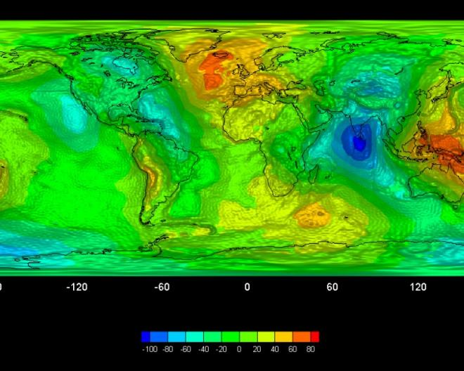
...to be combined and processed to get this
Processing/combining
Processing
Level 0
Level 1
Level 2

Slide 8
Our approach
For information preservation and re-use: get Representation Information or Transform
Alternatively move to another repository
Notes:
The important thing is to say the right words accompanying this and other slides

Slide 9
Representation Network
GOCE Level 1
(N1 File Format)
GOCE Level 0
Processor
Algorithm
GOCE Level 0
GOCE N1 file
standard
GOCE N1 file
Dictionary
GOCE N1 file
description
PDF standard
Dictionary specification
PDF software
XML

Slide 10
Transformation
Change the format e.g.
  Word → PDF/A
    PDF/A does not support macros
  GIF → JPEG2000
    Resolution/ colour depth…….
  Excel table → FITS file
    NB FITS does not support formulae
  Old EO or proprietary format → HDF
    Certainly need to change STRUCTURE RepInfo
    May need to change SEMANTIC RepInfo
We can help with making the decision whether or not to transform

Slide 11
Hand-over
Preservation requires funding
Funding for a dataset (or a repository) may stop
Need to be ready to hand over everything needed for preservation
  OAIS (ISO 14721) defines “Archival Information Package (AIP).
  Issues:
    Storage naming conventions
    Representation Information
    Provenance
    ….

Slide 12
When things changes
We need to:
  Know something has changed
  Identify the implications of that change
  Decide on the best course of action for preservation
  What RepInfo we need to fill the gaps
    Created by someone else or creating a new one
  If transformed: how to maintain data authenticity
  Alternatively: hand it over to another repository
  Make sure data continues to be usable
Orchestration Service
Gap Identification Service
Preservation Strategy Tk
RepInfo Registry Service
Authenticity Toolkit
Storage Service
RepInfo Toolkit
Data Virtualisation Toolkit
Process Virtualisation Toolkit
Notes:
We want to emphasize here that there is a need for specific preservation software and start giving some names to things.

Slide 13
How do we know that the services:
Satisfy a general demand?
Help with preservation?
Evidence
Notes:
I let this one to you, David. Here we say from where this sw solutions are coming from

Slide 14
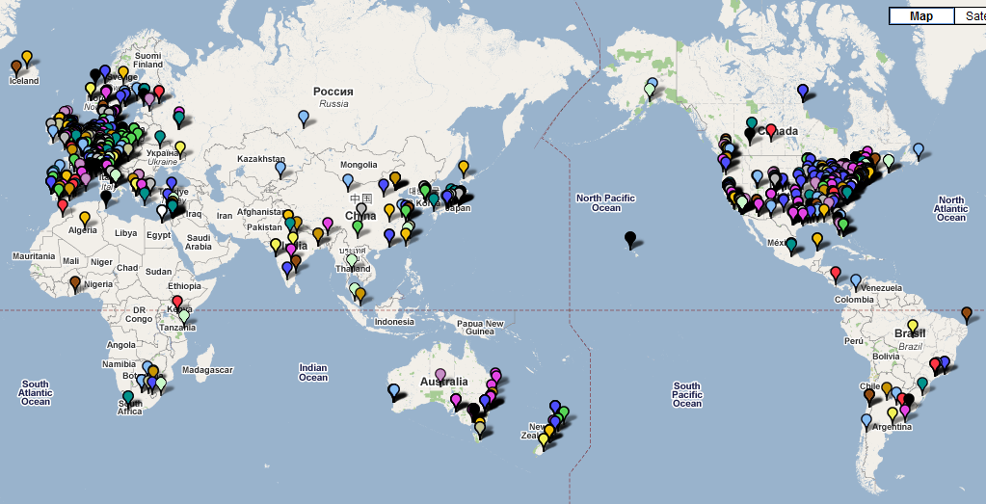
Parse.Insight survey
Responses from researchers, data managers and publishers:
44% Europe
33% USA
23% rest of world
Researchers:
1/3 Europe
1/3 USA
1/3 rest of world
Notes:
I would not emphasize the “several thousands” responses …because they were less than 2 thousands and we have “only” 500 replies on our survey ;-)

Slide 15
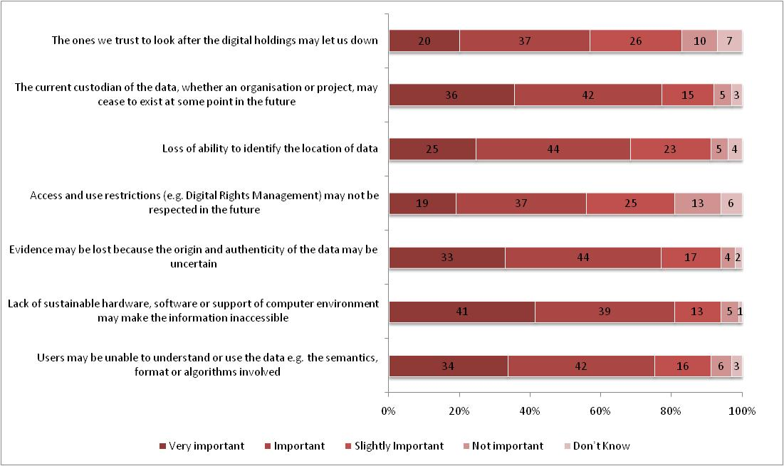
Threats to preservation (R)
The ones we trust to look after the digital holdings may let us down
The current custodian of the data may cease to exist
Loss of ability to identify the location of data
Access and use restrictions may not be respected in the future
Evidence may be lost
Lack of sustainable hardware/software
Users may be unable to understand or use the data

Slide 16
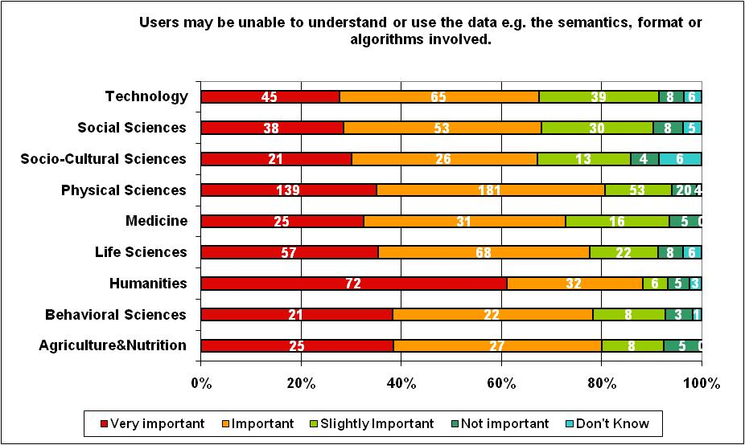
Threats to preservation (R)
Users may be unable to understand or use the data e.g. the semantics, format or algorithms involved.

Slide 17
Threat | Requirement for solution
Users may be unable to understand or use the data e.g. the semantics, format, processes or algorithms involved | Ability to create and maintain adequate Representation Information
Non-maintainability of essential hardware, software or support environment may make the information inaccessible | Ability to share information about the availability of hardware and software and their replacements/substitutes
The chain of evidence may be lost and there may be lack of certainty of provenance or authenticity | Ability to bring together evidence from diverse sources about the Authenticity of a digital object
Access and use restrictions may make it difficult to reuse data, or alternatively may not be respected in future | Ability to deal with Digital Rights correctly in a changing and evolving environment
Loss of ability to identify the location of data | An ID resolver which is really persistent
The current custodian of the data, whether an organisation or project, may cease to exist at some point in the future | Brokering of organisations to hold data and the ability to package together the information needed to transfer information between organisations ready for long term preservation
The ones we trust to look after the digital holdings may let us down | Certification process so that one can have confidence about whom to trust to preserve data holdings over the long term
RepInfo toolkit, Packager and Registry – to create and store Representation Information.
In addition the Orchestration Manager and Knowledge Gap Manager help to ensure that the RepInfo is adequate.
Registry and Orchestration Manager to exchange information about the obsolescence of hardware and software, amongst other changes.
The Representation Information will include such things as software source code and emulators.
Authenticity toolkit will allow one to capture evidence from many sources which may be used to judge Authenticity.
Packaging toolkit to package access rights policy into AIP
Persistent Identifier system: such a system will allow objects to be located over time.
Orchestration Manager will, amongst other things, allow the exchange of information about datasets which need to be passed from one curator to another.
Certification toolkit to help repository manager capture evidence for ISO 16363 Audit and Certification
Notes:
This can be inserted only once, later on… with caspar “answers”

Slide 18
CASPAR inheritance
CASPAR – an FP6 project
Completed fundamental research into digital preservation
Produced prototypes for services and toolkits which SCIDIP-ES is building on
Produced evidence that these services and toolkits did help in digital preservation

Slide 19

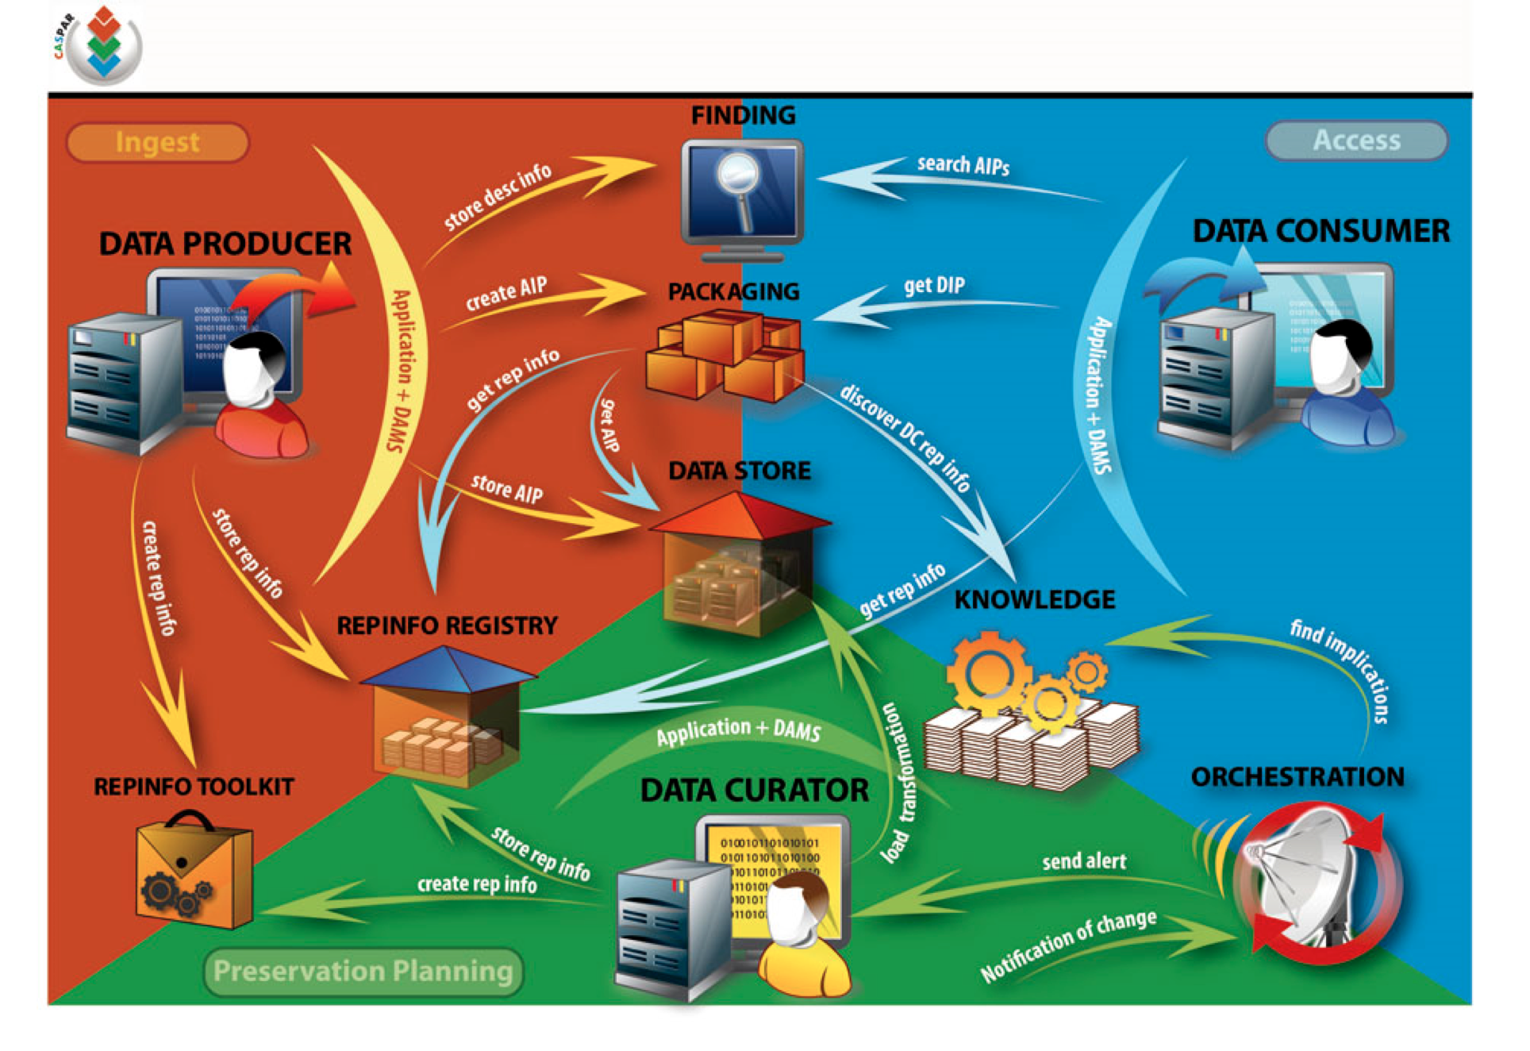
The CASPAR flows

Slide 20
CASPAR Testing
Notes:
How they satisfied the main needs

Slide 21
The complete view
External PI services
Persistent ID i/f Service
Certification Toolkit
ISO Certification Organisation
Services: run on remote servers
External Access/Use Services
RepInfo Registry Service
Gap Identification Service
Orchestration Service
Storage Service
Toolkits Runs on local machines
Preservation Strategy Toolkit
Finding Aid Toolkit
RepInfo Toolkit
Packaging Toolkit
Cloud Storage
Process Virtualisation Toolkit
Authenticity Toolkit
Data Virtualisation Toolkit
These SUPPLEMENT what repositories do (customised for repositories)
Make it easier for repositories to do preservation – share the effort
Notes:
This is the overall picture bringing together the pieces we introduced above and will talk about in detail later

Slide 22
When things change
We need to:
  Know something has changed
  Understand the implications of that change
  Decide on the best course of action for preservation
  What RepInfo we need to fill the gaps
    Created by someone else or creating a new one
  If transformed: how to maintain data authenticity
  Alternatively: hand it over to another repository
  Make sure data is now usable and close the process
Orchestration Service
Gap Identification Service
Preservation Strategy Tk
RepInfo Registry Service
Authenticity Toolkit
Storage Service
RepInfo Toolkit
Data Virtualisation Toolkit
Process Virtualisation Toolkit
Notes:
We want to emphasize here that there is a need for specific preservation software and start giving some names to things.

Slide 23
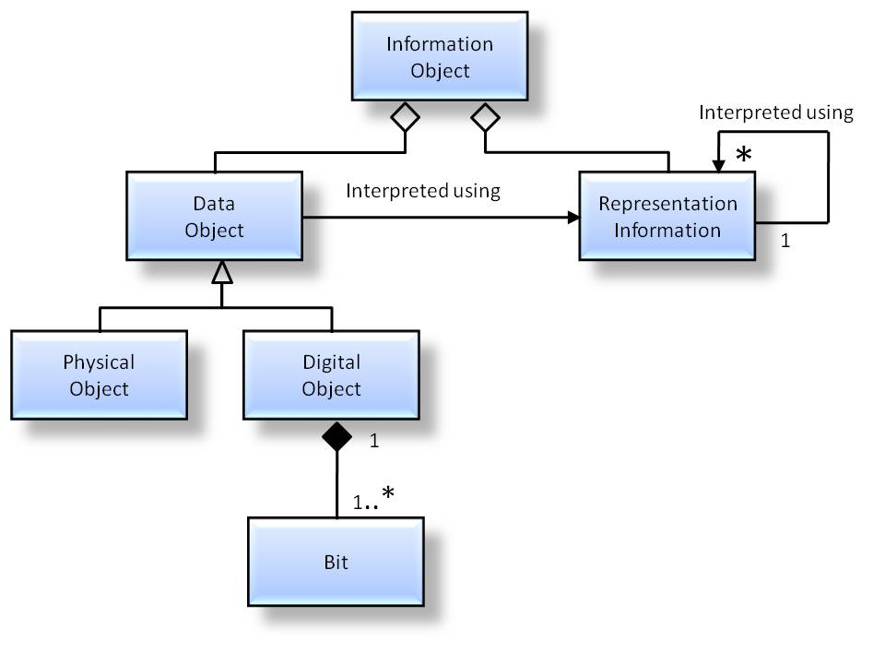
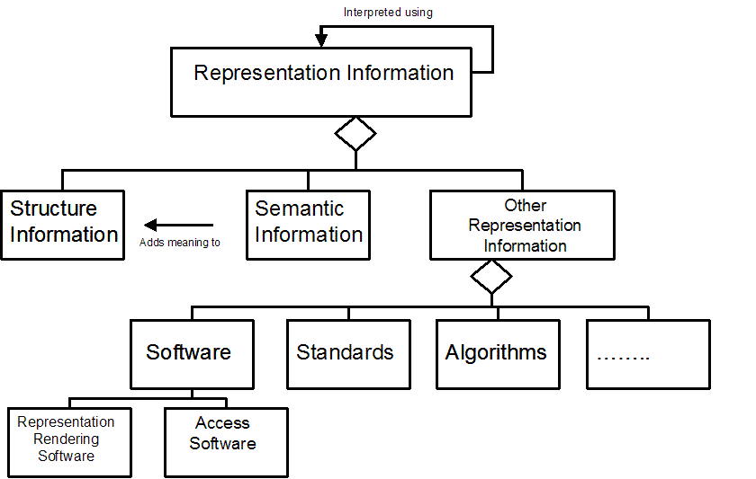
Representation Information
The Information Model is key
Recursion ends at KNOWLEDGEBASE of the DESIGNATED COMMUNITY
(this knowledge will change over time and region)
Notes:
Just to be clear – I am focussing on the OAIS Information Model

Slide 24
Representation Network
Preservation Network Model
GOCE Level 0
Processor
GOCE Level 1
(N1 File Format)
Algorithm
GOCE Level 0
GOCE N1 file
standard
GOCE N1 file
Dictionary
OR
GOCE N1 file
Description as text file
RISK: X
COST: Y
PDF standard
RISK: X’
COST: Y’
GOCE N1 file
Description as text file
GOCE N1 file
Description using DRB
PDF software
Dictionary specification
DRB specification
RISK: X’’
COST: Y’’
XML

Slide 25
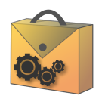

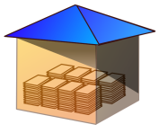

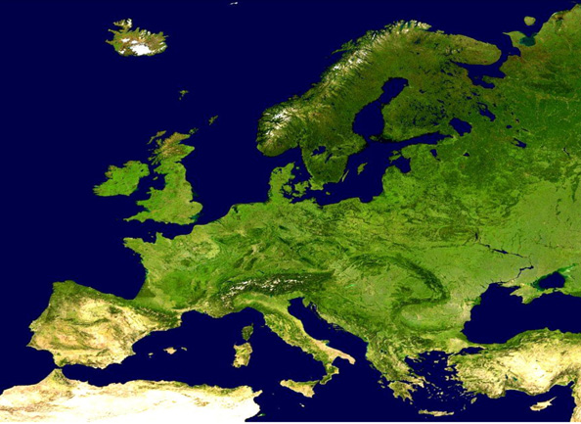
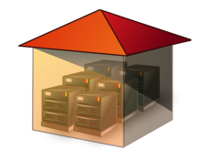



Guarantor/Exchange server node
RepInfo
Gap
Orchestration
Registry
Identification
Service
Service
Service
Storage
Service
REPINFO TOOLBOX
GAP MGR
REGISTRY
ORCHESTRATION
DATA STORE
DATA STORE
PACKAGING
AUTHENTICITY
FINDING AIDS
AIP (Archival Information Package)
Notes:
KEY MESSAGE: SCIDIP-ES supports the OAIS Information Model. It SUPPLEMENTS existing archives. Key components are distributed, heterogeneous and asynchronous
This maps the infrastructure to the OAIS INFORMATION MODEL
There will be different nodes in the system (primary and secondary) linked together. ES data owners might use the primary nodes for some services, implement other services in their own infrastructure and provide services through the external world. External SCIDIP-ES providers/users can use the Primary nodes and the services exposed to the external by the secondary nodes.
Note that we CANNOT demand that the existing repositories throw out their existing systems – we supplement existing systems.
We will take as our first example ES – very distributed, very heterogeneous, large number of users across many disciplines:
The bits may be stored in the STORAGE offering or in own storage systems (e.g. ESA (ITALY) will store its own data, STFC will offer paid STORAGE service).
Representation Information is held in the REGISTRY in STFC (UK) or in local registries (we can not say that ALL will use the Central system).
Creation of additional RepInfo is co-ordinated by the ORCHESTRATION () and GAP MANAGER ()
RepInfo is created at various places around Europe e.g. GERMANY using the REPINFO TOOLKIT
The AIP is created where the data is captured/created (where the expertise resides) e.g. Norway using the PACKGING component.
Additional information is needed in the packaging including PROVENANCE [AUTHENTICITY and ANNOTATION], DRM, ACCESS and DESCRIPTIVE INFO.
The “GUARANTOR NODE” provides the services to exchange between the separate service nodes and the fallback if services are withdrawn at other nodes
The mapping to the OAIS Functional Model may be described as:
- creation of AIPs
- ARCHIVAL STORAGE – the STORAGE component
- this would also include at least some of the DATA MANAGEMENT
- INGEST - the PACKAGING component – which picks up information from
REPINFO REGISTRY, AUTHENTICITY/ANNOTATION etc
- PRESERVATION PLANNING – from ORCHESTRATION, GAP MGR and REPINFO REGISTRY
- ACCESS - normally provided by the host archive – this is the front-end which
is heavily branded and made specific for the user community
However use can be made of the GAP MGR and REPINFO REGISTRY to
create packages which are appropriate for the knowledge base of the users
25

Slide 26
Avoiding a tower of Babel
Representation Information captures information needed to understand/use data.
  Allows continued use despite changes over time
In principle allows use despite massive diversity
  but at the cost of massive practical difficulties and costs
Therefore need to manage diversity

