Slide 1
Project Overview
APA Conference 2012
ESA/ESRIN (Frascati), 6-7 November 2012
U.Di Giammatteo (ACS)

Slide 2
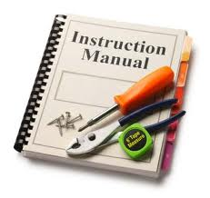
The general picture: from Reqs to Assessment
WP12
Use Scenarios
& Reqs
WP14
Community
WP22/
WP24
Test & Assessment
WP21
Services/Toolkits/Manuals

Slide 3
Main steps
Initial definition of the main operational scenarios, general enough to accommodate all ES
- Discussion with partners for an initial agreement - Discussion of preliminary results at the meeting in Capgemini and at the meeting in Edinburgh - Distribution of high level Use Cases to ES partners - Collection of feedbacks and assistance in specific UC writing - Face-to-face interviews to elicit the requirements and to clarify critical points

Slide 4
WP 12 Results
The Deliverable D12.1 has been successfully completed, revised within the consortium and delivered (with a slight delay) to the EC
- A comprehensive set of high level user requirements has been identified, which will serve as a basis for the test definition
- Use cases, reflecting the typical preservation scenarios have been identified

Slide 5
Results: process details
Description of Services and Toolkits reviewed in close collaboration with technical partners to facilitate their comprehension by the ES community
- 26 direct face-to-face interviews with people from 7 different scientific domains
- More than 100 persons compiled the online questionnaire (from three categories: data managers, data producers, data consumers)

Slide 6
Some other results
Achieved results: details of the process - Typical sizes assessed for 10 Data Collections: - up to 1.200.000 different products - up to several TB of raw data per year - up to several GB of RepInfo per year - 3 High Level Use Cases identified - 21 domain-specific Use Cases identified - 25 user Requirements identified - 23 PNMs and Representation Networks defined

Slide 7
From LTDP: Preservation workflow
The Preservation Analysis Workflow (from EO LTDP Guidelines) defines a procedure for design, creation and maintenance of an Archival Information Package, which is intended to optimise the re-use of ES data in the long term. The Preservation Analysis workflow is thus an excellent guide to set-up a preservation strategy in close collaboration with ES data managers and to elicit user requirements

Slide 8
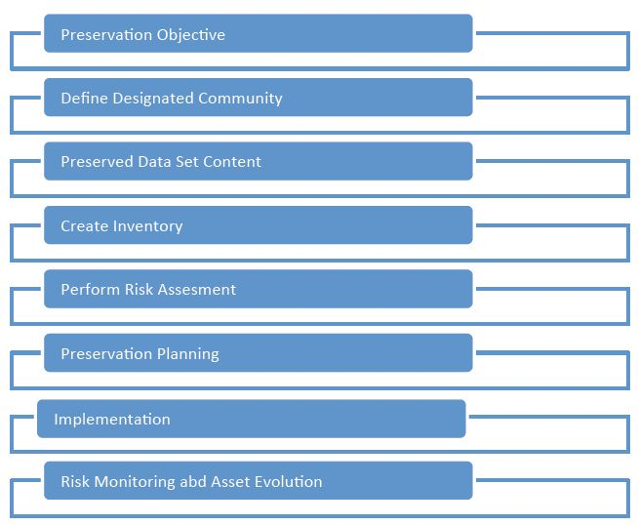
EARTH
SCIENCE
KNOWLEDGE
From WP33
EARTH
SCIENCE
DATA
PRESERVATION
POLICIES
EARTH
SCIENCE
DATA
PRESERVATION
POLICIES

Slide 9
Thank You !!
Contacts:
Mirko Albani, Project Coordinator: Mirko.Albani@esa.int
Website: www.scidip-es.eu

