Slide 1
EUDAT
Towards a pan-European Collaborative Data Infrastructure
Ari Lukkarinen
CSC - IT Center for Science, Finland
APA Conference, November 7th, 2012
Notes:
CSC : Finnish national ICT center for science
Established 1971, 250 employees
Non-profit company, shares owned by Finnish state

Slide 2
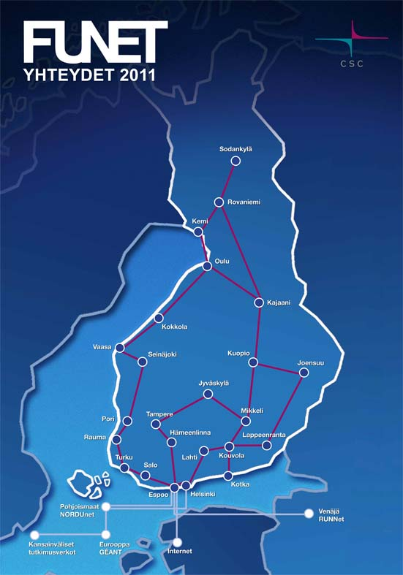
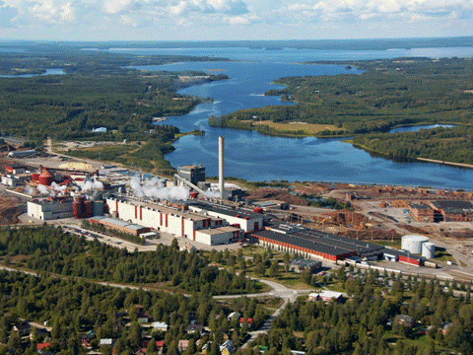
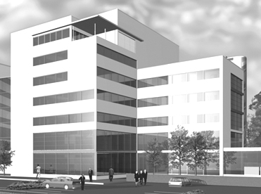
CSC – IT Center for science
Finnish national ICT center for science
Established 1971
250 employees
Non-profit limited company, shares owned by Finnish state

Slide 3
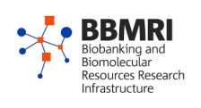
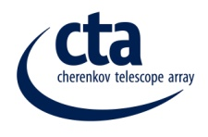
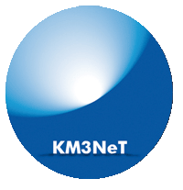
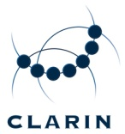
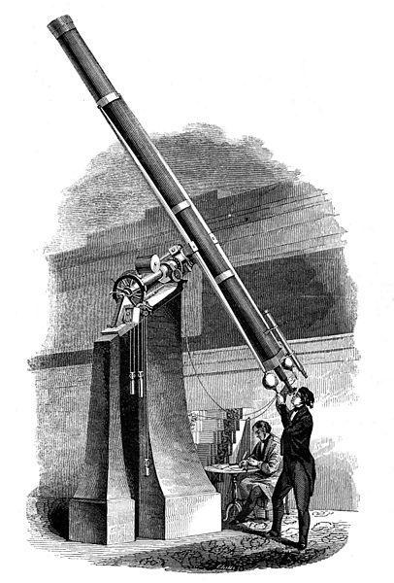
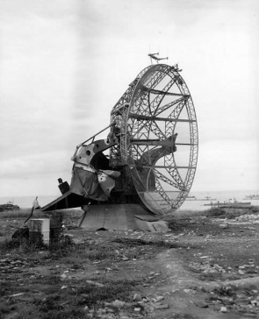
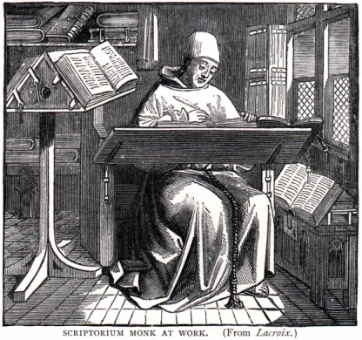
Research Infrastructures
Research Infrastructure trends:
Internationalisation
Diversification
European Ris:
Around 500
€ 100 billion investment
middle age 19th century 20th century 21st century
Notes:
Middle age: Individual persons, monks, noblemen, rich individuals able to do research
Later: research equipment become larger and more expensive. Most expensive research HW in CERN. Researchers started forming communities.
Number of RIS impossible to define accurately, but one estimate is of the order of 500.
Europe invest a lot to research. Could we do it more effectively ? What is common to all modern research activities ?

Slide 4
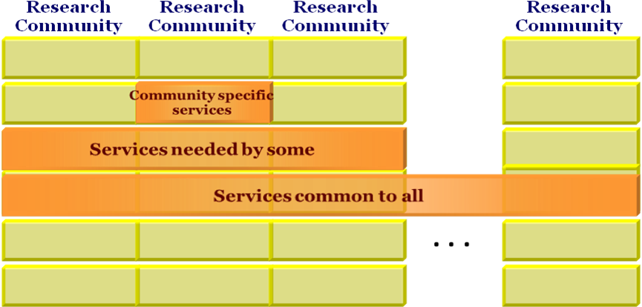
If there are hundreds of Research Infrastructures, how many different data management systems are feasible?

Slide 5
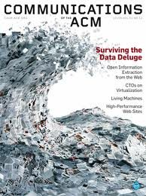
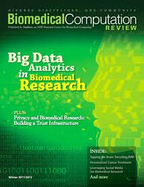
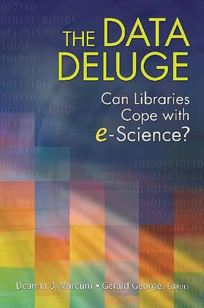
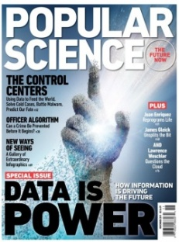
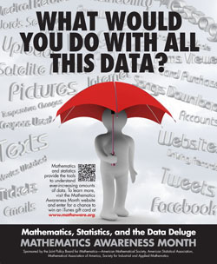
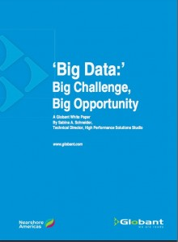
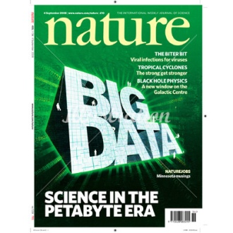
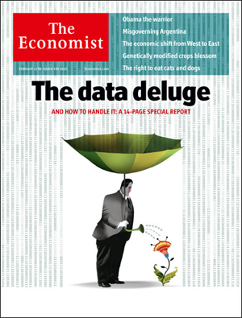
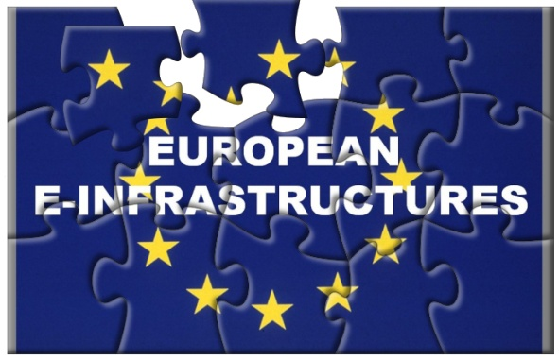
Data trends
Zettabytes
Exabytes
Exponential growth
Petabytes
Where to store it?
How to find it?
How to make the most of it?
Terabytes
Gigabytes
Increasing complexity and variety
Notes:
Data:
Lot of it. CSC traditional HPC customers, moderate growth rate. Growth rate of the order of 100%/2yrs.
Data generators:
Measurement technology.
Cheap CPU and storage (computing power doubled every 17 months, HD storage price erosion 25% /year.
Analog to digital conversions.
New customers: CERN, audiovisual material, biomedical data
New approach to reseach. Tools for large scale data analysis (Hadoop, noSQL, cloud computing) (google, facebook)
Problem is the same for all RIS and for all datacenters – everyone benefits from co-operation.

Slide 6
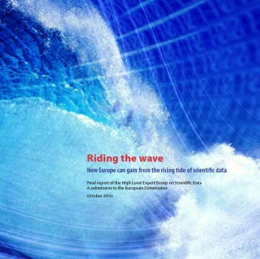
Collaborative Data Infrastructure
-A framework for the future? -
Data
Generators
Users
User functionalities, data capture & transfer, virtual research environments
Community Support Services
Data discovery & navigation, workflow generation, annotation, interpretability
Data Curation
Trust
Common Data Services
Persistent storage, identification, authenticity, workflow execution, mining

Slide 7
Notes:
BIG project, partners invest also own money, about 150 persons involved

Slide 8
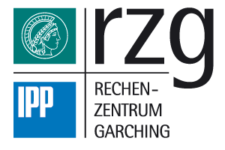
Consortium

Slide 9
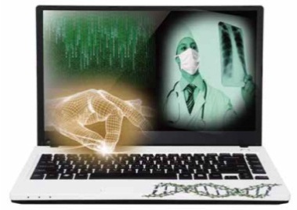
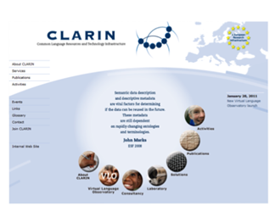
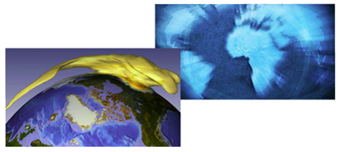
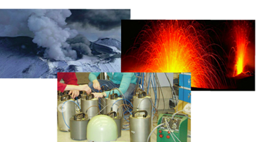
Five research communities on Board
EPOS: European Plate Observatory System
CLARIN: Common Language Resources and Technology Infrastructure
ENES: Service for Climate Modelling in Europe
LifeWatch: Biodoversity Data and Observatories
VPH: The Virtual Physiological Human
All share common challenges:
Reference models and architectures
Persistent data identifiers
Metadata management
Distributed data sources
Data interoperability
Notes:
Project partners represent the data scientists in these consortia. EPOS – data and observatories for earthquakes, volcanoes, tectonics – based on sensor data. CLARIN – making language resources and technology usable ENES – simulations of the climate system using HPC Lifewatch – biodiversity research VPH – biomedical modelling and simulation of the human body

Slide 10
Communities ↔ Data Centers
Requirements, service cases
Technology appraisal & matching
Service provision
Notes:
Requirements and service cases from scientific communities.
Use this information and plan and implement a system fullfilling requirements.

Slide 11
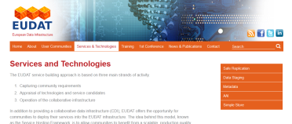
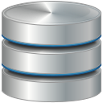
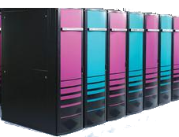
Building Blocks of the CDI
EUDAT Portal
Integrated APIs and harmonized access to EUDAT facilities
Metadata Catalogue
AAI
Aggregated EUDAT metadata domain.
Data inventory
Network of trust among authentication and authorization actors
Data Staging
Safe Replication
Simple Store
Dynamic replication to HPC workspace for processing
Data curation and access optimization
Researcher data store (simple upload, share and access)

Slide 12
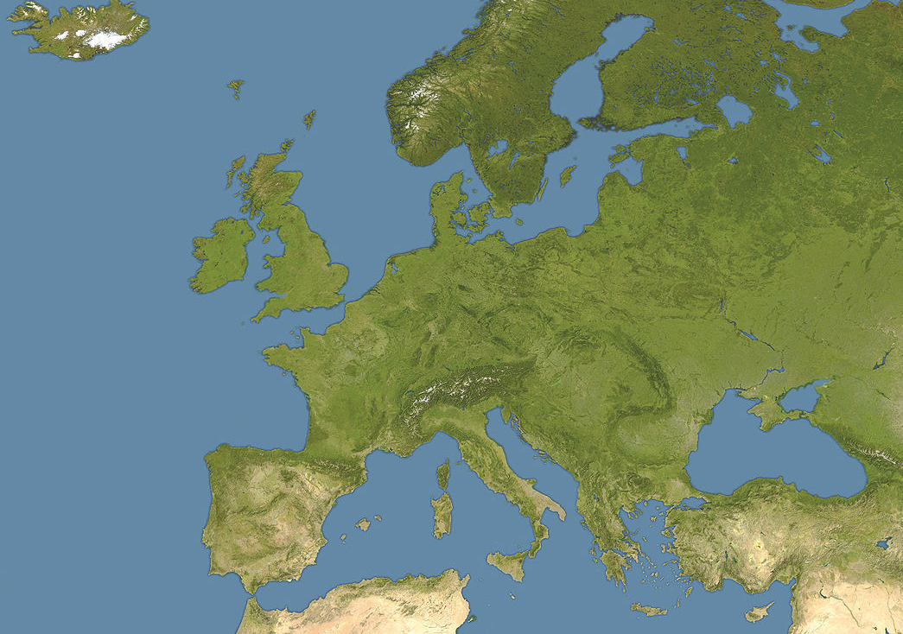
Infrastructure – first pilots
ENES
VPH
CLARIN
EUDAT service provider
Lifewatch
Community service provider
Safe Replication
Data staging
EPOS

Slide 13
Hierarchy of data needs
Combining data
Sharing data
Keeping data safe and accessible
Improving data usability and reusability
Storing and archiving data
Combining data in imaginative new ways to solve problems
Sharing data across communities
Metadata catalogue, persistent identifiers
Data security, data standards, data curation
Data archive, data storage facilities
Value creation, though openness and sharing…
… relies on more basic
data needs being
met
first
Notes:
Maslow’s hierarchy of needs –psychology model of a hierarchy of human needs starting with the most fundamental. Man can’t achieve full potential unless fundamental needs are met.
Main motivation for a collaborative data infrastructure comes from the belief that sharing and combining data will allow European researchers to work together to tackle societal challenges

Slide 14
Global Collaboration
Research Communities
E-Infrastructures
PRACE, EGI, DANTE, HELIX NEBULA, …
Funders
EC, National Governments
Research Organisations
ESFRI, Eiroforum, etc.
International Actors
CODATA, RDA, iCORDI

Slide 15
Global collaboration: iCORDI and RDA
Project Name | iCORDI – Global Data Interoperability
Start date | 1st September 2012
Duration | 24 months
Budget | 3,3 M€ (including 2,3 M€ from the EC) and 240 PMs
EC call | Call 10 (INFRA-2012-3.2): International cooperation with the USA on common e-Infrastructure for scientific data (11.2011)
Participants | 14 partners from 8 countries (national data centers, technology providers and research communities)
Objectives | “iCORDI’s prime objective is to establish a coordination platform between Europe and the USA to discuss and improve the interoperability of today’s and tomorrow’s scientific data infrastructures of both continents and to extend this to the global levels.”

Slide 16
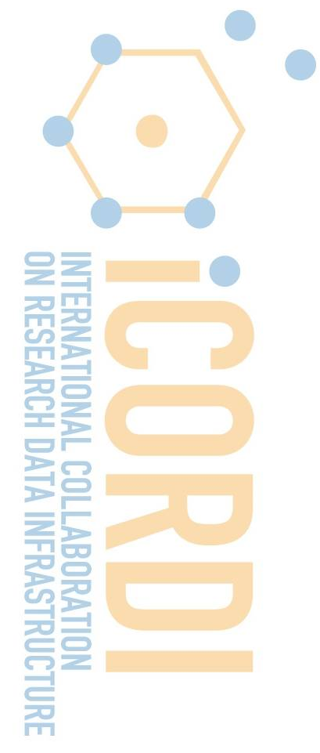
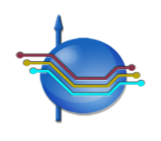
Who’s Involved in iCORDI
Association of Commonwealth
Universities
Athena-Research and
Innovation Center in
Information, Communication
and Knowledge Technologies
icordi-info@postit.csc.fi | www.icordi.eu

Slide 17
Contacts iCORDI, RDA
www.icordi.eu
www.rd-alliance.org

Slide 18
National Collaboration
Tier 1
International data services
Tier 2
National data services
Tier 3
Institutions (Universities & Institutes)
Tier 4
“Small science” researchers & research groups
EUDAT
* [Science as an Open Enterprise]
Notes:
Project partners represent the data scientists in these consortia. EPOS – data and observatories for earthquakes, volcanoes, tectonics – based on sensor data. CLARIN – making language resources and technology usable ENES – simulations of the climate system using HPC Lifewatch – biodiversity research VPH – biomedical modelling and simulation of the human body

Slide 19
Example - National Collaboration
TTA:
National research data repository
KDK – PAS
National digital library – long term preservation
National Tier-2 data service
Notes:
Used to be separate projects, but now a decision has been made to use same building blocks for both services.

Slide 20
Research infrastructures + Tier 2
Common metadata model
Common mechanism to harvest metadata
Common AAI mechanisms
Common mechanisms to move data
Trust
Common practises for data management
+ TTA/KDK-PAS, +others
Notes:
National Tier-2 level should kept in mind.
We need common building blocks and practices - and trust.

Slide 21
Conclusions
There is a growing need to manage data
EUDAT has completed the first year of the project with promising progress
Service development: Metadata catalogue, AAI, Data staging, Safe replication, Simple store, EUDAT portal
Active collaboration with user communities
Current work concentrates mostly on building blocks.
Discussion about processes and practices started.
Collaborative Data Infrastructure in Europe is developing, national and international collaboration is also needed.
Notes:
What has not been done yet:
OAIS practices

Slide 22
eudat-info@postit.csc.fi
Author: Ari Lukkarinen
ari.lukkarinen@csc.fi

