Slide 1
SCAPE
Scalable Preservation Tools and Infrastructure
Dr. Ross King
AIT Austrian Institute of Technology GmbH
APA Conference
Frascati, November 7, 2012

Slide 2
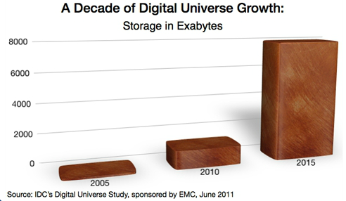
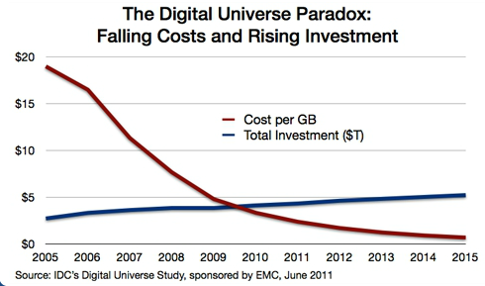
Digital Preservation – New Motives
Some growth rates
Number of bytes stored: 60%
Costs of storage media: -20%
Cost to store: ((1.6x0.8)-1) = 28%
Growth of IT budgets: 4%
This massive volume of digital material raises a number of issues:
What is worth preserving?
How to preserve so much?
How to access preserved data?

Slide 3
SCAPE – what is it about?
Planning and executing computing-intensive digital preservation processes such as the large-scale ingestion, characterisation or migration of large (multi-Terabyte) and complex data sets
SCAPE results include
Preservation scenarios
Preservation tools
Preservation workflows
Preservation infrastructure
Preservation best-practices
SCAPE is a follow-up to the highly successful FP6 IP Planets.

Slide 4
SCAPE Project Data
Project instrument: FP7 Integrated Project
6. Call
Objective ICT-2009.4.1: Digital Libraries and Digital Preservation
Target outcome (a) Scalable systems and services for preserving digital content
Duration: 42 months
February 2011 – July 2014
Budget: 11.3 Million Euro
Funded: 8.6 Million Euro

Slide 5
SCAPE Consortium
Number | Partner name | Partner short name | Country
1 (coordinator) | AIT Austrian Institute of Technology GmbH | AIT | AT
2 | British Library | BL | UK
3 | Internet Memory Foundation | IM | NL
4 | Ex Libris Ltd | EXL | IL
5 | Fachinformationszentrum Karlsruhe | FIZ | DE
6 | Koninklijke Bibliotheek | KB | NL
7 | KEEP Solutions | KEEPS | PT
8 | Microsoft Research | MSR | UK
9 | Österreichische Nationalbibliothek | ONB | AT
10 | Open Planets Foundation | OPF | UK
11 | Statsbiblioteket Aarhus | SB | DK
12 | Science and Technology Facilities Council | STFC | UK
13 | Technische Universität Berlin | TUB | DE
14 | Technische Universität Wien | TUW | AT
15 | University of Manchester | UNIMAN | UK
16 | Pierre & Marie Curie Université Paris 6 | UPMC | FR

Slide 6
SCAPE Project Overview
SCAPE will enhance the state of the art in digital preservation in three ways:
Infrastructure and tools for scalable preservation actions
A framework for automated, quality-assured preservation workflows
Integration of these components with policy-based automated preservation planning and watch
SCAPE results will be validated in three large-scale testbeds:
Digital Repositories
Web Content
Research Data Sets
Takeup
Stakeholders
Communities
Dissemination
Training Activities
Sustainability
Testbeds
Corpora
Integration
Benchmarking
Validation
The SCAPE Consortium brings together a broad spectrum of expertise from
Memory institutions
Data centres
Research labs
Universities
Industrial firms
Cross-project Activities
Platform
Project Management
Technical Coordination
Research Roadmap
Automation
Workflows
Parallelization
Virtualization
Planning and Watch
Preservation Components
Institutional Policies
Technical Watch
Automated Planning
Quality Assurance
Scalable Components
Automation-ready Tools

Slide 7
Selected SCAPE Testbed Scenarios
See http://wiki.opf-labs.org/display/SP/Scenarios
Carry out large scale image migrations
The master files from legacy digitized image collections are typically TIFF files that can be costly to store due to their size. The cost benefit can only be realized if one can remove the original TIFFs and this can only be done if one can provide evidence of successful migration.
Detect poor sound quality
In a collection of mp3 files (20 Tbytes - 360.000 files) we have discovered files with very bad sound quality. Before ingesting everything into our DOMS we would like to be able to discover the bad files and potentially get those re-digitized from the original analogue media.
RAW to NEXUS conversion
Apart from the file size, volume of content challenges identified in IS29 for nexus files, the raw to nexus format migration tool can be customised to take into account of various other types of experiment data files in the process of the migration. However, the scalability challenge here is that for different instrument (specific to each facility), the other types of experiment data files vary significantly.
Quality assurance in web harvesting
Web crawling is a process that is highly susceptible to errors. Often, essential data is missed by the crawler and thus not captured and preserved. Currently, quality assurance requires manual effort and because crawls often contain millions of pages, manual quality assurance will be neither very efficient nor effective.
from digitalbevaring.dk

Slide 8
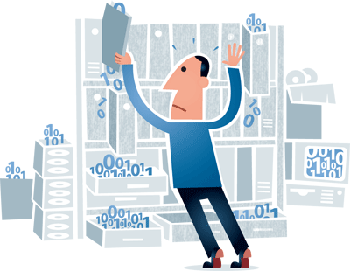
Selected SCAPE Challenges
Bridging the gap between test workflows and scalable workflows
Applying Map/Reduce to binary data
Locality of data
Bring the data to the computation, or bring the computation to the data?
Repository Integration
Repository Consistency
Scalable Ingest
Preservation Planning
How to scale?
How to automate?
Research data sets
How to preserve contextual information?
from digitalbevaring.dk

Slide 9
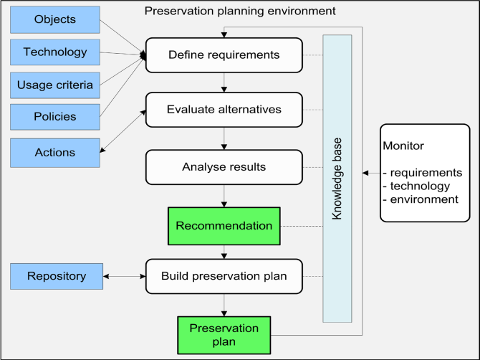
SCAPE Solutions
Automated Planning Component
Builds on the Planets PLATO tool and methodology
https://github.com/openplanets/plato
Emphasizes simplicity, scalability and automation
Makes use of the Taverna workflow engine
Integrates with existing repositories
Uses semantically formalized policies
https://github.com/openplanets/policies

Slide 10
SCAPE Solutions
Automated Watch Component
Based on
Gathering information from various external sources from diverse domains
Creating a centralized knowledge base with information of interest for preservation
Expressing preservation risks and opportunities as questions to this knowledge base
Monitoring the result of question assessment to reveal significant events that indicate the existence of the defined risks and opportunities
https://github.com/openplanets/scout

Slide 11
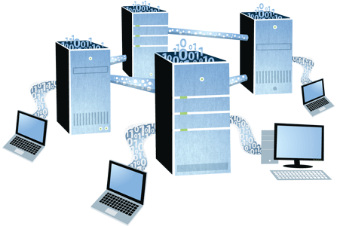
SCAPE Solutions
SCAPE Platform
HADOOP, Eucalyptus
Virtualized cluster
Repository integration
HBASE, HDFS - Fedora
Three levels of parallelization
Distribution of files
Splitting binary files
Parallelisation of algorithms
Multiple instances (how-to)
Mapping Taverna to HADOOP
from digitalbevaring.dk

Slide 12
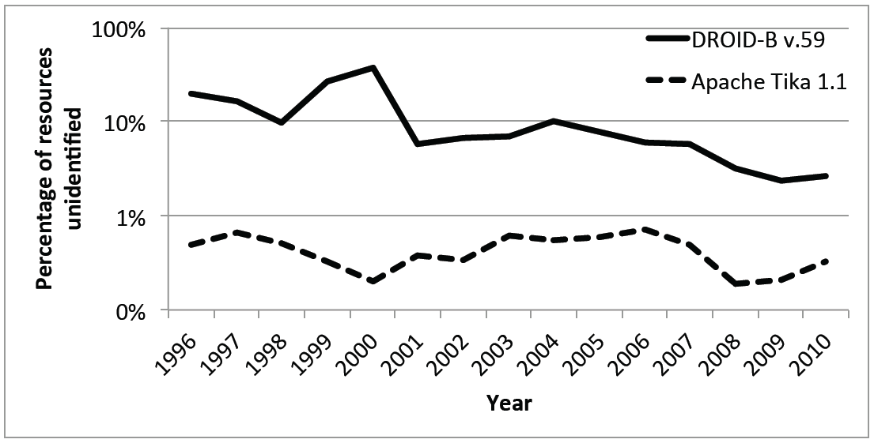
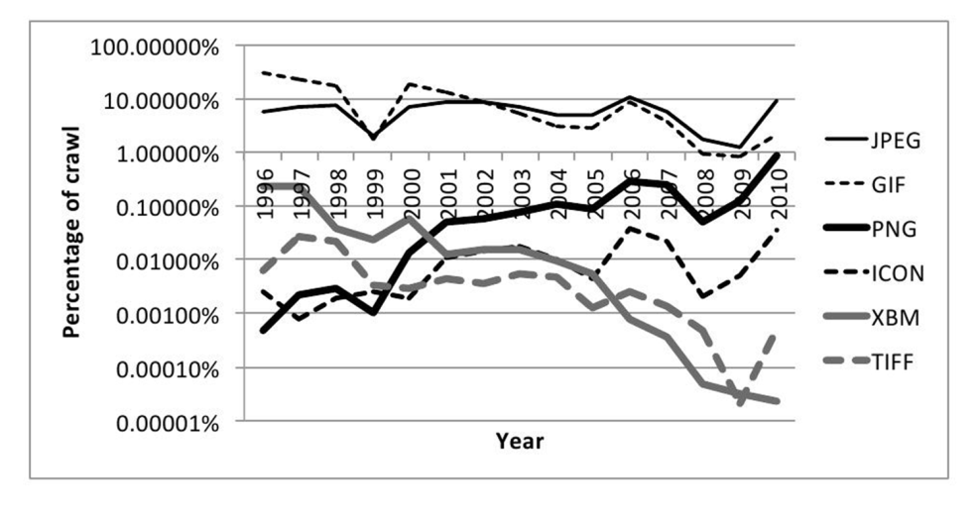
SCAPE Solutions
SCAPE Platform
Use case: Characterisation of file formats in JICS UK Domain dataset (35 TB)
Compared DROID engine and Apache Tika
Conclusions
Apache Tika has a significantly lower failure rate than DROID-B
Most formats last much longer than 5 years
Network effects to appear to stabilise formats
New formats appear at a modest, manageable rate.
Hence the “Rosenthal hypothesis” is confirmed to some extent
HOWEVER, this study is about format usage; it does not yet address format renderability
A. Jackson. http://arxiv.org/abs/1210.1714
See also: http://www.openplanetsfoundation.org/blogs/2012-11-06-running-apache-tika-over-arc-files-using-apache-hadoop

Slide 13
SCAPE Solutions
Automated Quality Assurance
QA in web harvesting through automated comparison of rendered pages – combined structural and image analysis
MarcAlizer
QA in image migration through deep characterisation
Jpylyzer
QA in image digitisation through automated duplicate detection
matchbox

Slide 14
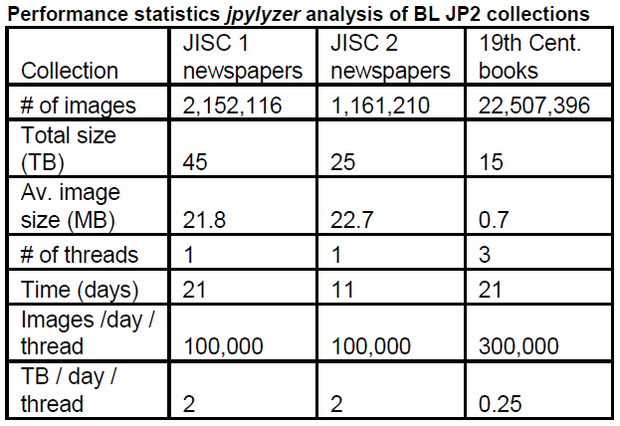
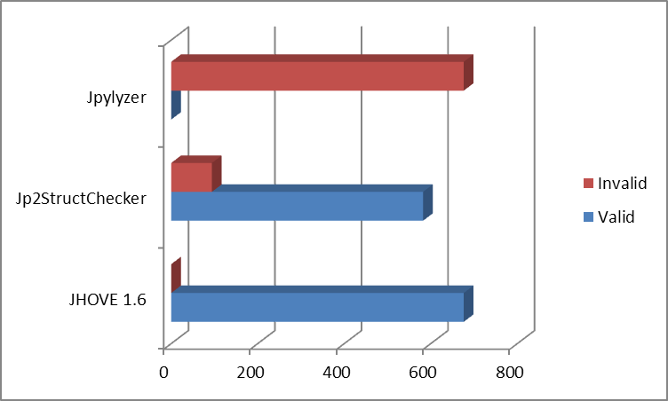
SCAPE Solutions
Automated Quality Assurance – Jpylyzer
Parses a file and tests against format specification (ISO/IEC 15444-1)
Tests for required boxes and restrictions defined by the standard
Proves a file does not conform to the standard but cannot prove it does, valid means “probably valid”.
Next steps
Run on Hadoop cluster: reduce run time from 21 days to 21 hours!
Add “repair” functionality to workflow

Slide 15
SCAPE Solutions
Automated Quality Assurance – matchbox
Various sources in the digital book production process (e.g. different scanning sources, various book page image versions, etc.) can introduce image duplicates in the compiled version of a digital book
matchbox provides an automated solution to the duplicate image detection problem using the following algorithm:
Detection of salient regions and extraction of most discriminative descriptors using standard SIFT detector and descriptors.
A visual dictionary following a Bag of Word approach is created from a set of spatially distinctive descriptors.
Once the dictionary is set up, fingerprints - visual histograms expressing the term frequency for each visual work in the corresponding image - are extracted for each image.
Comparison of images becomes matching of visual fingerprints and results in a ranked shortlist of possible duplicates.
Next steps
Optimise performance
Run on Hadoop cluster

Slide 16
Additional Resources of Interest
Development Infrastructure
Code repository hosted by the Open Planets Foundation and GitHub
https://github.com/openplanets/scape/
Development Wiki
http://wiki.opf-labs.org/display/SP/Home
Experimental Workflows
http://www.myexperiment.org/search?query=SCAPE&type=all&commit=Search
Publications
http://www.scape-project.eu/category/publication
Public Deliverables
http://www.scape-project.eu/category/deliverable

Slide 17
First SCAPE Training Event
Keeping Control – Scalable Preservation Environments for Identification and Characterisation
6-7 December 2012
Archaeological Museum of the Martins Sarmento Society, Guimarães, Portugal
Hosted by KEEP Solutions
Registration: http://scape-guimaraes.eventbrite.co.uk
This event is also supported by the European Capital of Culture 2012: http://www.guimaraes2012.pt/

Slide 18
SCAPE Contact Information
http://www.scape-project.eu/
Twitter: #scapeproject
office@list.scape-project.eu
Dr. Ross King AIT Austrian Institute of Technology GmbH Donau-City-Strasse 1 A-1220 Wien

Slide 19
Thank you for your attention!

