Slide 1
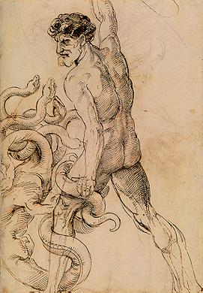
Data management planning at the DCC
Martin Donnelly
Digital Curation Centre
University of Edinburgh
APA CONFERENCE, FRASCATI
6 November 2012

Slide 2
What is a DMP?
In general, funders tend to ask:
What kinds of data will be created and how?
How will the data be documented and described?
Are there ethical or Intellectual Property issues?
What are the plans for data sharing and third-party access?
What is the strategy for longer-term preservation?
However, different funders ask these
questions in different ways…

Slide 3
A Generic and Comprehensive Checklist
§1: Introduction and Context
§2: Data Types, Formats, Standards and Capture Methods
§3: Ethics and Intellectual Property
§4: Access, Data Sharing and Re-use
§5: Short-Term Storage and Data Management
§6: Deposit and Long-Term Preservation
§7: Resourcing
§8: Adherence and Review
§9: Agreement/Ratification by Stakeholders
§10: Annexes
Checklist for a Data Management Plan v3.0 (Donnelly and Jones, March 2011)
http://www.dcc.ac.uk/resources/data-management-plans
Notes:
Checklist and other DCC resources have been utilised in a number of research-intensive universities, including Columbia, Swinburne, MIT and Heidelberg.

Slide 4
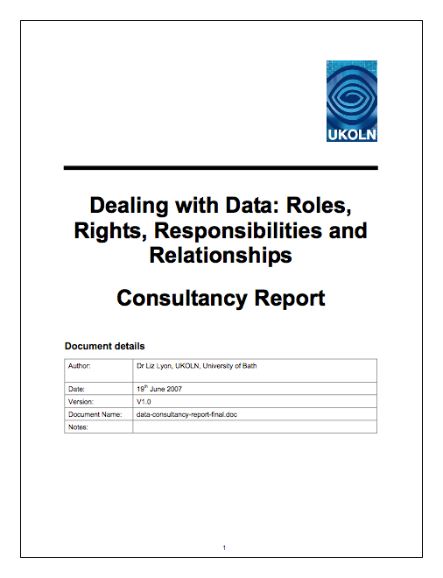
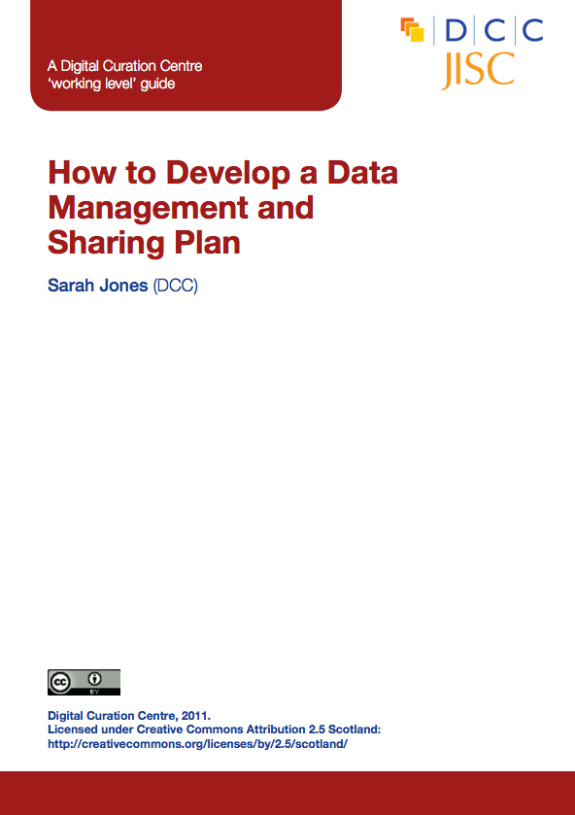
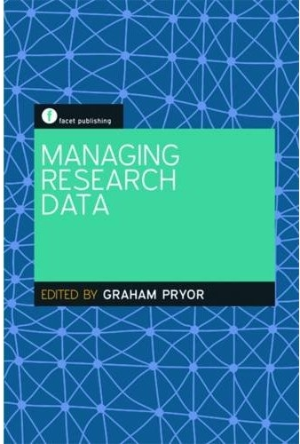
Printed DMP resources
“Dealing with Data” (Lyon, 2008)
Analysis of Funder Policies (Jones, 2009)
Checklist for a Data Management Plan (Donnelly and Jones, 2009)
“How to Develop a Data Management and Sharing Plan” (Jones, 2011)
“Data Management Plans and Planning” (Donnelly, 2012) in Pryor (ed.) Managing Research Data, London: Facet
DMP Online briefing paper (Donnelly and Richardson, forthcoming 2012)
Links to all DCC resources via http://www.dcc.ac.uk/resources/data-management-plans
Notes:
So in summary, these are some of the key DMP-related resources.

Slide 5
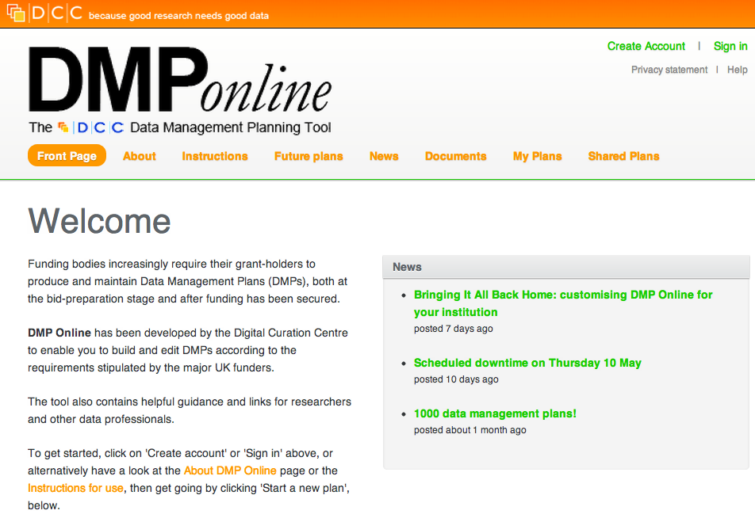

Slide 6
What does do?
A free and Open web-based tool enabling users to...
Create, store and update multiple versions of Data Management Plans across the research lifecycle
Meet a variety of specific data-related requirements (from funders, institutions, publishers, etc.) in a single place
Get tailored guidance on best practice and helpful contacts, at the point of need
Customise, export and share DMPs in a variety of formats in order to facilitate communication within and beyond research projects
Notes:
The DCC Checklist is by nature very long, and its length was felt to be off-putting to researchers. Most of them don’t want to deal with this stuff even at a basic level, and a long Checklist with over 100 questions was not going to enjoy a large takeup.
No matter how many times we said “you don’t need to fill it all in, just the bits that are relevant to you at this time” the message wasn’t going to sink in, so we developed a fairly basic wizard style tool which asked a few questions about what stage your research was at, who your funder was, etc, and then pulled out only the most relevant questions from the Checklist to help you meet the pertinent requirements. So instead of seeing 115 questions, you might be presented with only 15 or 20. Much better.
We then added functionalities like export and customisation, and some generic guidance to help with some of the more esoteric sections such as file format selection and metadata.

Slide 7
New features in v3.0 (May 2012)
Improved user interface, inc. customisable institutional versions
New features
Overlaying multiple templates for ‘hybrid’ DMPs
Multiple template phases (e.g. pre- / during / post-project)
Granular read / write / share permissions
Multilingual support / boilerplate text
API for systems interoperability
Endorsement from funders
Notes:
As I mentioned earlier, version 3 launched very recently, and has a number of great new features.
The user interface has been tweaked to allow easier (one-click) access to most of the screens, and we’re investigating customised institutional versions with, among others, the University of Oxford.
The tool now enables the application of multiple templates, so you can create a single DMP that satisfies your institution, your funder and your publisher at the same time. These templates can be phased more elegantly, so that you can ask (for example) a few questions at the application stage, more during the project’s lifetime, and then add even more detail when you’re close to completion.
Users now have the option to make their plans more widely available. Authentication can be managed via the UK Federated Access Shibboleth mechanism, and we have coded the new system to enable easy translation into other languages, and to handle boilerplate text where this is thought to be beneficial.
We have also been working behind the scenes to gain more official endorsement from some of the big funding councils, and this is starting to bear fruit.

Slide 8
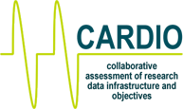
Institutional workflows
DMP Online can also be used in conjunction with other tools that support the data management/curation lifecycle, e.g.…
DAF (Data Asset Framework)
DRAMBORA (Digital Repository Audit Method Based On Risk Assessment)
CARDIO (Collaborative Assessment of Research Data Infrastructure and Objectives)
Also non-DCC tools:
LIFE
Planets tools
CRIS systems
and more
Notes:
Similarly, DMP Online can also be used in conjunction with other tools that support the data management/curation lifecycle, be these DCC tools or tools from other sources.

Slide 9
Research Support Office
Researcher
Data Library / Repository
DATA
MANAGEMENT
…PLAN?
UNRULY
DATA
Computing Support
Faculty Ethics Committee
Etc...

Slide 10
DMP Collaborations
Guidance
Generic data management guidance (in conjunction with UK Data Archive)
Tailored guidance developed in collaboration with funders themselves (ESRC, MRC, Wellcome Trust)
Institution-specific guidance developed with key contacts in universities
Disciplinary guidance developed and deployed through JISC MRD projects (e.g. DMT Psych at York, DATUM for Health at Northumbria)
Templates developed with funders and institutions
Joint training events organised and delivered by DCC and
Notes:
So, in addition to the liaison with the funders, we’ve developed relationships with a variety of others. Our closest working relationship has probably been with the UK Data Archive, which is the designated place of long term deposit for the Economic and Social Research Council. Working with UKDA we have developed a data management planning template and guidance for ESRC applicants, and we also point to some UKDA guidance in the generic Checklist. We have also liaised with Wellcome Trust, the Medical Research Council and various other funders to develop dedicated DMP templates for them.
Continuing in this vein, we’ve worked with disciplinary specialists and key institutional contacts to develop further DMP templates, and through the JISC Managing Research Data programmes we’ve contributed to a number of projects creating training materials around this area.

Slide 11
DMP International
DCC is a founder member of the US DMPTool consortium, and we continue to work together. Joint workshops at IDCC in Amsterdam (Jan 2013) and iSchools Conference in Texas (Feb 2013)
We’re working with ANDS in Australia to deploy DMP Online on the NECTAR academic cloud
European Commission has encouraged DCC to propose a pilot DMP tool for Horizon 2020. Expecting a DMP requirement/recommendation in the next funding programme
Notes:
As Carlos mentioned earlier…

Slide 12
Grazie!
Martin Donnelly
Digital Curation Centre
University of Edinburgh
martin.donnelly@ed.ac.uk
Twitter: @mkdDCC
www.dcc.ac.uk/resources/data-management-plans
For other DCC services see www.dcc.ac.uk or follow us on twitter @digitalcuration and #ukdcc
This work is licensed under the Creative Commons Attribution 2.5 UK: Scotland License.
Image credits:
Slide 1 - http://upload.wikimedia.org/wikipedia/commons/8/88/LernaeanHydraRephael.jpg
Slide 9 - http://en.wikipedia.org/wiki/File:Hercules_slaying_the_Hydra.jpg
Notes:
Thank you.

