Slide 1




VISION
Tools
Information about users and practices
Digital Preservation activities
Infrastructure
PRELIDA
ISO : Audit and Certification
Standards plus organisation
Relationship to related work and community practices
ISO standard: OAIS update
ISO standard: OAIS

Slide 2
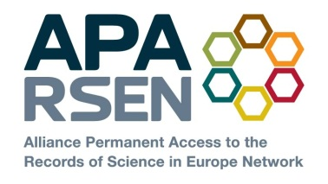

APARSEN
E-Infrastructures (Interoperability and preservation)
COMMON VISION
Testing environment
GENESI-DR
HLEG Sci data e-Infr
Authenticity & Provenance
TRUST
Research provides tools and techniques which feed into e-infrastructure
Universities & Research Institutes
PARSE.Insight
SCIDIP-ES
Annotation, reputation & data quality
DPC, nestor, STM, LIBER
Peer review and 3rd party certification
Vendors:
IBM
Tessella
Preservation services
SUSTAINABILITY
APARSEN
Network of Excellence
Storage solutions
National libraries
Virtual Centre
of Excellence
Cost/benefit data & modelling
APA
Brokerage
Big science: CERN/MPI/ HA/STFC
Business cases
USABILITY
ESA LTDP
Industrial:
Airbus, SMEs
Common tools
Interoperability & intelligibility
Integrated research, best practice, services, tools and training
European Organisations and researchers
Scalability
CASPAR
Identifiers & citability
ACCESS
PLANETS
SHAMAN
Data policies & governance
HLEG Digital Library
Digital rights
Formal qualifications
APARSEN in brief
Create common vision for digital preservation research
  de-fragment existing efforts in academia, commerce, research labs, libraries etc
INTEGRATED TOPICS
Common vision allows coherent approaches to training and practice
RESEARCH SILOS
Training & awareness
USA
Asia
Australisia etc
Research (Digital Preservation)
See http://www.aparsen.eu or http://www.alliancepermanentaccess.org/index.php/current-projects/aparsen

