Slide 1
A Collaboration to Clarify the Costs of Curation
Pending final grant agreement
Start – 1st February 2013 End – 31st January 2015
24 months
13 European partners
Co-ordination Action

Slide 2
Coordinated by
Partners and Workpackages
Engagement
Group Leader
WP2
Assessment
Project Management
Roadmap
Group Leader
WP3
Enhancement
WP1
Group Leader
WP4
WP5

Slide 3
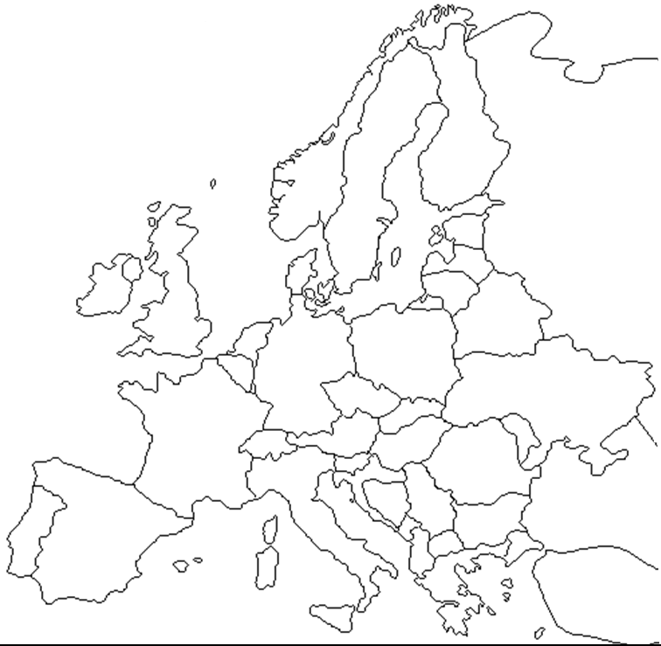
Coordination
Engagement
Assessment
Enhancement

Slide 4
A Collaboration to Clarify the Costs of Curation
The main objective of the 4C project is to ensure that all the existing work relating to the costs of digital curation and preservation is known, understood and can be implemented and exploited by a wide range of stakeholders.
The related task is, therefore, to ensure that the currently developed resources are: well described, matched and fit-for-purpose, relevant and useable by a wide range of organisations operating at different scales in both the public and the private sector.

Slide 5
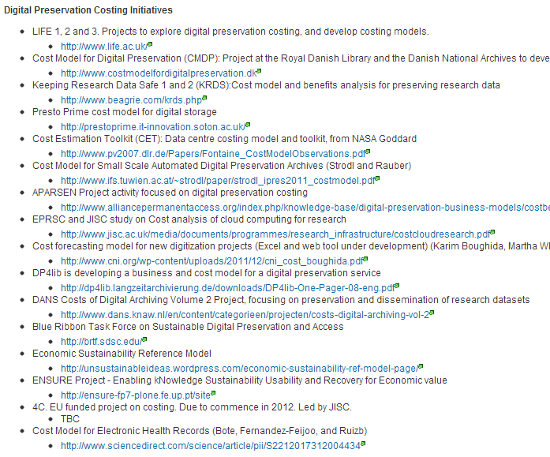
Paul Wheatley
http://wiki.opf-labs.org/display/CDP/Home

Slide 6
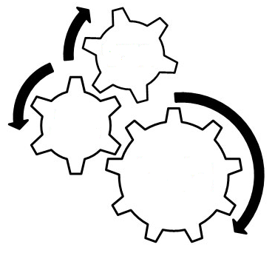
Engagement
Tasks
Engage stakeholders
Raise awareness
Organise meetings
Promote Research & Innovation
Build community network
Collaboration to Clarify the
Costs of
Curation
Assessment
Tasks
Assess cost models & strategies
Examine good practice
Analyse requirements
Integrate components
Produce guidance & briefing materials
Setup costs exchange
Networking & Coordination
Outputs
Events, Workshops, Meetings & Reports
Affiliate Partners & Stakeholders
Reports for General Dissemination
Curation Costs
Exchange
Enhancement
Tasks
Examine and refine related concepts
Value
Risk
Benefits
Sustainability
Economic Reference Model
Project Coordination
Tasks
Project meetings
Project reporting
EC liaison
Budget oversight
Outputs QA
Reports for European Commission
Submission of Roadmap to the EC

Slide 7
Coordination & Roadmap
Neil Grindley
JISC
Engagement
Assessment
Enhancement
Sabine Schrimpf
Deutsche Nationalbibliothek
Alex Thirifays
Danish National Archives
Raivo Ruusalepp
National Library of Estonia
William Kilbride
Digital Preservation Coalition
Ulla Bøgvad Kejser
Royal Danish Library
Matthew Woollard / Hervé L’Hours
UK Data Archive
Kevin Ashley
Digital Curation Centre (Edinburgh)
Andi Rauber
Secure Business Austria
José Borbinha
Institute of Systems Engineering and Computer Research and Development in Lisbon
Miguel Ferreira
Keep Solutions
Joy Davidson
Digital Curation Centre
(Glasgow)
Heiko Tjalsma
DANS

