Slide 1
EUDAT
Towards a pan-European Collaborative Data Infrastructure
Ari Lukkarinen
CSC-IT Center for Science, Finland
APA Conference, November 6th, 2012

Slide 2
Big (Chaotic) Data
SCIENTIFIC DATA PROBLEM
Cheap CPU capacity
Systems easy to built
Hard drive price erosion
Lot of data
”Unorganized library, where books are written with disappearing ink.”
PROBLEM
T10
  T10_H50
    T10_H50_RAMP
      T10_H50_RAMP_UNIFORM
FCC
  D012
    D012_GAP020
      D012_GAP010_1000
Notes:
Old times, systems were expensive
Large amount of data was only stored by some supercomputing centers and governmental organizations.
Films will disappear. Digital distribution means that whole film industry will collapse.

Slide 3
What is needed ?
Standardized storage service and processes for data management
Notes:
Standardize storage service

Slide 4
How Do We Achieve This?
Capturing Community Requirements
How data is organised
What are the first wishes
(Community Interviews)
Service Deployment and Operations
How to deploy services on the distributed infrastructure
(Operations team)
Technology Appraisal and Service building
What services can be built to match the requirements
(Service Taskforces)

Slide 5
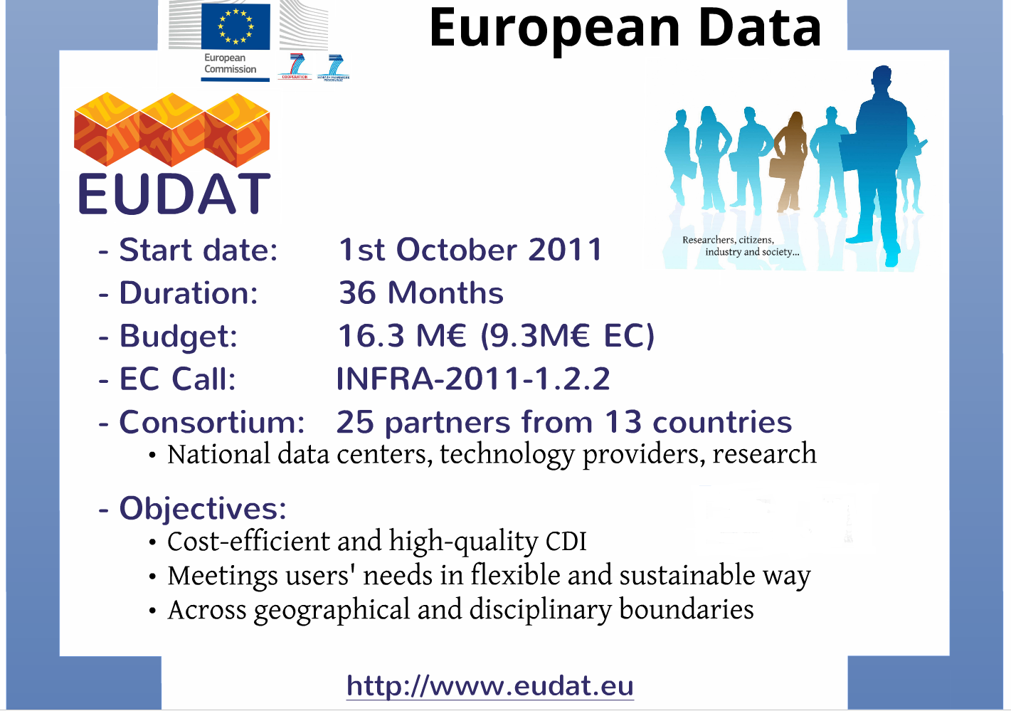
Notes:
BIG project, partners invest also own money, about 150 persons involved

Slide 6
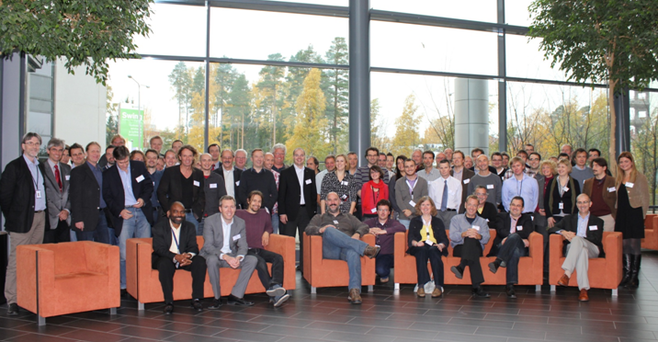
EUDAT Consortium

Slide 7

























Data centers and Communities

Slide 8


Slide 9
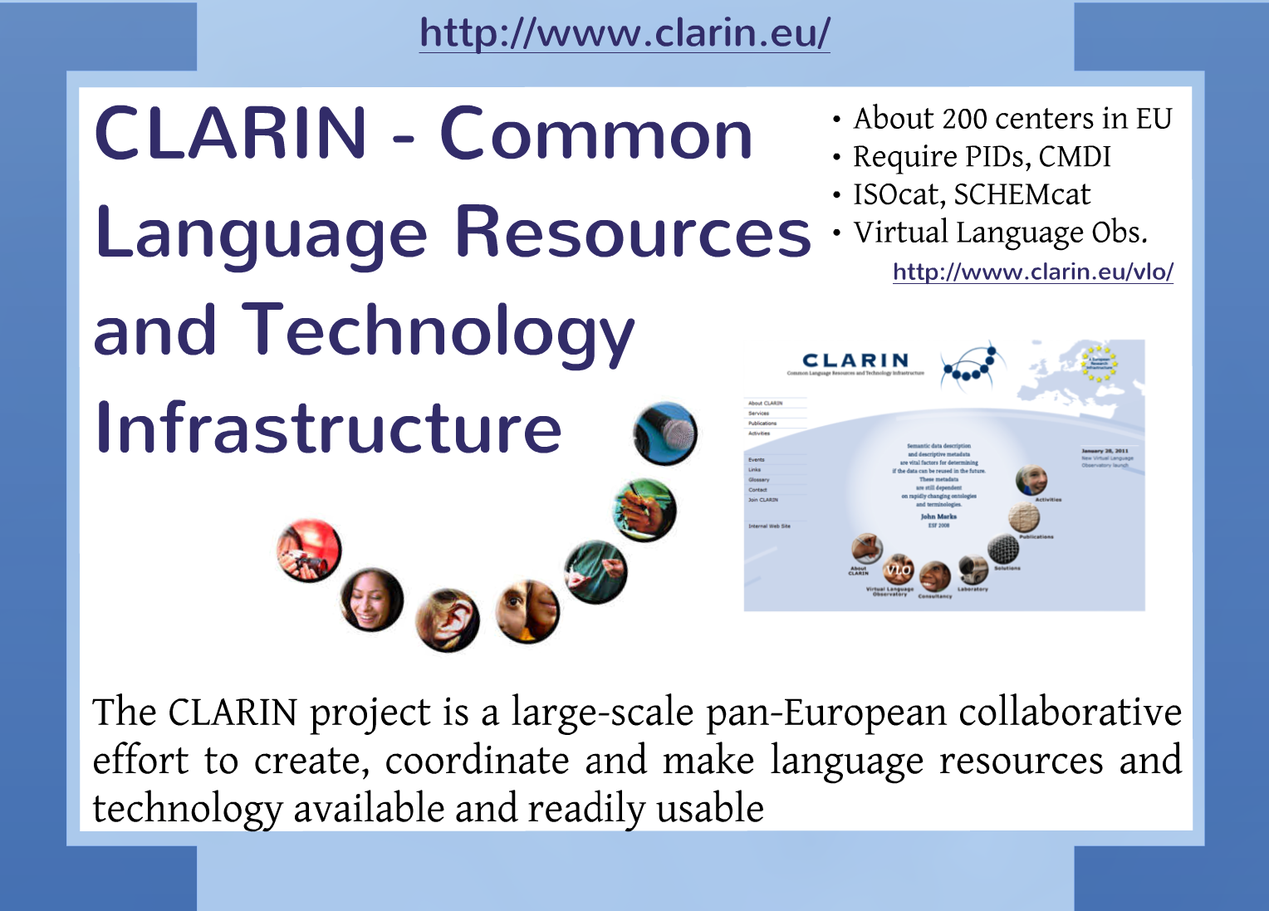

Slide 10


Slide 11
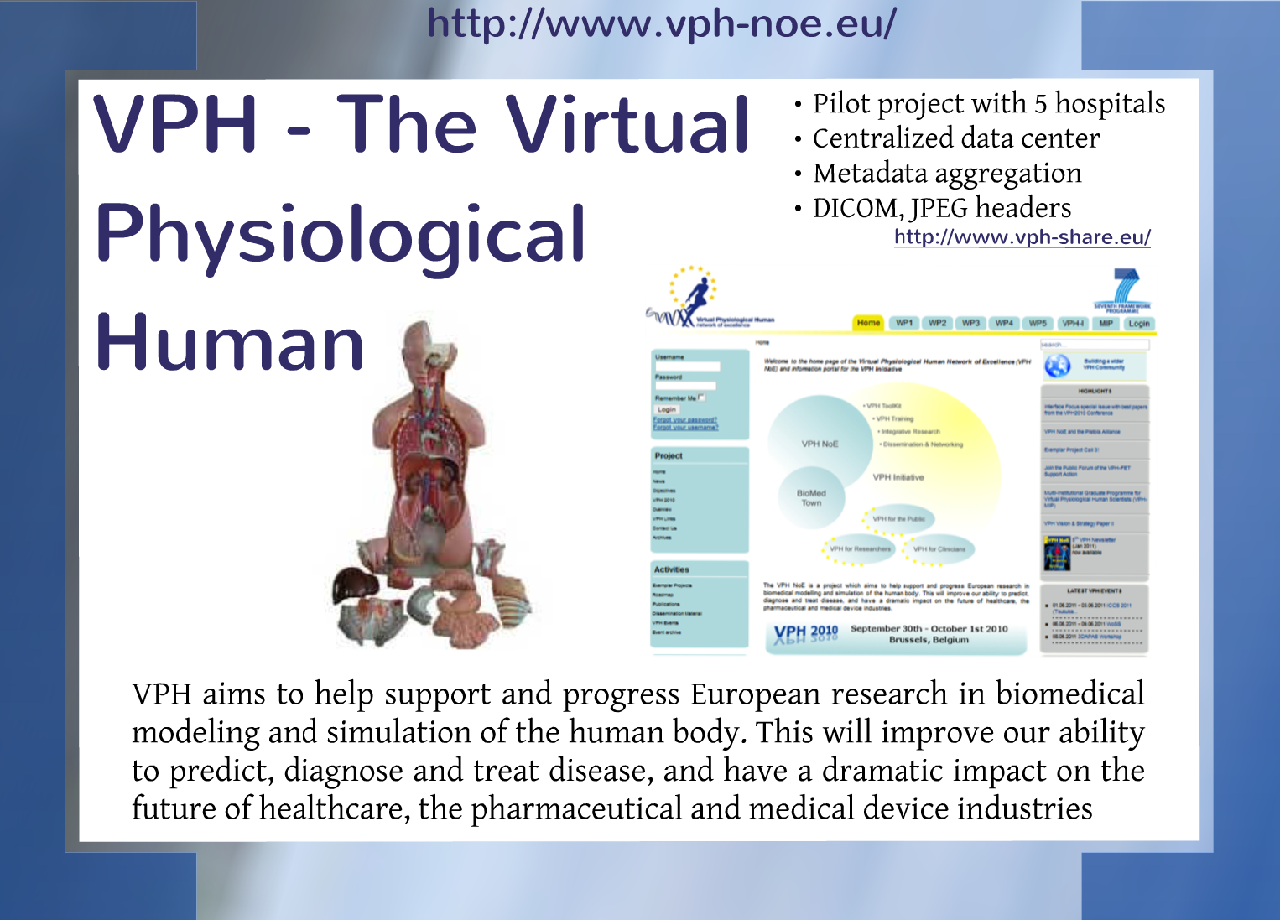

Slide 12


Slide 13
Communities
Capturing Community Requirements
How data is organised
What are the first wishes
(Community Interviews)
Technology Appraisal and Service building
What services can be built to match the requirements
(Service Taskforces)
Service Deployment and Operations
How to deploy services on the distributed infrastructure
(Operations team)
Notes:
Standardize storage service

Slide 14

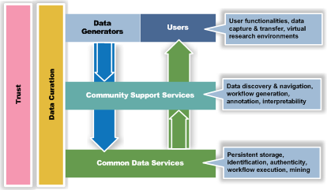
The collaboration concept

Slide 15





Communities and Data Centers
What are the
basic
requirements?
Which common
services are
needed?

Slide 16
Common services
Safe replication
    Enable communities to safely replicate data to selected data centers for storage and do this in a robust, reliable and highly available way.
Dynamic replication
    Enable communities to perform (HPC) computations on the replicated data.
Metadata
    Common metadata domain for all data stored by EUDAT data centers and a searchable catalogue covering all the data stored within EUDAT, allowing data searches.
HPC
Notes:
Safe replication, irods
Dynamic, gridftp, FTS

Slide 17
Common services, cont
Research data store
    Easy-to-use service that will enable researchers and scientists to upload, store and share data that are not part of the officially-managed data sets of the research communities
PID
    PID system that can be used within the communities and by EUDAT.
AAI
    Federated AAI
Notes:
Research data store: Invenio, figshare, beehub and MyExperiment.
PID: EPIC handle
AAI: Shibboleth, moonshot

Slide 18
Use cases
Research community:
  Provides services to research groups.
Research group:
  Active data is stored to research data store.
  Move ”finalized” data to storage service. PID will be automatically generated. Metadata is required. Data will be replicated to secondary site.
  When needed stored data will be copied to HPC environment for further analysis.
Other scientists (open data ?)
  Centralized metadata service helps to locate the data.

Slide 19
What are the Requirements?
6 service/use cases identified
Safe replication: Enable communities to safely replicate data to selected data centers for storage and do this in a robust, reliable and highly available way.
Dynamic replication: Enable communities to perform (HPC) computations on the replicated data.
Metadata: Create a common metadata domain for all data stored by EUDAT data centres and a searchable catalogue covering all the data stored within EUDAT, allowing data searches
Research data store: create an easy-to-use service that will enable researchers and scientists to upload, store and share data that are not part of the officially-managed data sets of the research communities
PID: a robust, highly available and effective PID system that can be used within the communities and by EUDAT.
AAI: A solution for a working AAI system in a federation scenario.

Slide 20
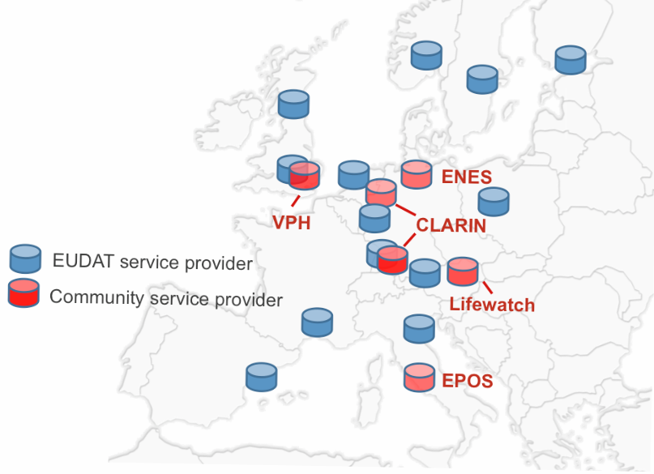
INFRASTRUCTURE

Slide 21

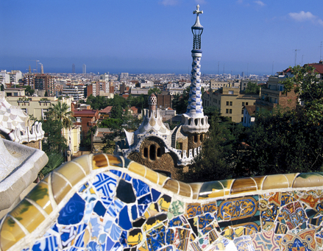
Welcome to the 1st EUDAT Conference!
22-24 October 2012, Barcelona
International event with keynotes from Europe and US
A forum to discuss the future of data infrastructures
Project presentations and poster sessions
Parallel session on Sustainability and Funding Models
Training tutorials

Slide 22
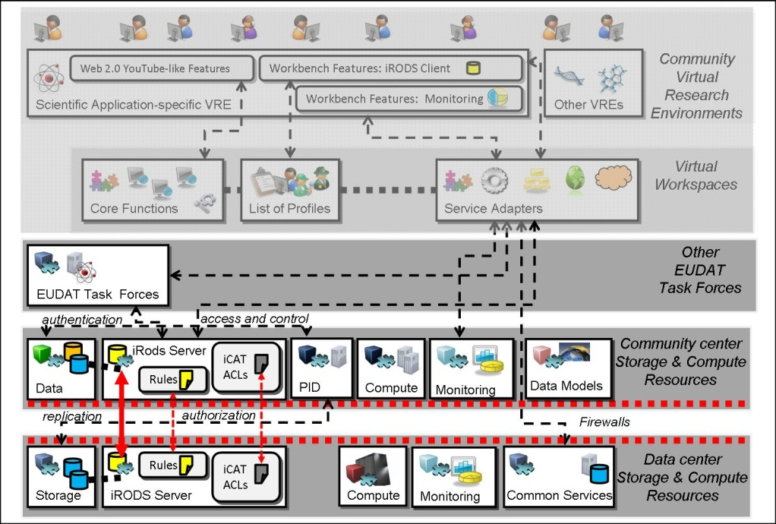

SAFE REPLICATION
Objective: Enable communities to easily replicate data to selected data centers for storage in a robust and reliable manner.
Key benefits: data bit stream preservation, more optimal data curation, better accessibility
Description: Data replication management based on users’ requirements and constraints; data replication solutions and services embedded into critical security policies, including firewall setups and user accounting procedures.
Technology: iRODS to be used as an initial replication middleware, implemented across the community centers and data centers; as more user communities join the task force, other storage technologies may be added, depending on user needs.
Production setup expected by 2013, such that users will be able to safely replicate data across different user community centres and data centres.
More info: eudat-safereplication@postit.csc.fi

Slide 23
DATA STAGING
Objective: Enable communities to perform (HPC) computations on the replicated data
Key benefits: Access to large computing facilities
Description: This service will allow the EUDAT communities to dynamically replicate subsets of their data stored in EUDAT to HPC machine workspaces for processing.
Differences with the safe replication scenario:
  replicated data are discarded when the analysis application ends;
  Persistent Identifier (PID) references are not applied to replicated data into HPC workspaces;
  Users initiate the process of replicating data while in the safe replication scenario data are replicated automatically on a policy basis.
Technologies: GridFTP, Griffin, gTransfer, FTS (under appraisal)
CINECA
EPOS
HPC
Facility
2
EUDAT
Storage
1
Community
Storage
3
PID
3
PRACE
SARA
HPC
Facility
2
4
HPC
Facility
EUDAT
Storage
More info: eudat-datastaging@postit.csc.fi

Slide 24
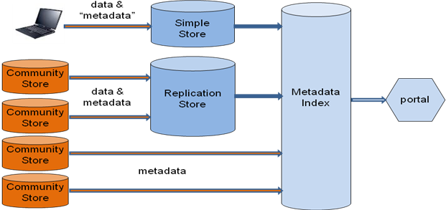
METADATA
Objective: Create a joint metadata domain for all data stored by EUDAT data centers and a catalogue which exposes the data stored within EUDAT, allowing data searches.
Key benefits: Advertising platform for data sets, metadata service for less mature communities
Description: EUDAT will handle metadata for more resources than just those deposited within the EUDAT CDI. In the initial phase we will target mainly resources contributed by the participating communities augmented with those of interested well-organized communities that are ready to contribute. Then, later, other interested communities can be approached depending on the respective community capabilities.
Technology: OAI-PMH and embeds domain specific metadata, as XML, within the OAI-PMH record
More info: eudat-metadata@postit.csc.fi
Notes:
Open data requires metadatacatalog.

Slide 25
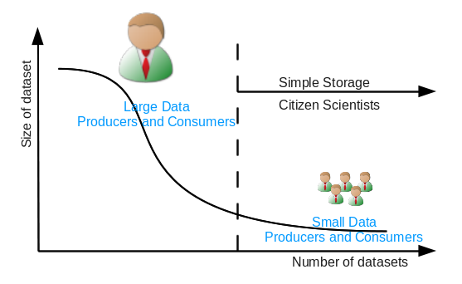
SIMPLE STORE
Objective: create an easy-to-use service that will enable researchers and scientists to upload, store and share data that are not part of the officially-managed data sets of the research communities.
Key benefits: Store, share, and retrieve smaller sets of data not officially handled.
Description: This service will address the long tail of "small" data, and the researchers/citizen scientists creating and manipulating it. Typically this type of data comes in a wide range of formats including text, spreadsheets, number series, audio and video files, photographs and other images. The Research Data Store is complementary to the other EUDAT services that manage the large volumes of official community data.
Technologies: Invenio, figshare, beehub and MyExperiment.
More info: eudat-simplestore@postit.csc.fi

Slide 26
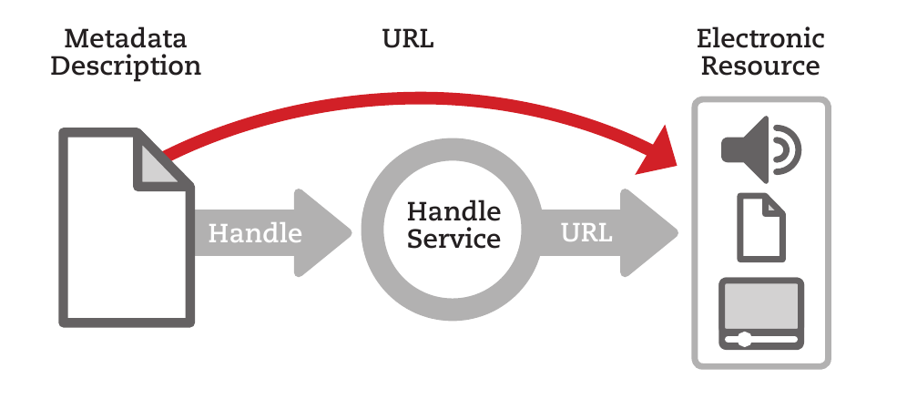
PID
Objective: Deploy a robust, highly available and effective PID service that can be used within the communities and by EUDAT.
Description: Keeping track of the “names” of data sets or other digital artefacts deposited with the CDI requires more robust mechanisms than “noting down the filename”. The PID service will be required by many other CDI services, from Data Movement to Search and Query.
Technologies: Currently considering use of both EPIC for data objects, and DataCite to register DOIs (Digital Object Identifiers for published collections.
More info: eudat-persistentidentifiers@postit.csc.fi

Slide 27
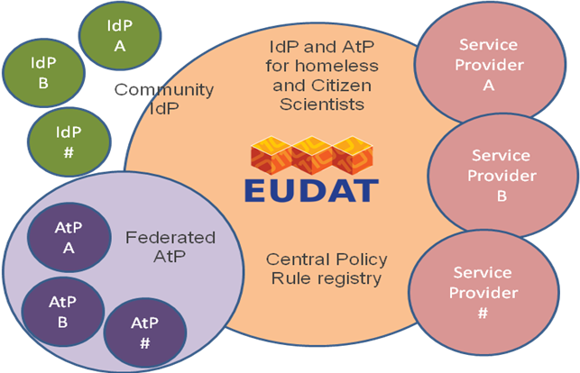
AAI@EUDAT
Objective: Provide a solution for a working AAI system in a federated scenario.
Description: Design the AA infrastructure to be used during the EUDAT project and beyond.
Key tasks:
Leveraging existing identification systems within communities and/or data centers
Establishing a network of trust among the AA actors: Identifty Providers (IdPs), Service Providers (SPs), Attribute Authorities and Federations
Attribute harmonization
Technologies: Oauth2, OpenID, RADIUS, SAML2, X.509, XACML, etc.
More info: eudat-AAI@postit.csc.fi

Slide 28
How Requirements are Shared?
Service | SR | DR | MD | SS | PID | AAI
Community
CLARIN | X | + | X | X | + | X
ENES | X | X | X |  | + | X
EPOS | X | X |  |  | X | X
VPH | X | X |  |  | X | X
LifeWatch | X | + | X | + | + | X
NB: “X”= this service is relevant to this community, “+“ = this community has interest in this service but at a later stage or has a similar service already running in production.

Slide 29
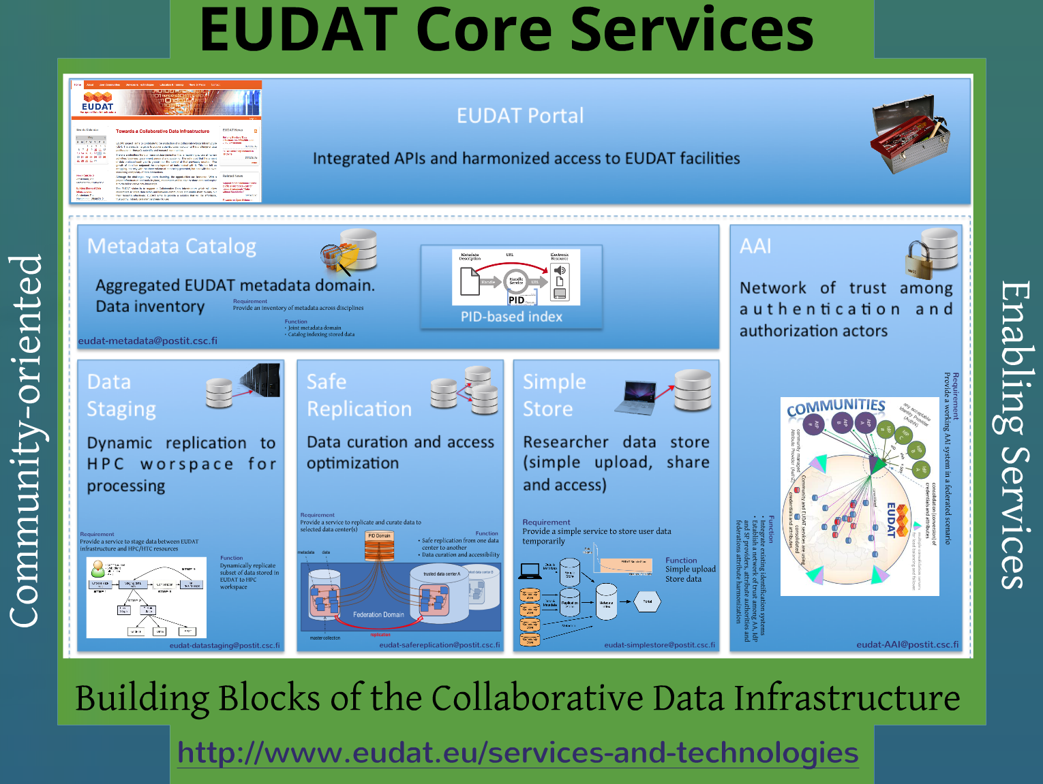
Dynamic replication to HPC workspace for processing

Slide 30

eudat-info@postit.csc.fi
Thank you
Ari Lukkarinen
E-mail: ari.lukkarinen@csc.fi

Slide 31
Thank you
Ari Lukkarinen
E-mail: ari.lukkarinen@csc.fi

Slide 32
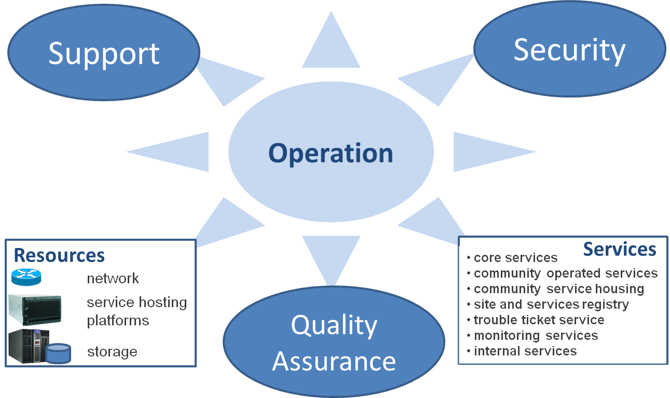
OPERATION TEAM

Slide 33









Communities and Data Centers
What are the
basic
requirements?
Which common
services are
needed?

Slide 34

How Do We Sustain This?
Organisational Model
  How do we move for a project collaboration to a federated infrastructure?
  Which are the actors of this infrastructure and what is/are their role(s)?
  How do we integrate new members?
  How will the infrastructure interact with other infrastructures and projects?
Costs and Funding Models
  Who will pay for the infrastructure and the shared services?
  What are the costs of the services?
  How to define a business model that best support the interest of research communities, data centers and funders?
What role for Knowledge Exchange?

Slide 35
Welcome to the 1st EUDAT Conference!
22-24 October 2012, Barcelona
International event with keynotes from Europe and US
A forum to discuss the future of data infrastructures
Project presentations and poster sessions
Parallel session on Sustainability and Funding Models
Training tutorials

Slide 36
eudat-info@postit.csc.fi

