Slide 1
ARCOMEM From Collect-All ARchives to COmmunity MEMories
Thomas Risse
L3S Research Center

Slide 2
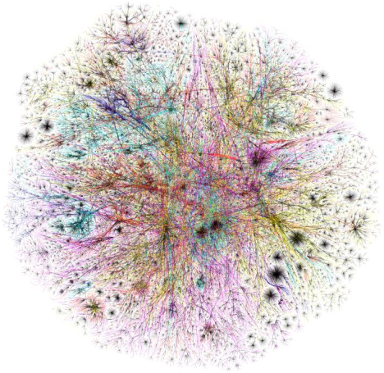
The Web is Changing and Forgetting
The Web is a quickly changing, ever growing information space [1]
It’s growing by >8% per week
After 1 year only 40% of the pages are still accessible while 60% of the pages are new
A Web Archive as a Collective Memory is a cultural necessity for the future
But „Archive and Store Everything“ is not a practical approach
[1] A. Ntoulas, J. Cho, and C. Olston. What's new on the web?: the evolution of the web from a search engine perspective. In Proceedings of the 13th international conference on World Wide Web (WWW '04)

Slide 3
The ARCOMEM Aim & Approach
Aim of the ARCOMEM project
Transforming digital archives into community memories
More than an archive
Valuable Content
Easily accessible by future generations
ARCOMEM Approach
Make use of the Social Web
Huge source of user generated content
Wide range of articulation methods
Represents the diversity of opinions of the public
Reflection on
topics, events, etc.
Related Web pages
→ A semantic-aware and socially-driven preservation model is a natural way to go

Slide 4
ARCOMEM Way of Crawling
Social & Semantic Information
6
Entities, Events
Europe, Greece, Germany, Sarkozy, Merkel, Papandreou, ...
Media Categories
Microblogs, Social Networks, …
Reference Seedlist
http://www.economist.com/node/21534849
http://www.ekathimerini.com/ekathi/comment
http://www.bbc.co.uk/news/world-europe-15589568
Seedlist
http://www.bbc.co.uk/search/news/?q=Greek%20crisis
http://www.guardian.co.uk/business/blog
http://www.kathimerini.gr/
http://twitter.com/#!/EU_Commission
....
1
Analysis
Enrichment
5
Content Analysis
Guidance
2
Web Crawler
e.g. Heritrix, HTTrack, ARCOMEM
4
Storage
Live Storage
Content + Meta
Crawling
3
Selection
7
Archive

Slide 5
?
Thank You!
ARCOMEM Homepage
http://www.arcomem.eu/
Dr. Thomas Risse Forschungszentrum L3S Appelstrasse 9a 30167 Hannover | E-Mail: risse@L3S.de Telefon: 0511 – 762 17764 Telefax: 0511 – 762 17779

